Slide 1


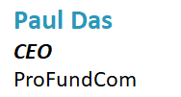
Navigating Microsoft's New High-Volume Email Regulations:
Ensuring Your Fund Emails Reach Investors


Slide 2
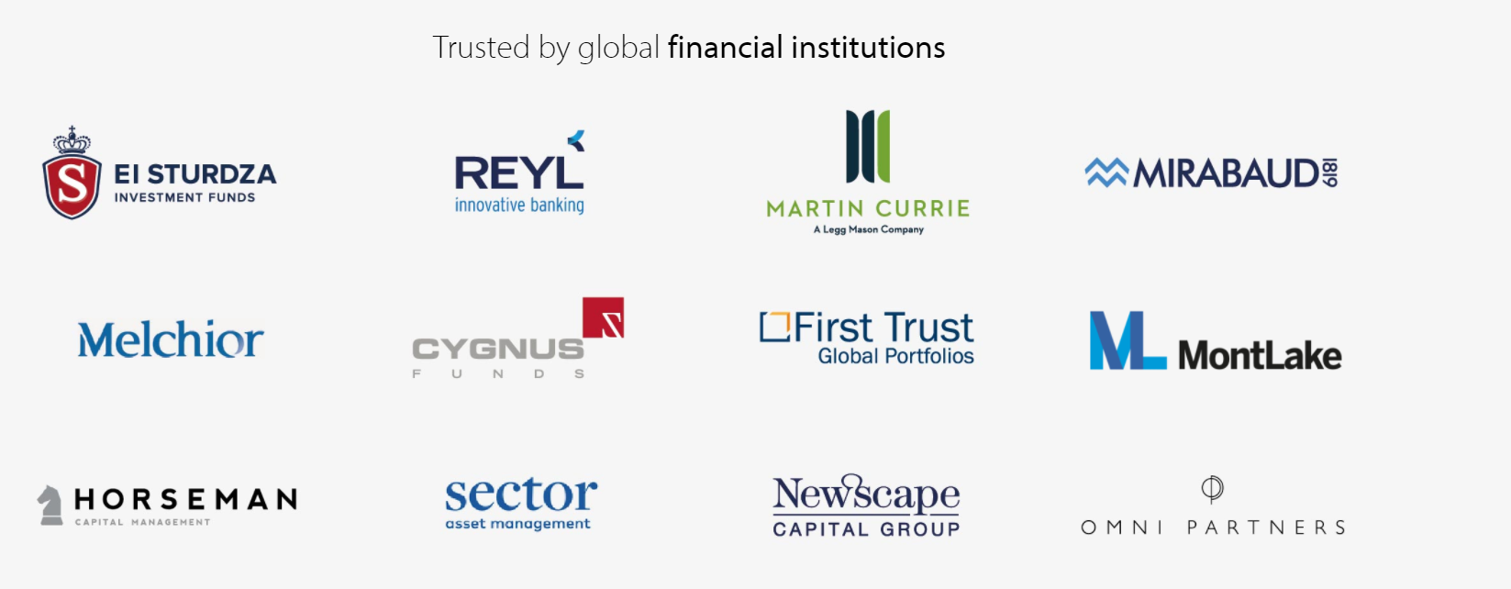
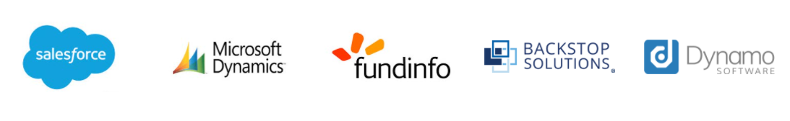
ProFundCom
Using Marketing Automation to Raise AuM
For the last 20 years we have helped fund managers raise assets using marketing automation

Slide 3
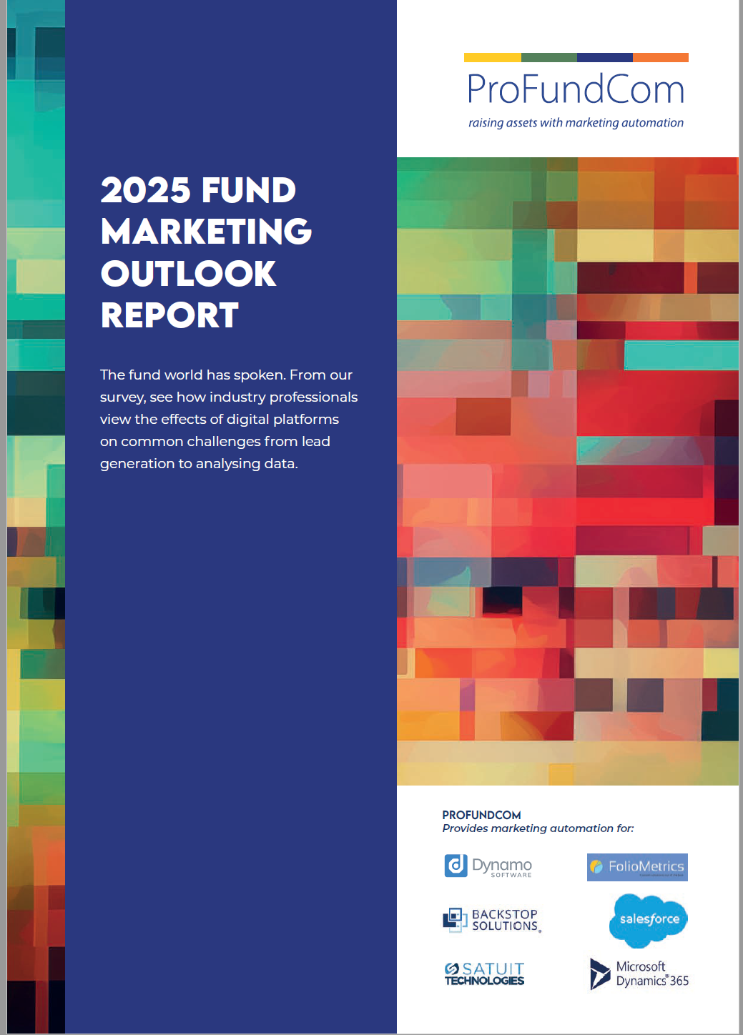
ProFundCom
Using Marketing Automation to Raise AuM
For the last 20 years we have helped fund managers raise assets using marketing automation

Slide 4
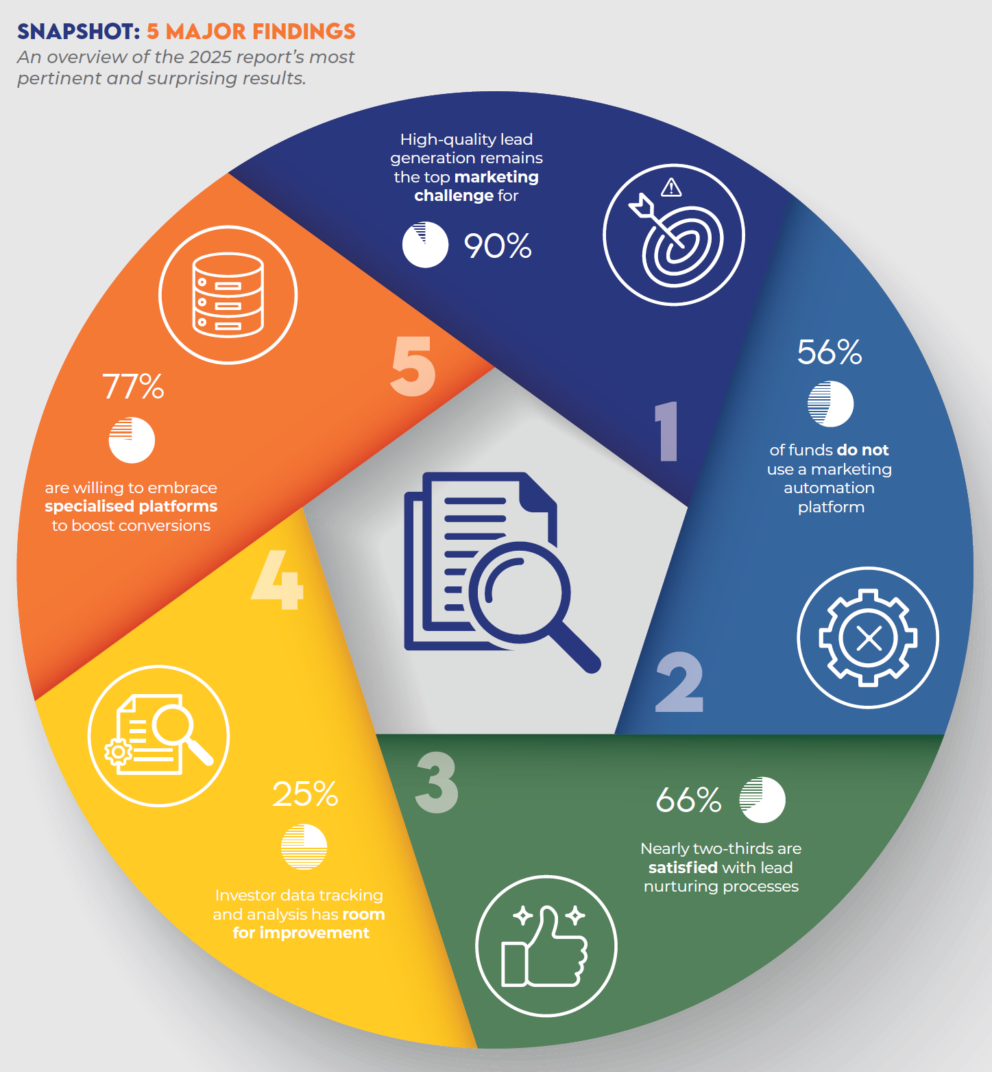
ProFundCom
Using Marketing Automation to Raise AuM
For the last 20 years we have helped fund managers raise assets using marketing automation

Slide 5
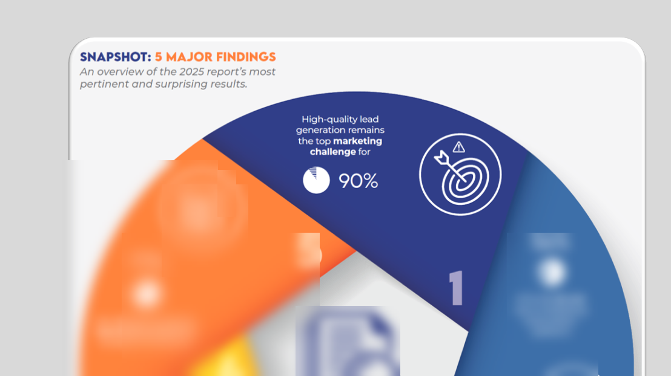
ProFundCom
Using Marketing Automation to Raise AuM
For the last 20 years we have helped fund managers raise assets using marketing automation

Slide 6
Why Has Microsoft Done This
Example Impact Scenario
Microsoft has done this to clean up the global email ecosystem — but the way they’ve done it is punishing legitimate senders like funds and investor-relations teams who behave “technically” like spammers (high volume, repetitive content, lots of external recipients).
The Real Goal: Stop Spam, Phishing & Brand Spoofing – only 10% is real traffic
Protecting Microsoft 365 Infrastructure from Abuse
Enforcing Global Email Authentication Standards (SPF, DKIM, DMARC)
Reducing “Noisy” and Low-Engagement Mail
Moving Bulk Email Out of Exchange Online – only for business 1-2-1 emails

Slide 7
Navigating Microsoft's New High-Volume Email Regulations
Ensuring Your Fund Emails Reach Investors
1
What Has Changed
01
2
02
How Does Is Affect Fund Marketing Teams
3
How To Fix It
03

Slide 8
Navigating Microsoft's New High-Volume Email Regulations
Ensuring Your Fund Emails Reach Investors
1
What Has Changed
01
2
02
How Does Is Affect Fund Marketing Teams
3
How To Fix It
03

Slide 9
New Authentication & Hygiene Requirements
High-Volume Senders
Microsoft is enforcing stricter sender domain authentication for domains sending 5,000+ emails/day.
The required stack: SPF must pass and list authorized IPs/hosts. DKIM signatures must pass. DMARC must at least be published (p=none) and aligned with SPF or DKIM.
Non-compliant messages will be filtered to Junk, and Microsoft plans to progress to outright rejection for those senders.
Beyond authentication, Microsoft emphasises: valid From/Reply-To addresses, clear unsubscribe links, good list hygiene (remove bounces/inactives) and transparent mailing practices.

Slide 10
Tenant-Level External Recipient Rate Limit (TERRL)
High-Volume Senders
Microsoft has introduced a tenant-wide cap on how many external recipients can be emailed in a rolling 24-hour window (not just per-user) when using regular mailboxes.
Started April 2025 (for smaller-licence tenants) and by early May 2025 for all tenants.
This applies except for messages sent via the HVE or via other specialised services (so those are excluded) but affects automated notifications, marketing sends, etc.

Slide 11
Changes to the HVE (“High Volume Email”) Feature Itself
The HVE service is under review and being repositioned
Microsoft now intends HVE to be for internal-tenant usage only (i.e., sending to recipients within your organisation) from June 2025 onward. External-recipient capability is being removed for HVE.
Basic authentication (legacy SMTP Auth) support for HVE is extended until ~September 2028 (giving a transitional window) but Microsoft increasingly encourages modern auth (OAuth) and will disable basic auth for other SMTP/regular mailboxes earlier.
Message size and some capabilities may differ

Slide 12
Implications for Devices/Apps and Basic Auth
High-Volume Senders
Microsoft is phasing out legacy authentication (Basic/SMTP Auth) for many services. For devices/apps that currently rely on SMTP Auth, this is a major shift.
If you have applications/devices that rely on legacy auth and send email externally, you’ll need to plan migration (either new endpoint, modern auth, or switch to a specialist service).

Slide 13
Navigating Microsoft's New High-Volume Email Regulations
Ensuring Your Fund Emails Reach Investors
1
What Has Changed
01
2
02
How Does Is Affect Fund Marketing Teams
3
How To Fix It
03

Slide 14
Navigating Microsoft's New High-Volume Email Regulations
Ensuring Your Fund Emails Reach Investors
1
What Has Changed
01
2
02
How Does Is Affect Fund Marketing Teams
3
How To Fix It
03

Slide 15
How Does Is Affect Fund Marketing Teams
Funds Look Like “High-Volume Senders”
Microsoft classifies any domain that sends 5,000+ messages/day (across all recipients) as a high-volume sender.
    That easily includes fund updates, investor newsletters, and research blasts — especially if a manager uses a CRM, Mailchimp, HubSpot, or even Outlook/Exchange distribution lists.
    Once in that category, you must pass SPF, DKIM, and DMARC authentication.If any of these fail (or alignment isn’t strict enough), your messages go straight to Junk or are silently dropped — no NDR (non-delivery report).
    Microsoft has introduced a tenant-wide cap on how many external recipients can be emailed in a rolling 24-hour window (not just per-user) when using regular mailboxes.

Slide 16
How Does Is Affect Fund Marketing Teams
“Bulk-Like” Behaviour Patterns
Microsoft’s AI-based reputation scoring now downgrades senders that show
Identical subject lines/content sent en masse
Sudden spikes in outbound volume
No clear unsubscribe links
Poor open/click engagement
High bounce/complaint rates (even small percentages can hurt)
Funds are particularly exposed because:
  Investor lists are small but repetitive — same addresses week after week.
  Legacy CRM systems (e.g. Salesforce, Dynamo, Satuit) often use relay methods that don’t sign DKIM.

Slide 17
How Does Is Affect Fund Marketing Teams
Example Impact Scenario
A hedge fund sends its quarterly commentary to 8,000 investors via its CRM relay through Microsoft 365.
SPF lists CRM domain, not relay IP → fail
DKIM not aligned → fail
DMARC missing → fail
TERRL cap hit → throttled
Microsoft sees >5k/day with low open rates → marked “bulk spam”
Outcome: 60% of recipients never see the email (junk or dropped).

Slide 18
Navigating Microsoft's New High-Volume Email Regulations
Ensuring Your Fund Emails Reach Investors
1
What Has Changed
01
2
02
How Does Is Affect Fund Marketing Teams
3
How To Fix It
03

Slide 19
Navigating Microsoft's New High-Volume Email Regulations
Ensuring Your Fund Emails Reach Investors
1
What Has Changed
01
2
02
How Does Is Affect Fund Marketing Teams
3
How To Fix It
03

Slide 20
How To Fix It
Example Impact Scenario
Area | Fix
Authentication | SPF: add all sending servers DKIM: enable signing for your domain DMARC: publish record (start with p=none)
Alignment | Make sure From: domain matches SPF/DKIM domains (no mismatched sub-domains)
Infrastructure | Use a dedicated, authenticated send channel (like ProFundCom) that’s fully compliant
Unsubscribes & Engagement | Always include one-click unsubscribe; prune inactive recipients quarterly
List Hygiene | Remove hard/soft bounces, outdated institutional contacts
Rate Management | Stagger large sends; keep under TERRL caps; avoid blasting all investors simultaneously
Reputation Monitoring | Use DMARC reports + postmaster tools (MXToolbox) to track domain/IP health

Slide 21
Navigating Microsoft's New High-Volume Email Regulations
Ensuring Your Fund Emails Reach Investors
1
What Has Changed
01
2
02
How Does Is Affect Fund Marketing Teams
3
How To Fix It
03

Slide 22
Navigating Microsoft's New High-Volume Email Regulations
Ensuring Your Fund Emails Reach Investors
1
What Has Changed
01
2
02
How Does Is Affect Fund Marketing Teams
3
How To Fix It
03

Slide 23
Navigating Microsoft's New High-Volume Email Regulations:
Ensuring Your Fund Emails Reach Investors


