Slide 1

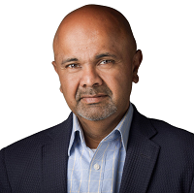
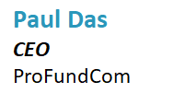
5 Quick Wins for Fund Marketers in 2023


Slide 2
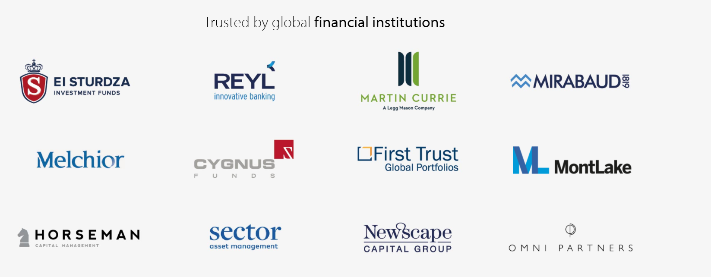

ProFundCom
Using Marketing Automation to Raise AuM
For the last 20 years we have helped fund managers raise assets as well as be alerted to redemption risks using marketing automation

Slide 3
5 Quick Wins for Fund Marketers in 2023
Do or Don’t – There Is No Try
1
Campaign analytics – what’s working and what’s not?
01
2
02
Aggregating – email, website, social, Zoom, investor portals
3
03
How to deliver insights that matter to the sales team
4
04
Integrations – easy actions for maximum impact
5
Marketing automation techniques to make you more efficient
05

Slide 4
5 Quick Wins for Fund Marketers in 2023
Do or Don’t – There Is No Try
1
Campaign analytics – what’s working and what’s not?
01
2
02
Aggregating – email, website, social, Zoom, investor portals
3
03
How to deliver insights that matter to the sales team
4
04
Integrations – easy actions for maximum impact
5
Marketing automation techniques to make you more efficient
05

Slide 5
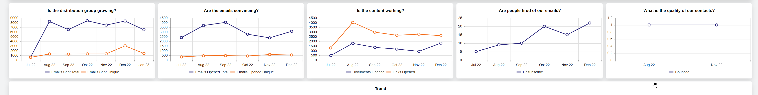
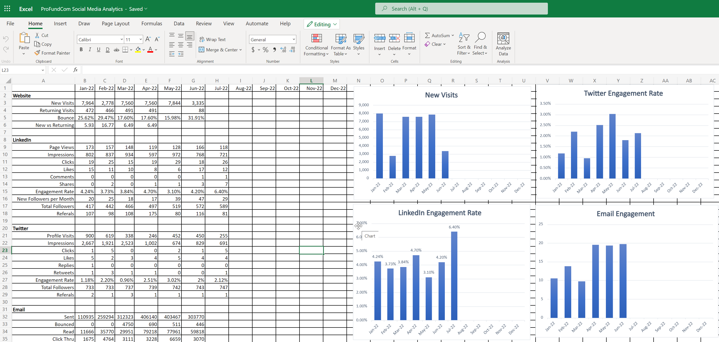
Remove Noise From Campaigns
Get a Broadview Across All Channels

Slide 6
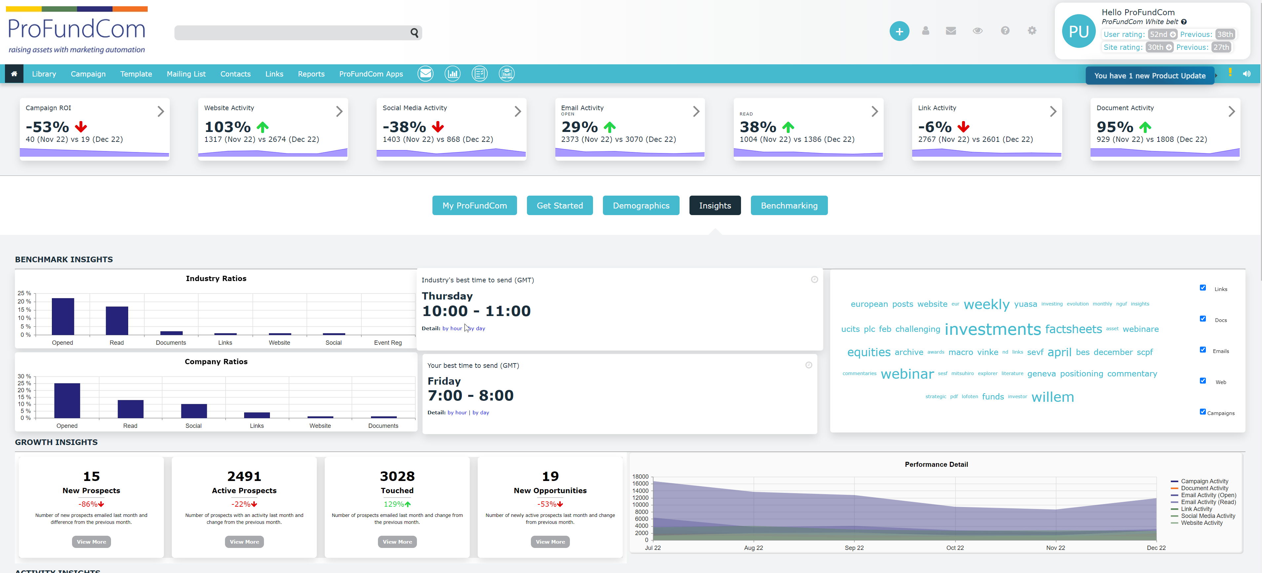
Remove Noise From Campaigns
Get a Broadview Across All Channels

Slide 7
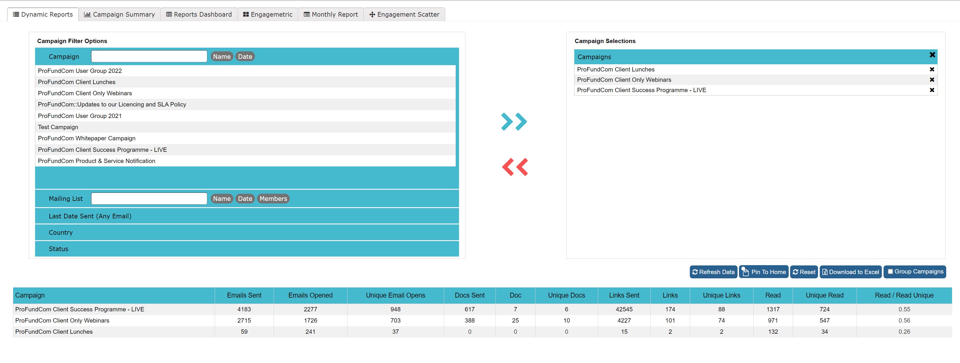
Remove Noise From Campaigns
Get a Broadview Across All Channels

Slide 8
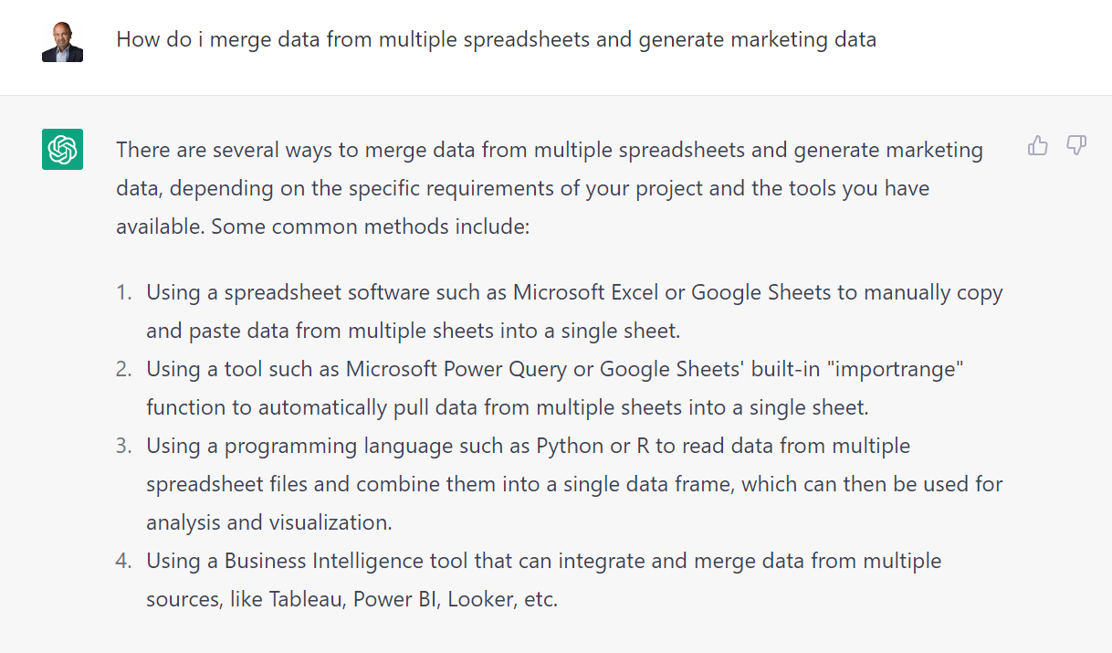
Remove Noise From Campaigns
Get a Broadview Across All Channels

Slide 9
5 Quick Wins for Fund Marketers in 2023
Do or Don’t – There Is No Try
1
Campaign analytics – what’s working and what’s not?
01
2
02
Aggregating – email, website, social, Zoom, investor portals
3
03
How to deliver insights that matter to the sales team
4
04
Integrations – easy actions for maximum impact
5
Marketing automation techniques to make you more efficient
05

Slide 10
5 Quick Wins for Fund Marketers in 2023
Do or Don’t – There Is No Try
1
Campaign analytics – what’s working and what’s not?
01
2
02
Aggregating – email, website, social, Zoom, investor portals
3
03
How to deliver insights that matter to the sales team
4
04
Integrations – easy actions for maximum impact
5
Marketing automation techniques to make you more efficient
05

Slide 11

Aggregating Multiple Channels
Get a Broadview Across All Channels At The User Level
EMAIL
WEBSITE
SOCIAL
WEBINARS / EVENTS
INVESTOR PORTAL

Slide 12
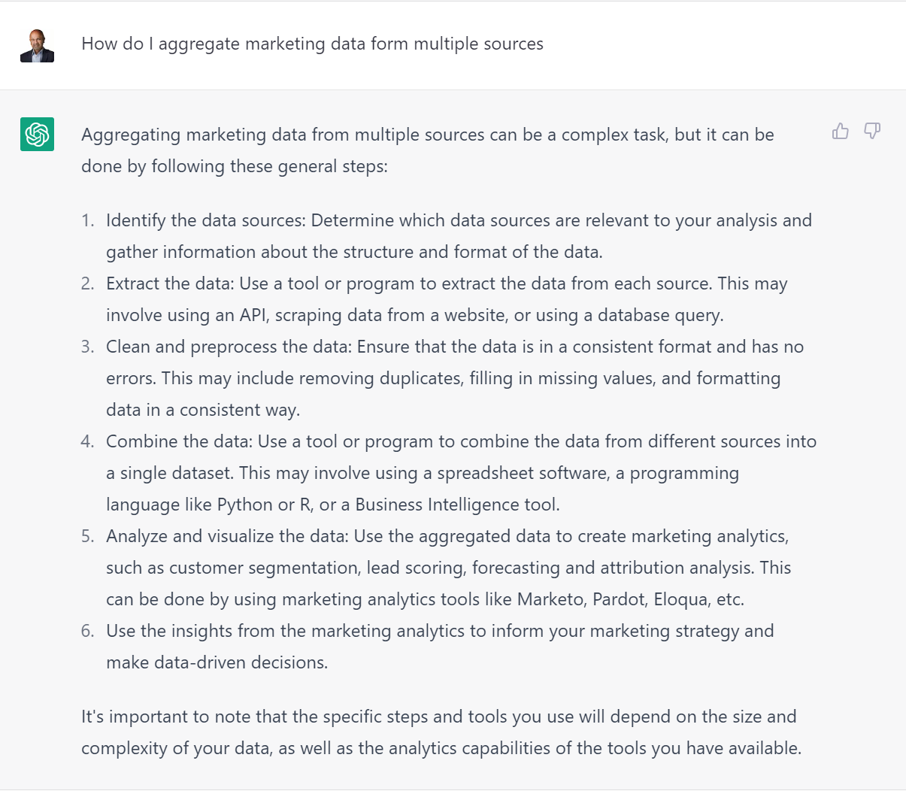
Aggregating Multiple Channels
Get a Broadview Across All Channels At The User Level

Slide 13

Aggregating Multiple Channels
Get a Broadview Across All Channels At The User Level

Slide 14
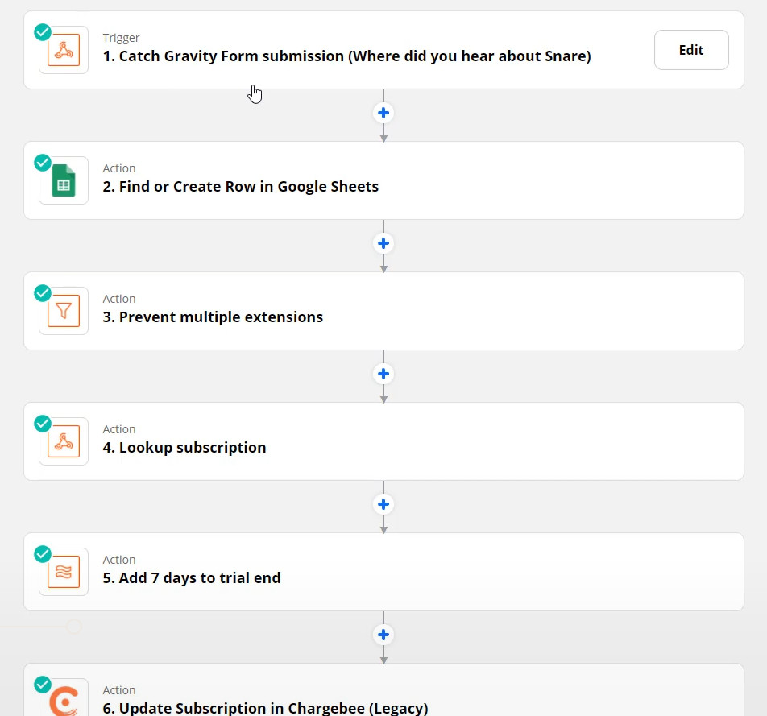
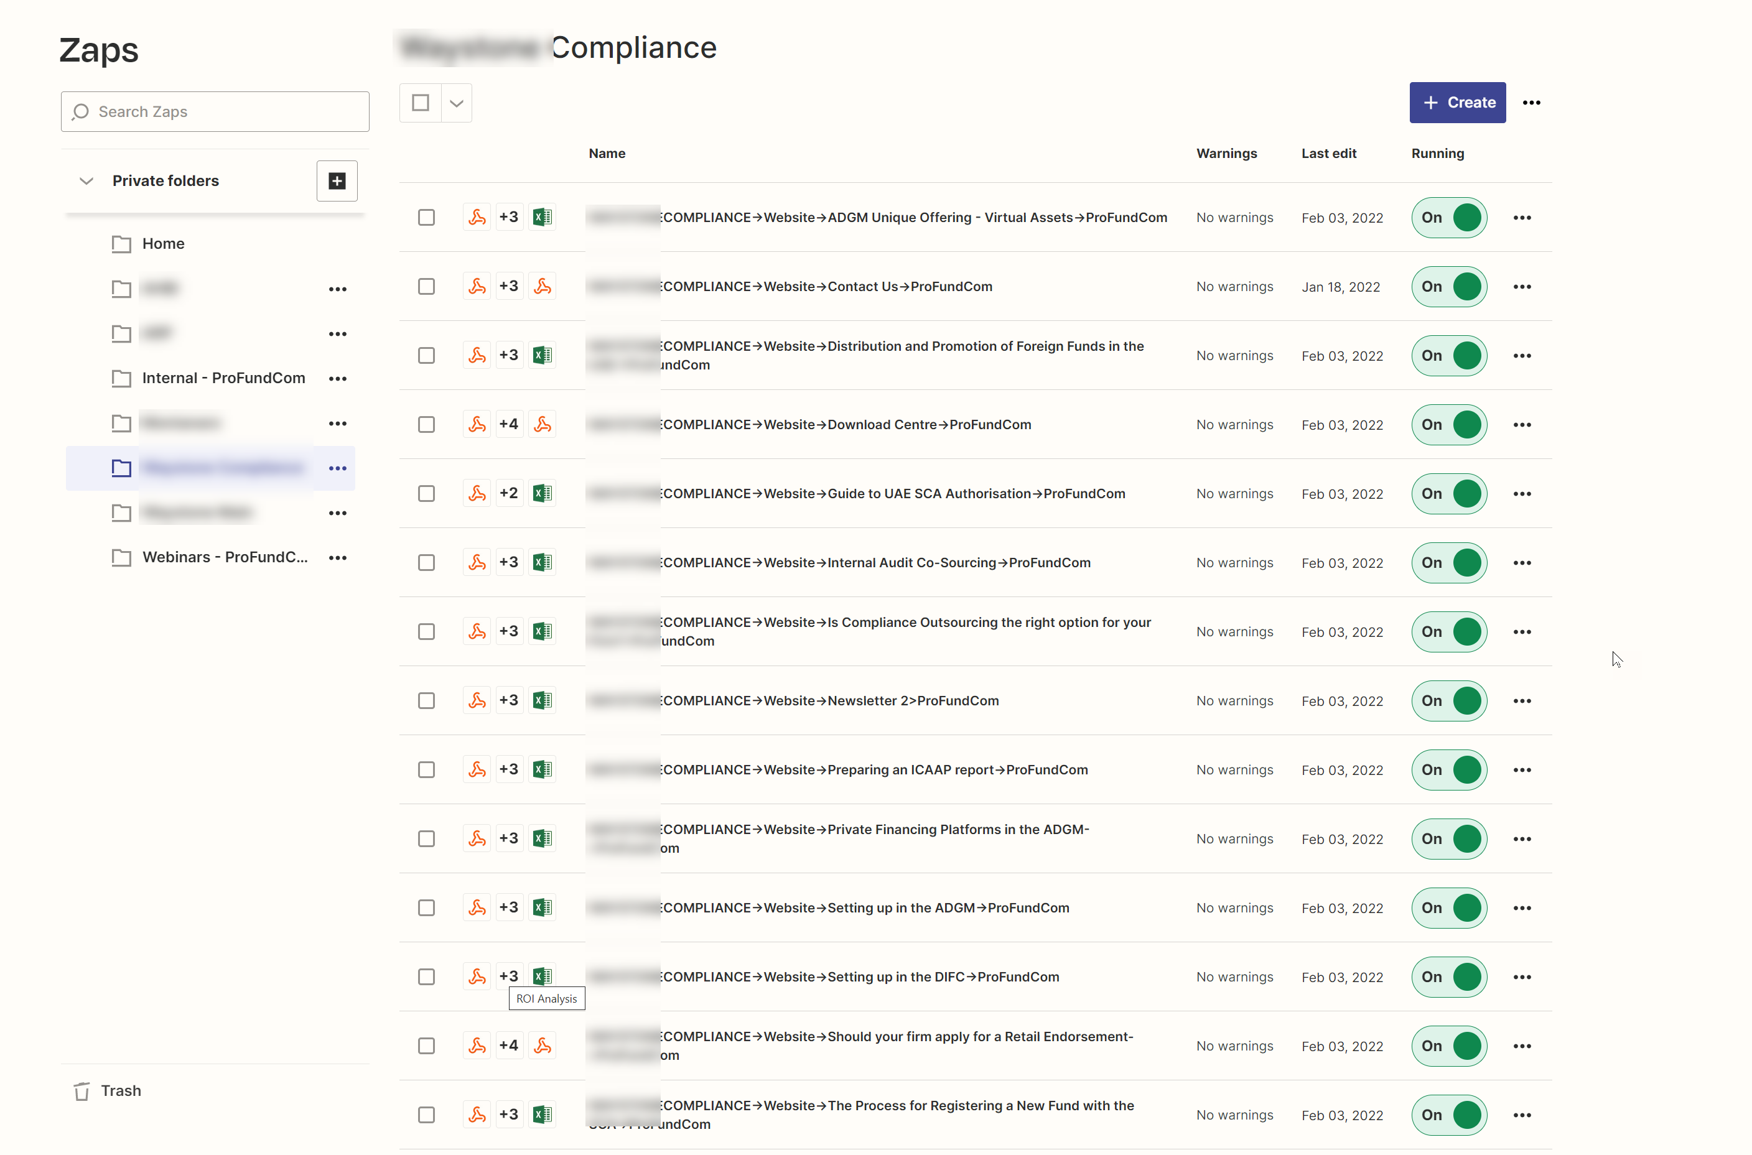
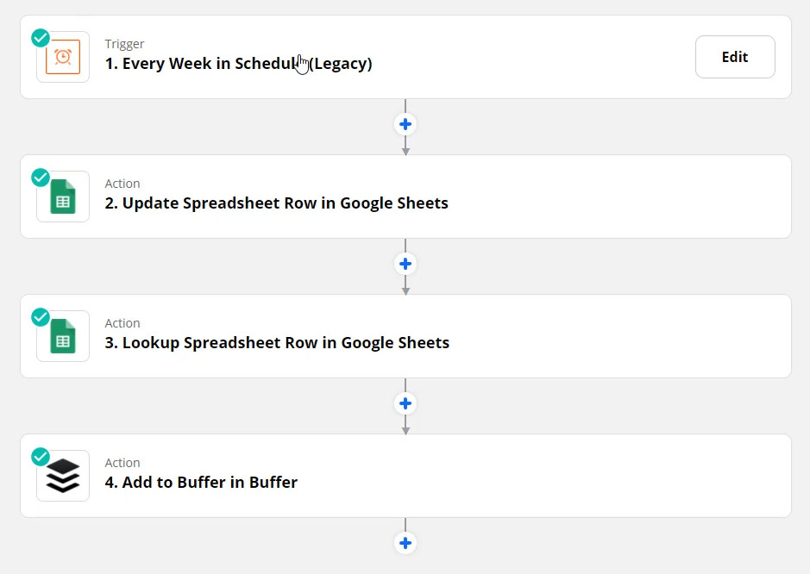
Aggregating Multiple Channels
Get a Broadview Across All Channels At The User Level

Slide 15
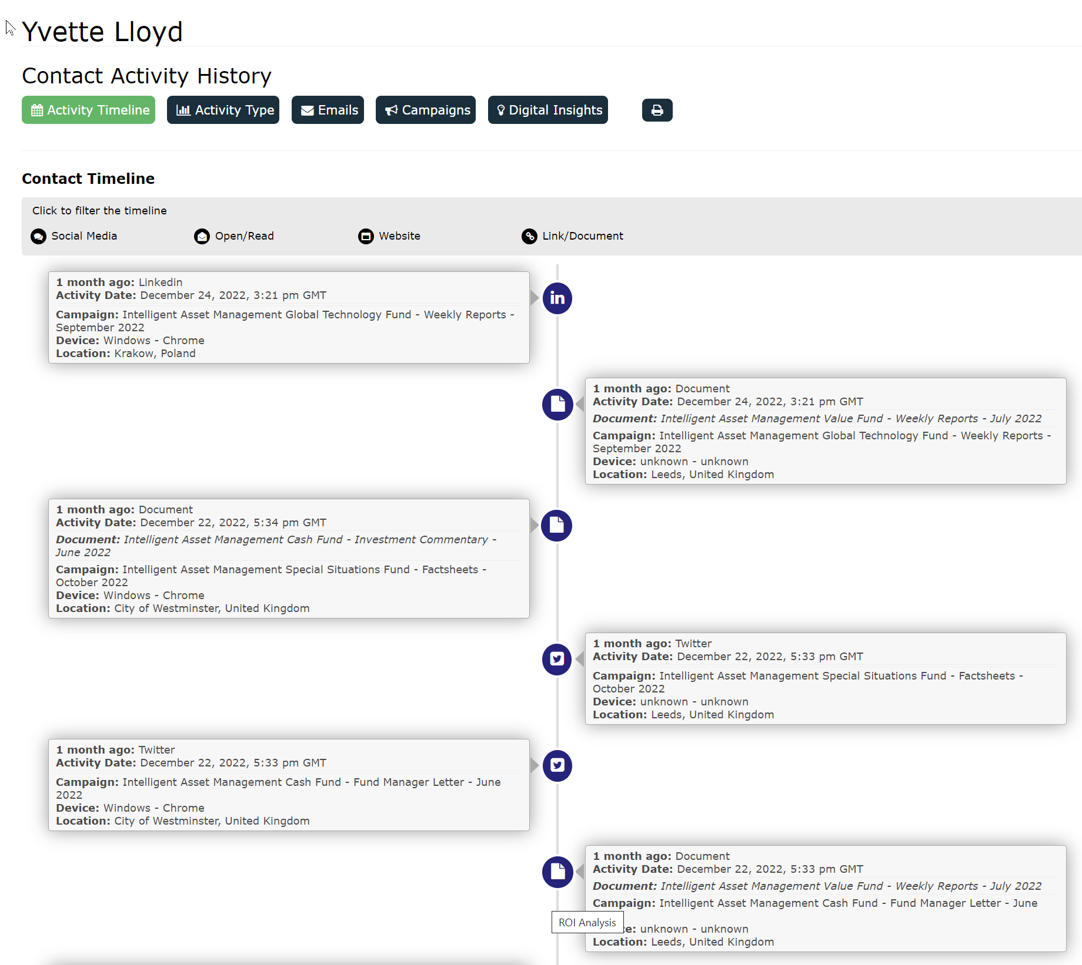
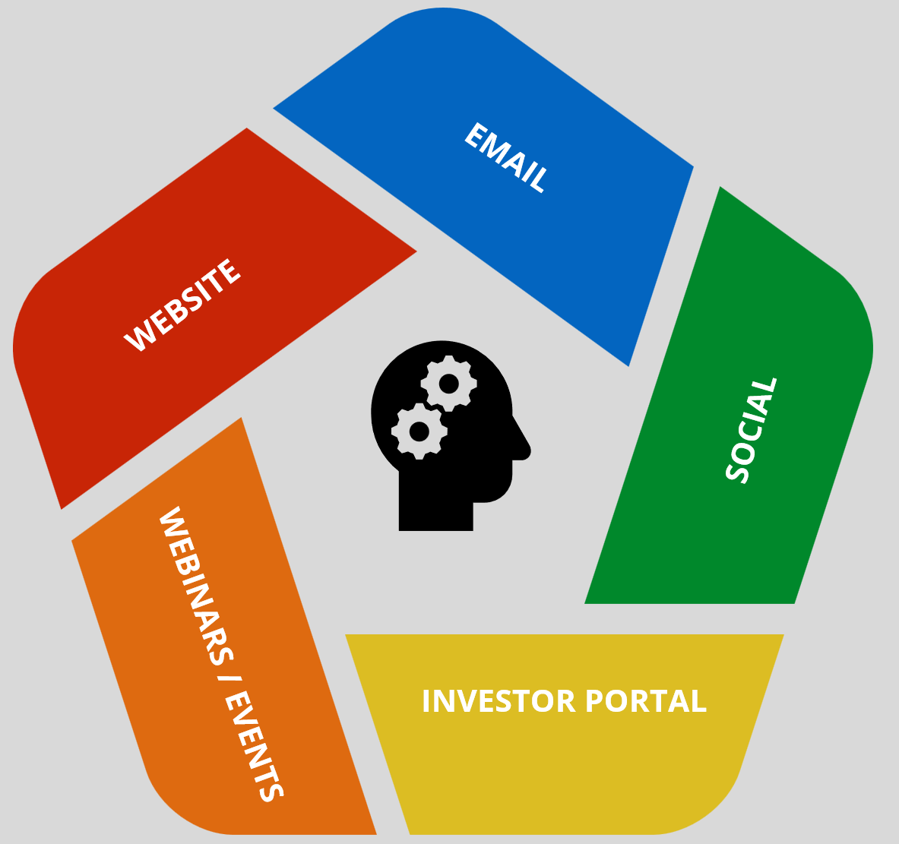
Aggregating Multiple Channels
Get a Broadview Across All Channels At The User Level

Slide 16
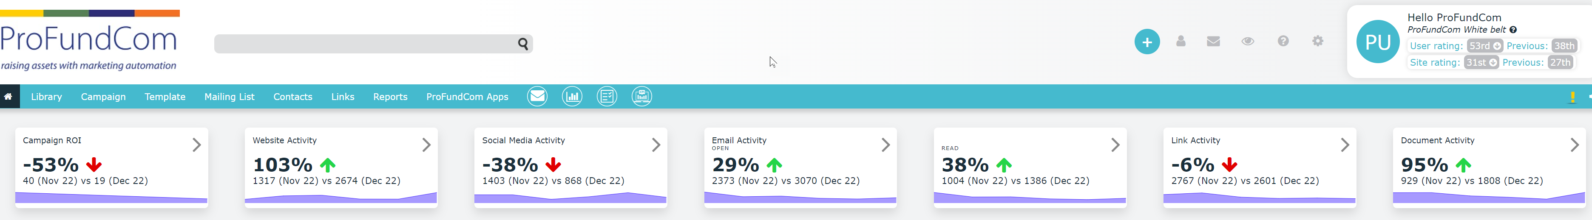
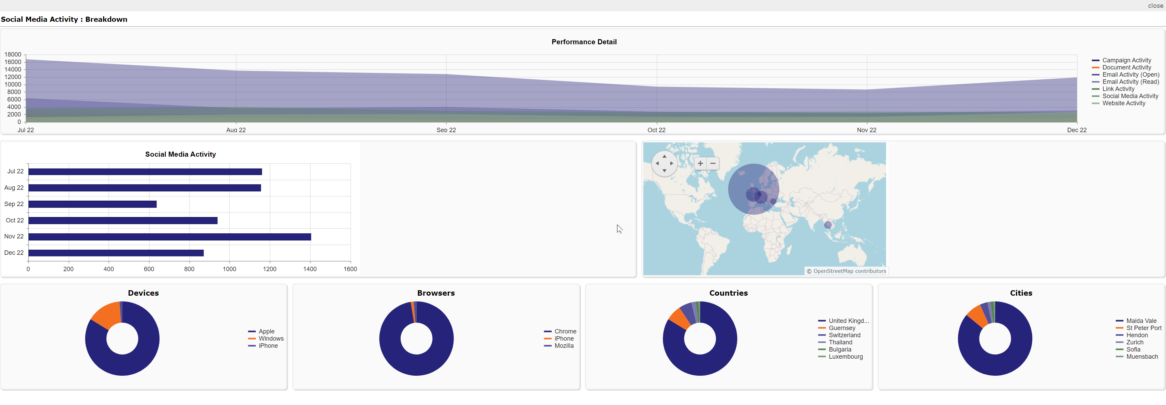
Aggregating Multiple Channels
Get a Broadview Across All Channels At The Company Level

Slide 17
5 Quick Wins for Fund Marketers in 2023
Do or Don’t – There Is No Try
1
Campaign analytics – what’s working and what’s not?
01
2
02
Aggregating – email, website, social, Zoom, investor portals
3
03
How to deliver insights that matter to the sales team
4
04
Integrations – easy actions for maximum impact
5
Marketing automation techniques to make you more efficient
05

Slide 18
5 Quick Wins for Fund Marketers in 2023
Do or Don’t – There Is No Try
1
Campaign analytics – what’s working and what’s not?
01
2
02
Aggregating – email, website, social, Zoom, investor portals
3
03
How to deliver insights that matter to the sales team
4
04
Integrations – easy actions for maximum impact
5
Marketing automation techniques to make you more efficient
05

Slide 19
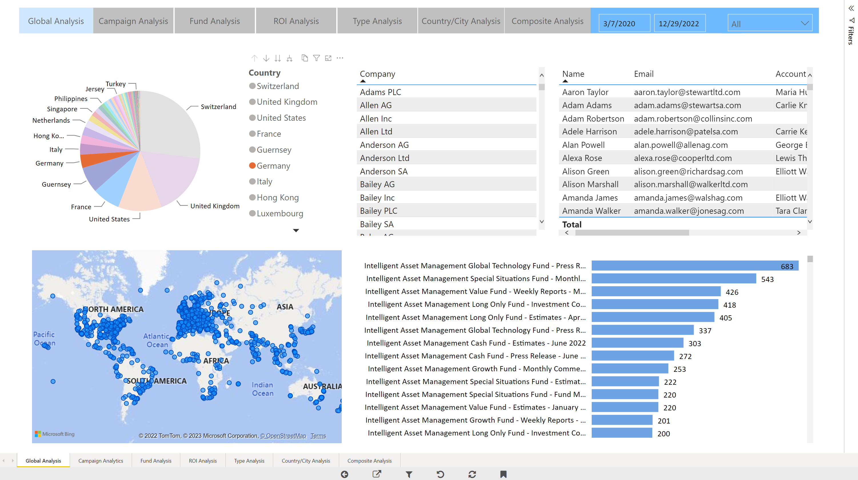
Deliver Insights To The Sales Team
Actionable Insights

Slide 20
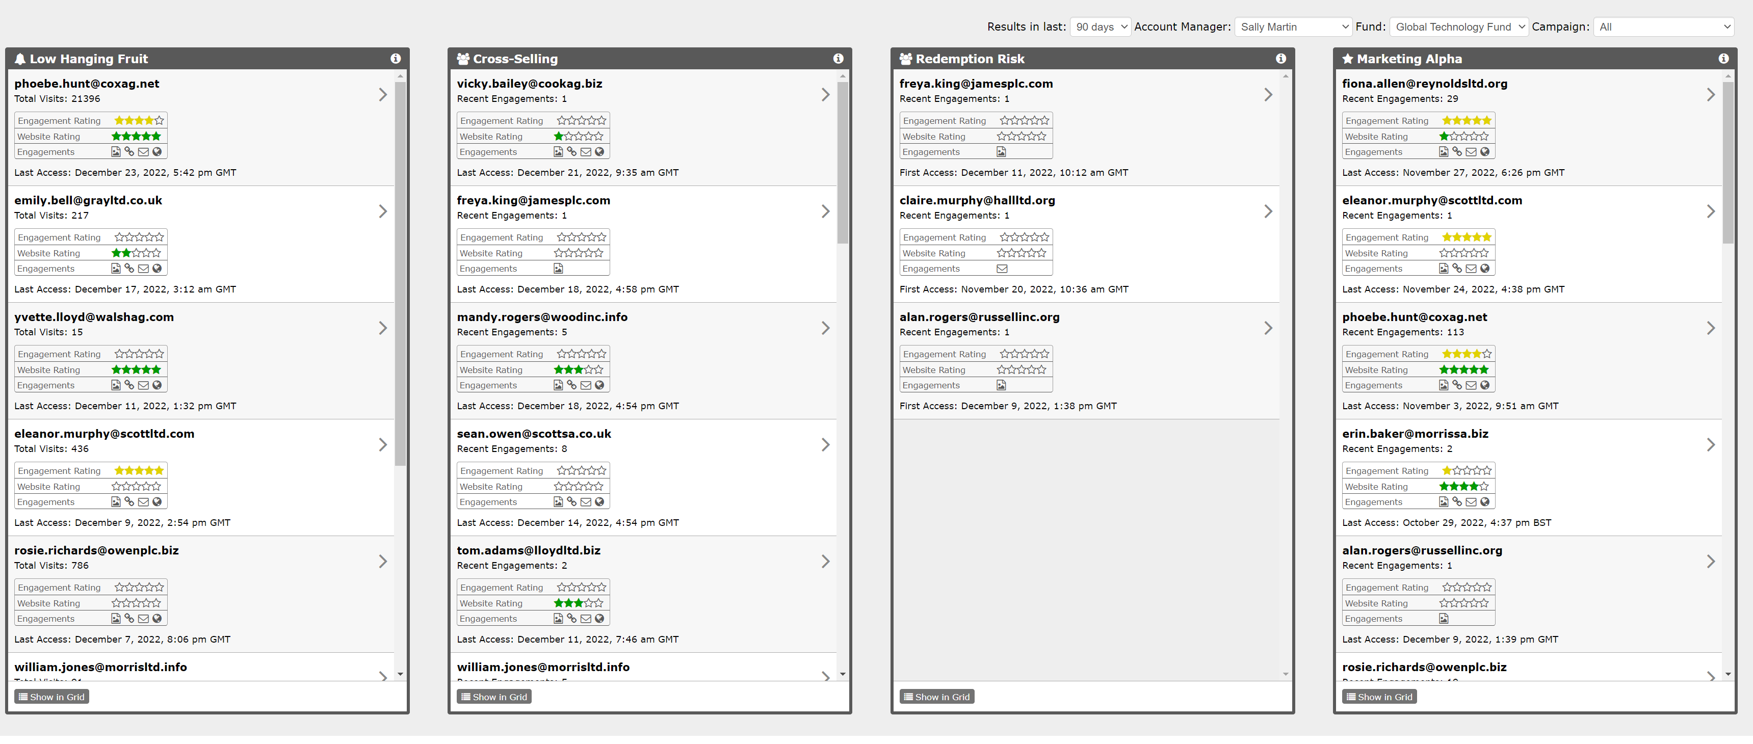
Deliver Insights To The Sales Team
Actionable Insights

Slide 21
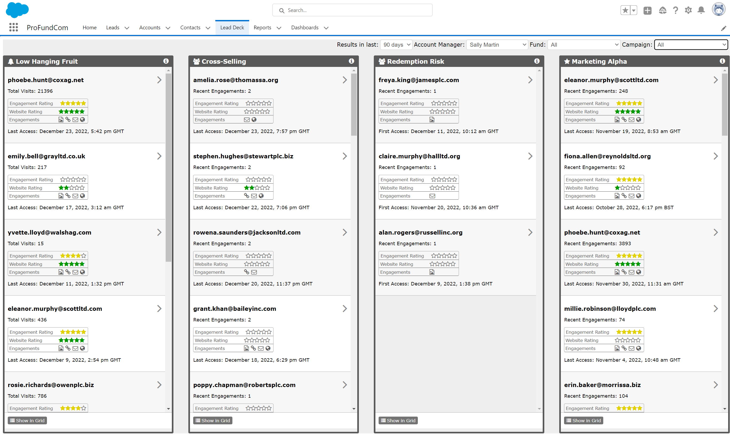
Deliver Insights To The Sales Team
Actionable Insights

Slide 22
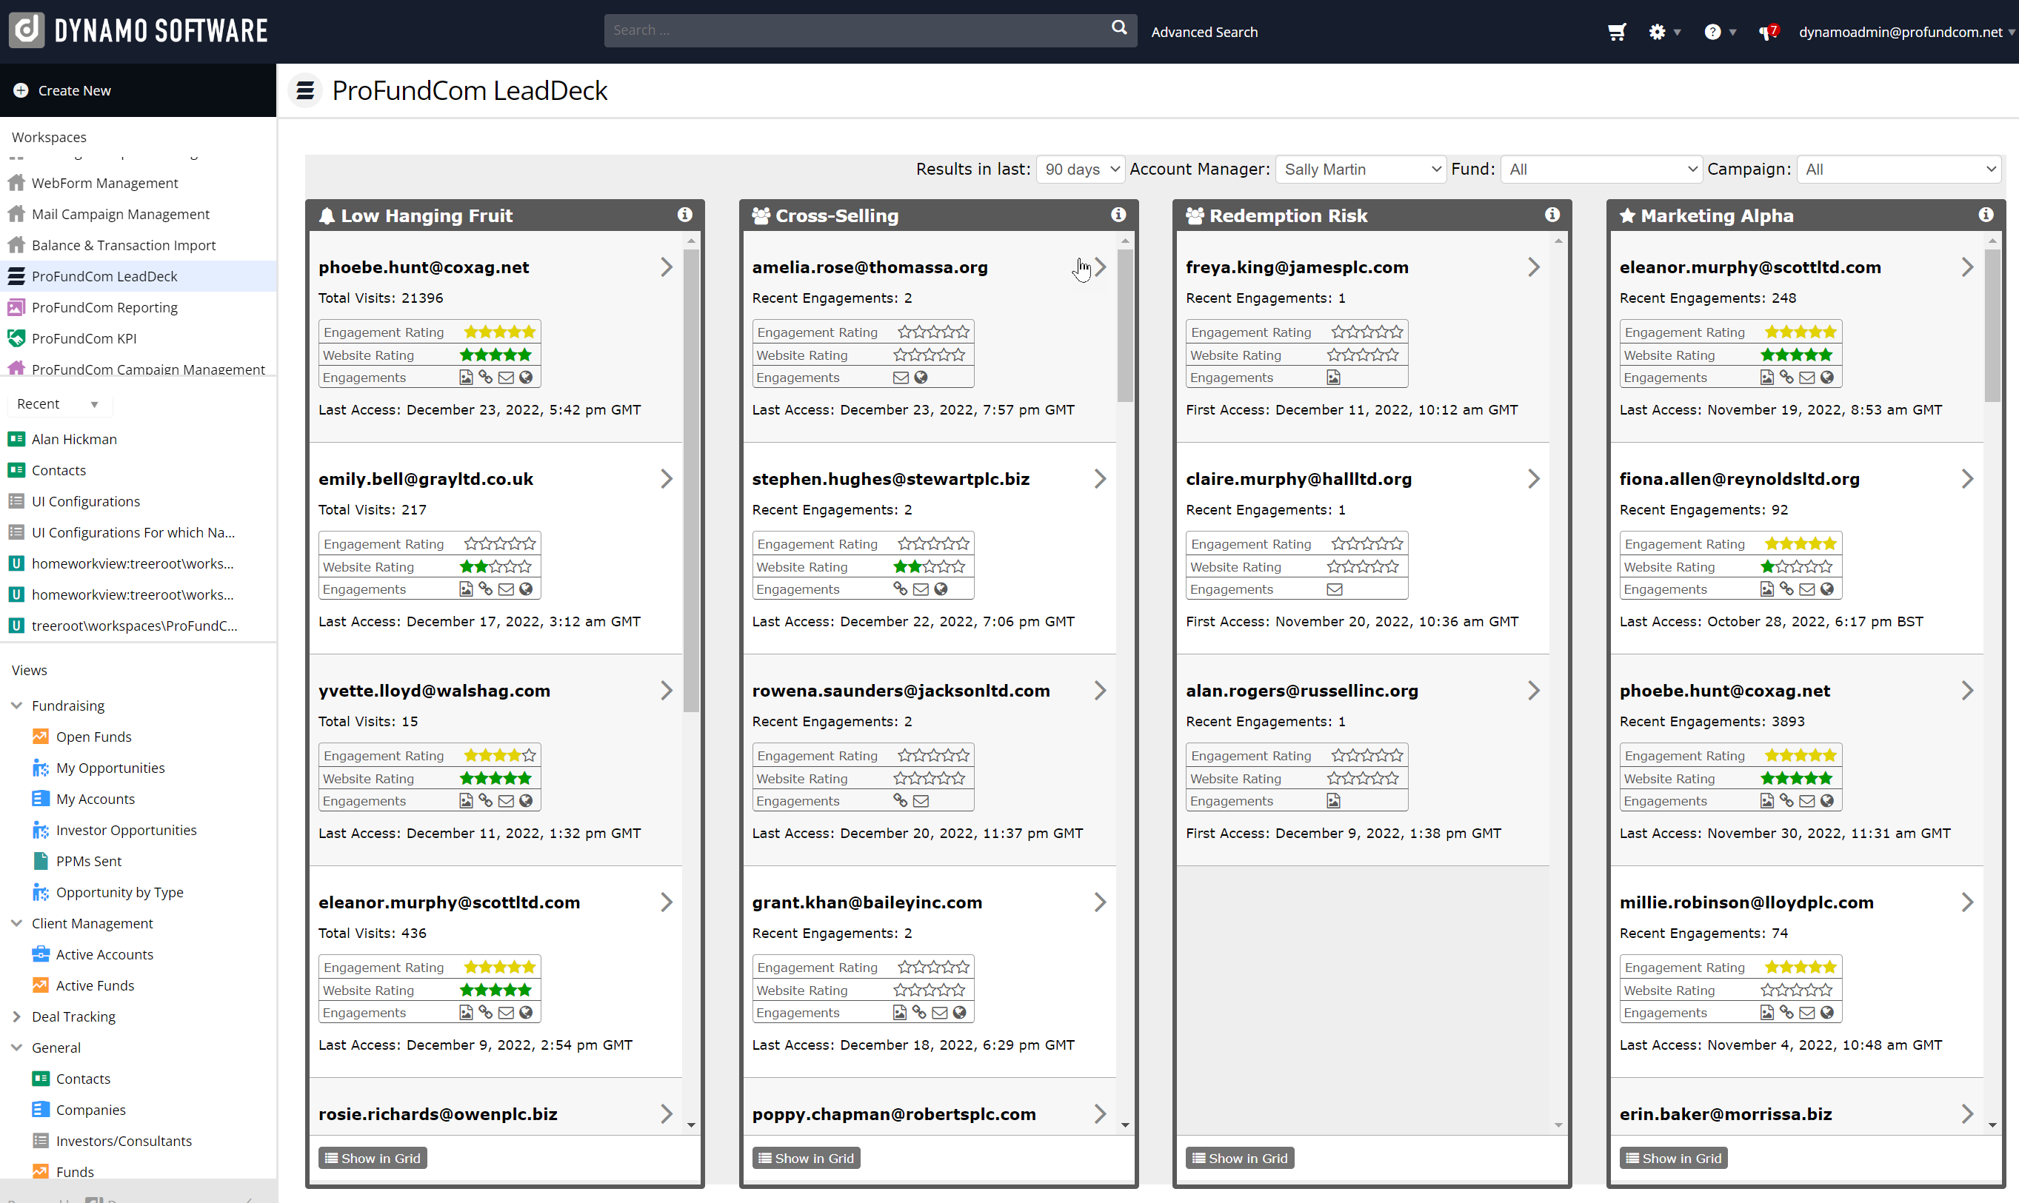
Deliver Insights To The Sales Team
Actionable Insights

Slide 23
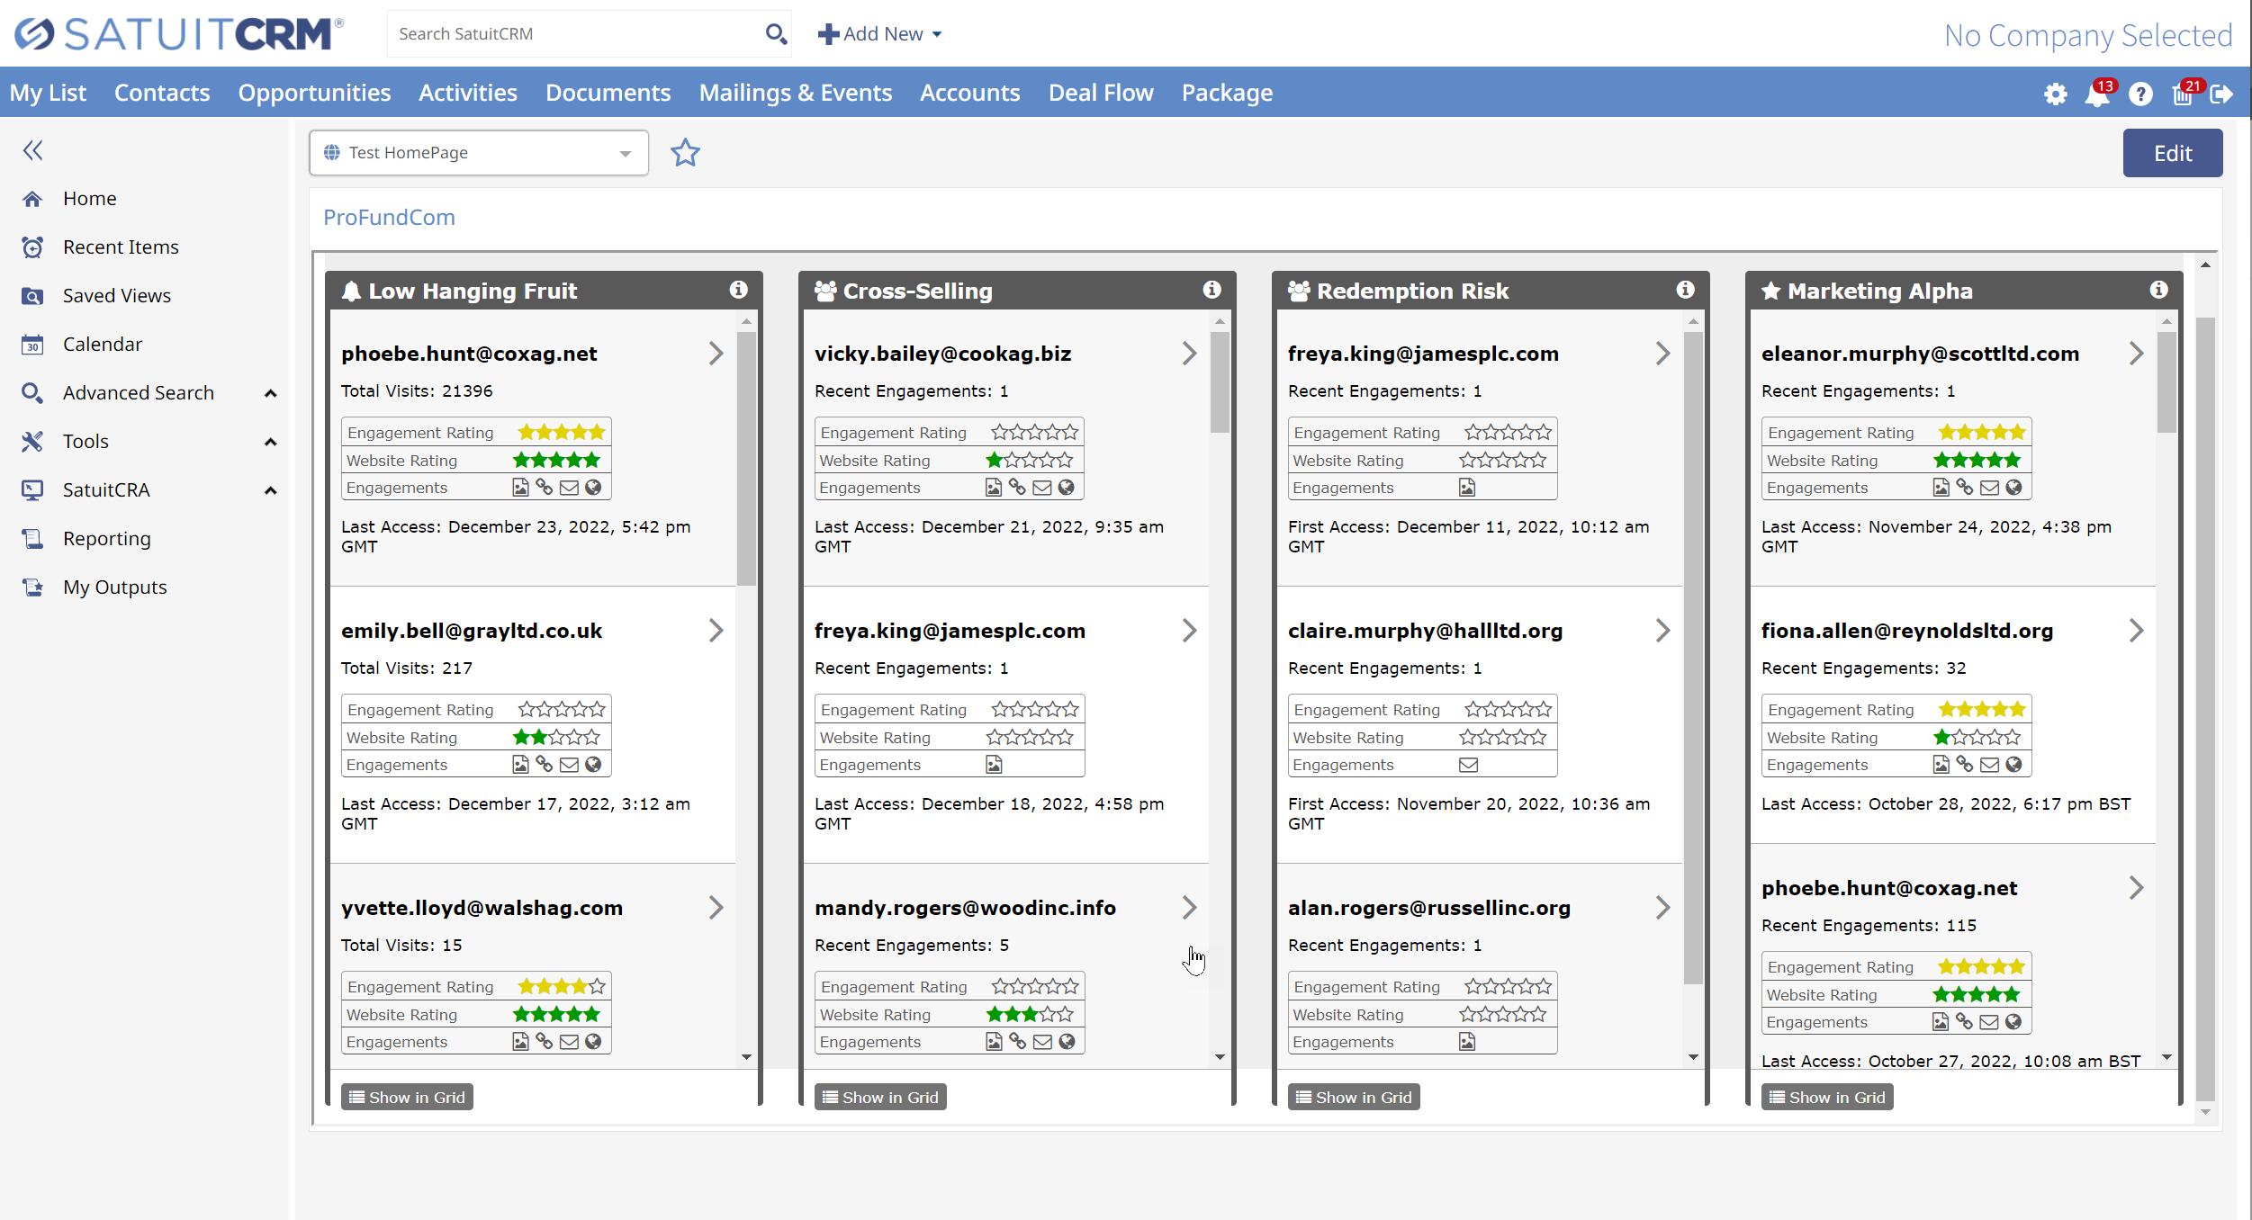
Deliver Insights To The Sales Team
Actionable Insights

Slide 24
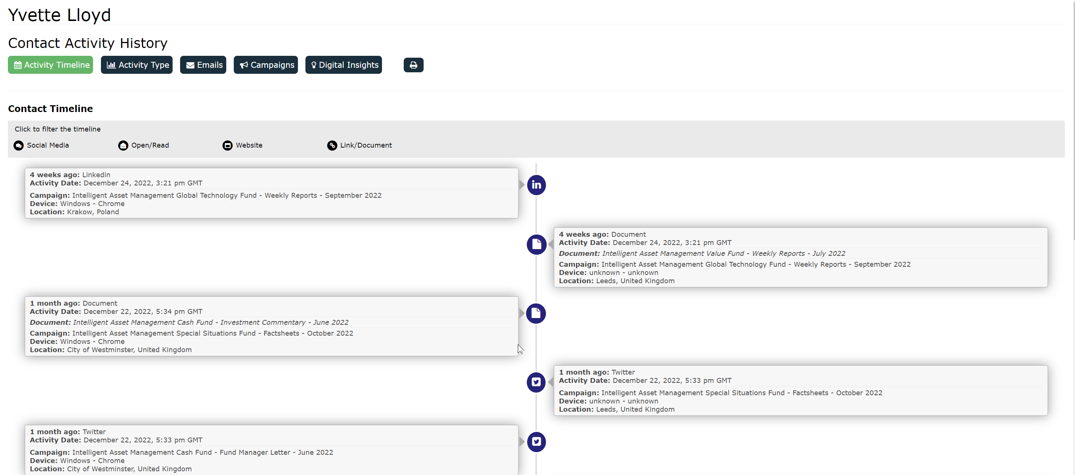
Deliver Insights To The Sales Team
Actionable Insights

Slide 25
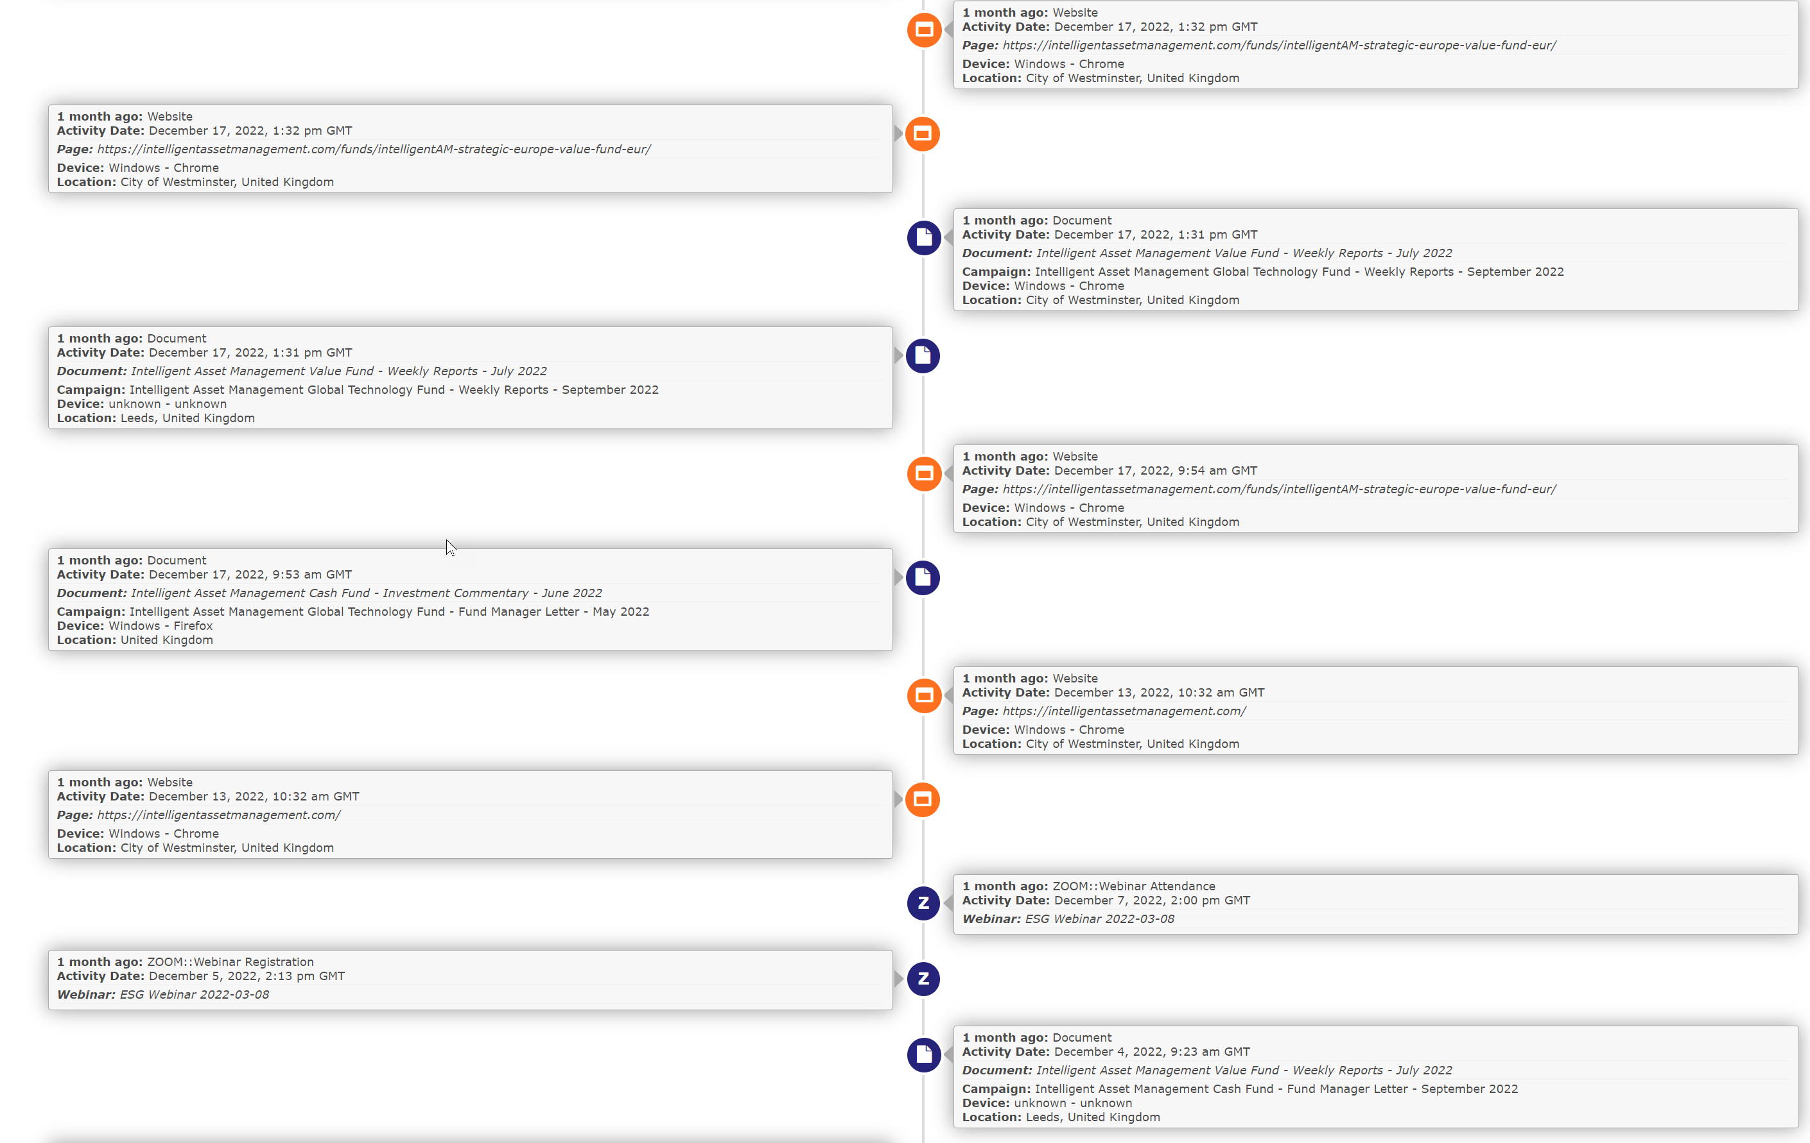
Deliver Insights To The Sales Team
Actionable Insights

Slide 26
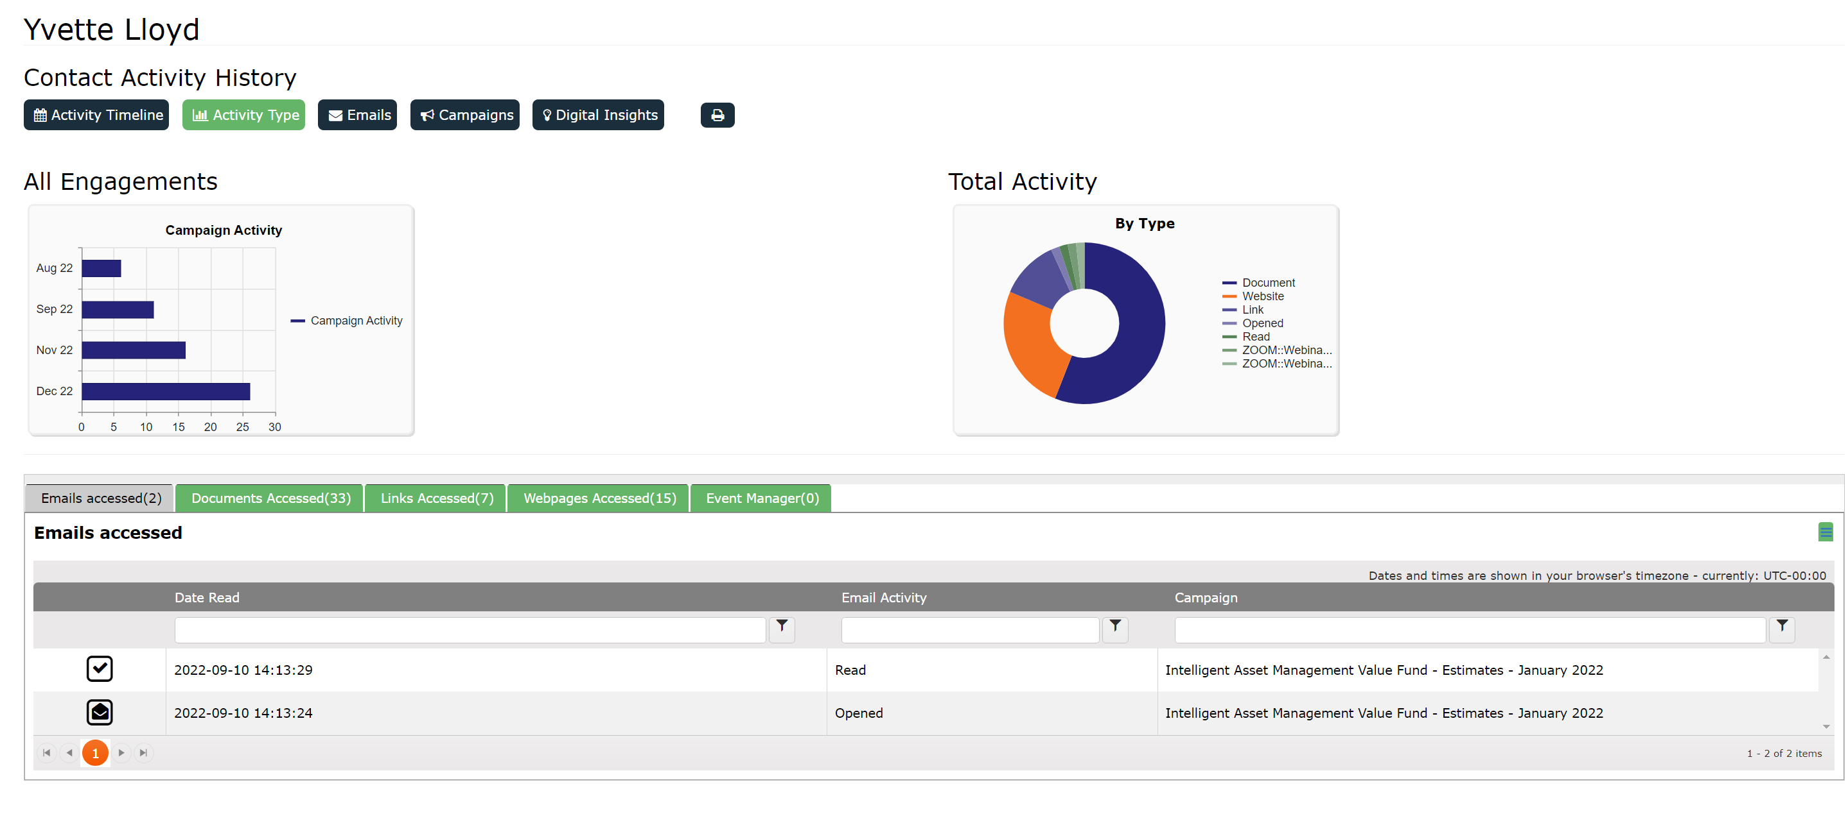
Deliver Insights To The Sales Team
Actionable Insights

Slide 27
5 Quick Wins for Fund Marketers in 2023
Do or Don’t – There Is No Try
1
Campaign analytics – what’s working and what’s not?
01
2
02
Aggregating – email, website, social, Zoom, investor portals
3
03
How to deliver insights that matter to the sales team
4
04
Integrations – easy actions for maximum impact
5
Marketing automation techniques to make you more efficient
05

Slide 28
5 Quick Wins for Fund Marketers in 2023
Do or Don’t – There Is No Try
1
Campaign analytics – what’s working and what’s not?
01
2
02
Aggregating – email, website, social, Zoom, investor portals
3
03
How to deliver insights that matter to the sales team
4
04
Integrations – easy actions for maximum impact
5
Marketing automation techniques to make you more efficient
05

Slide 29
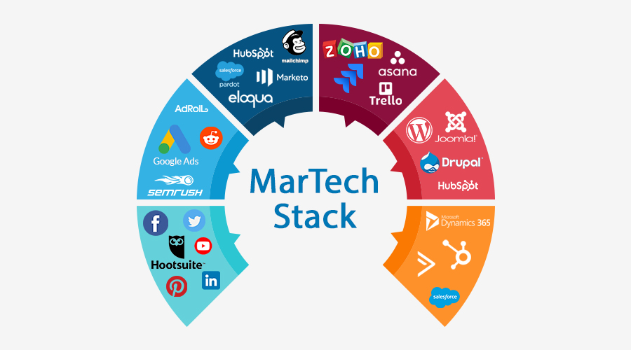
Lots Of Moving Parts – Marketing Is Hard
What Do We Need To Get Right?

Slide 30
Lots Of Moving Parts – Marketing Is Hard
What Do We Need To Get Right?
CRM
DELIVERY
SEO
CONTENT
Social
ANALYTICS

Slide 31






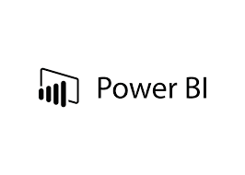


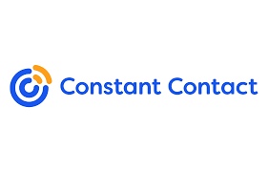






Lots Of Moving Parts
What Do We Need To Get Right?
DELIVERY
CHECKS
ANALYTICS
CONTENT

Slide 32
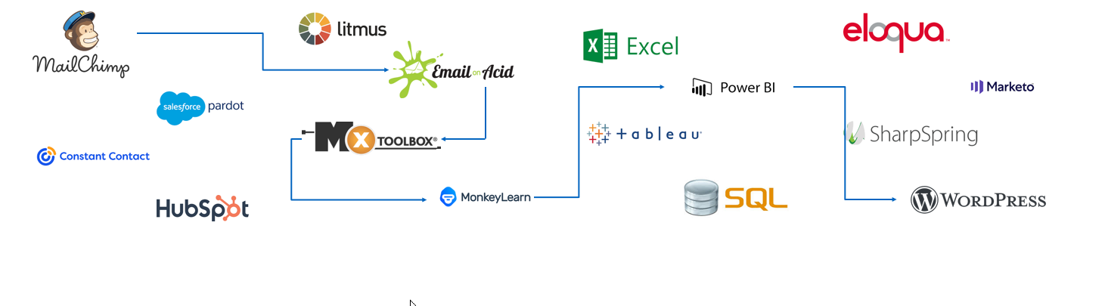
Lots Of Moving Parts
Lots To Go Wrong
DELIVERY
CHECKS
ANALYTICS
CONTENT

Slide 33
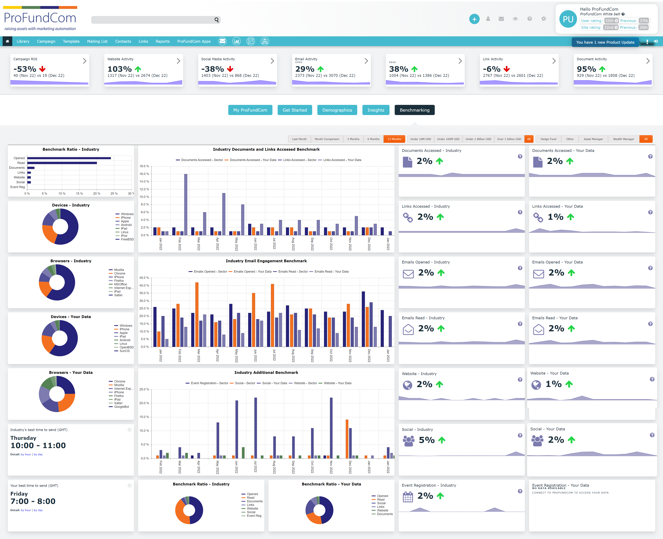
Use An Integrated Platform

Slide 34
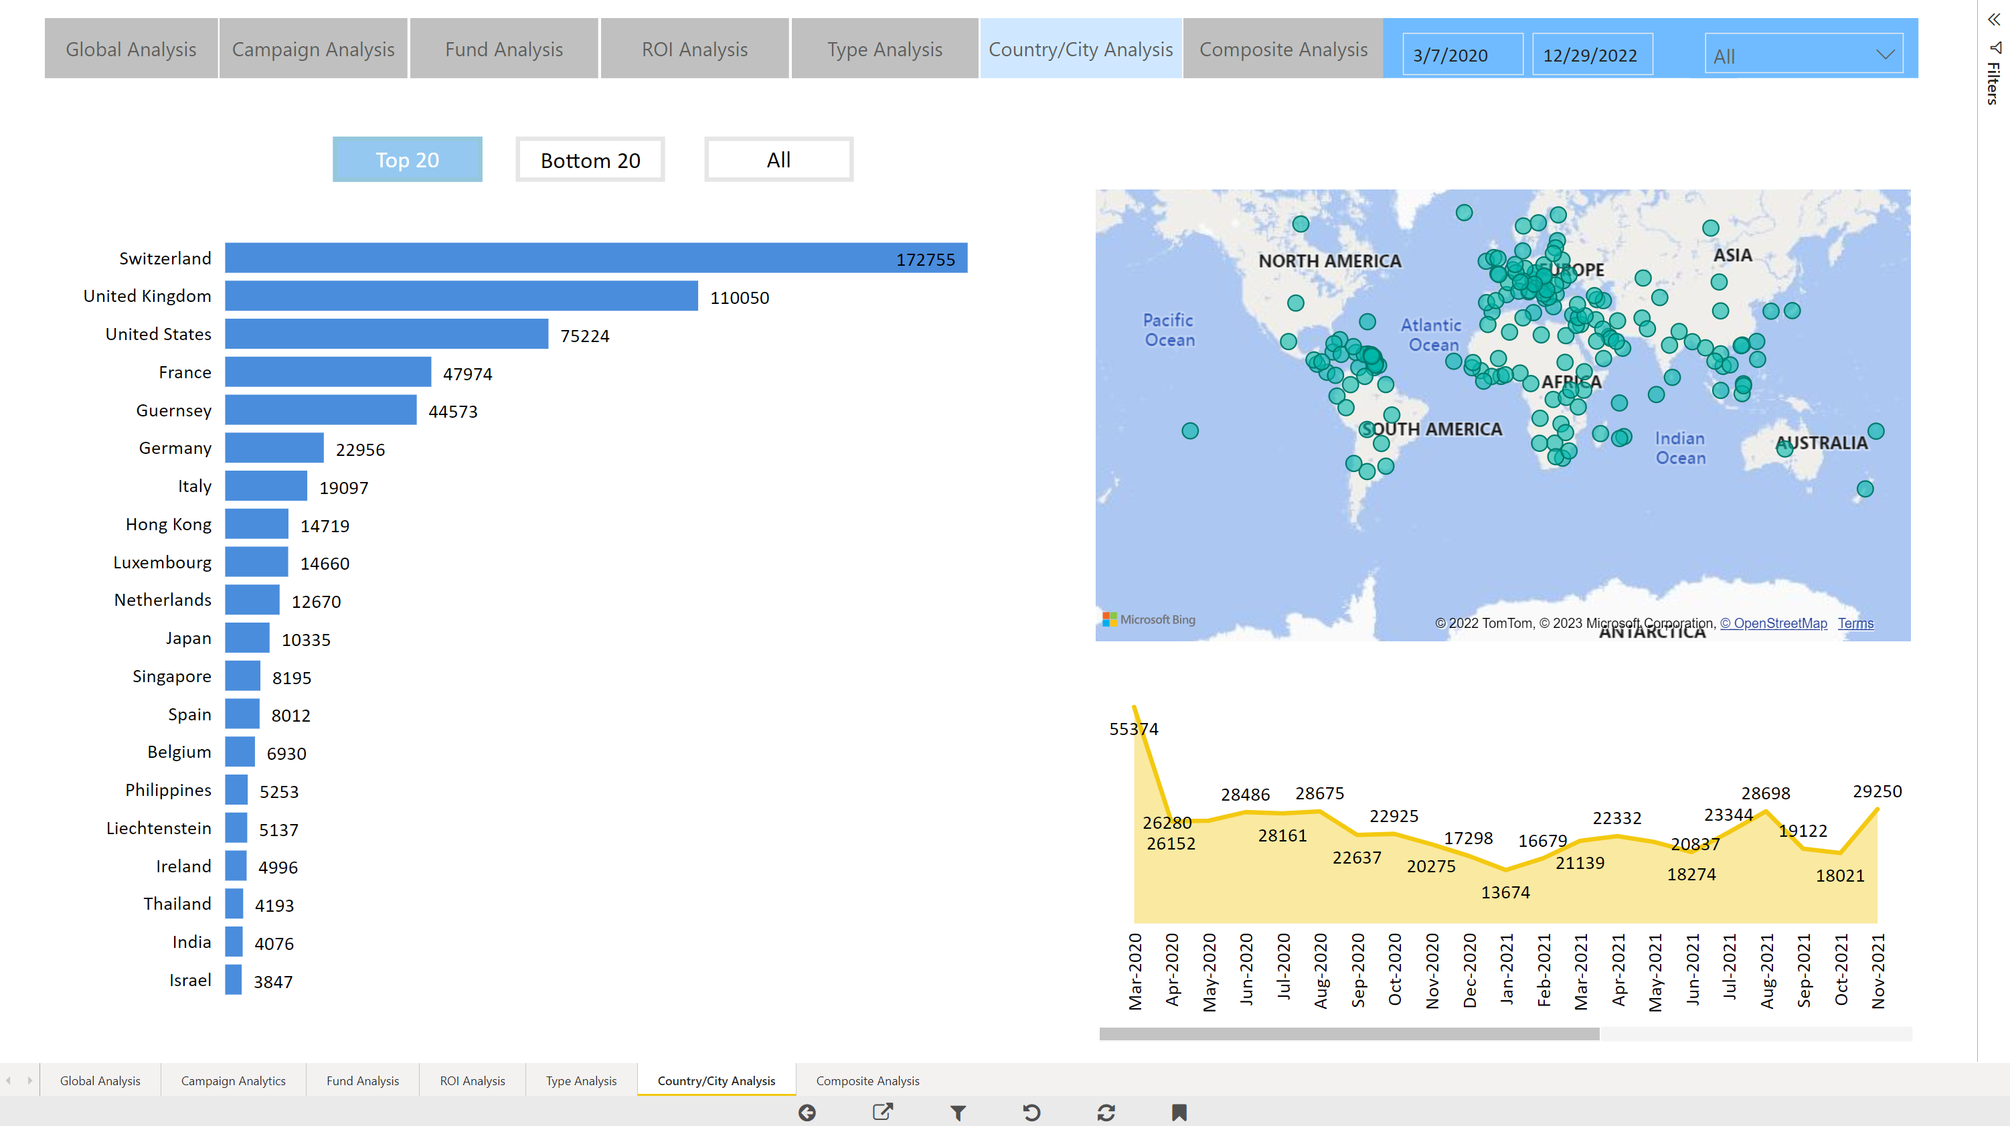
What is the End Game
Show the impact marketing is having on AuM

Slide 35
5 Quick Wins for Fund Marketers in 2023
Do or Don’t – There Is No Try
1
Campaign analytics – what’s working and what’s not?
01
2
02
Aggregating – email, website, social, Zoom, investor portals
3
03
How to deliver insights that matter to the sales team
4
04
Integrations – easy actions for maximum impact
5
Marketing automation techniques to make you more efficient
05

Slide 36
5 Quick Wins for Fund Marketers in 2023
Do or Don’t – There Is No Try
1
Campaign analytics – what’s working and what’s not?
01
2
02
Aggregating – email, website, social, Zoom, investor portals
3
03
How to deliver insights that matter to the sales team
4
04
Integrations – easy actions for maximum impact
5
Marketing automation techniques to make you more efficient
05

Slide 37
GTM – Go To Market
The REAL Plan – IF YOU ONLY DO ONE THING
INVESTMENT
1
2
3
4
5
NARRATIVE
BRAND
DEMAND
ENGAGEMENT
ANALYTICS
The what you do and the why you do it
Creating content about the narrative for your Ideal Investor
Creating channels for the Ideal Investor to Engage with your Narrative and Brand
(Outbound)
Creating a demand for your Ideal Investors and they Engage with you
(Inbound)
Track engagement and target the right Ideal Investor at the right time
START

Slide 38
AGTM – Automated Go To Market
Create A Marketing Echo Chamber
1
2
3
4
5
NARRATIVE
BRAND
DEMAND
ENGAGEMENT
ANALYTICS
The what you do and the why you do it
Creating content about the narrative for your Ideal Investor
Creating channels for the Ideal Investor to Engage with your Narrative and Brand
(Outbound)
Creating a demand for your Ideal Investors and they Engage with you
(Inbound)
Track engagement and target the right Ideal Investor at the right time
START

Slide 39
AGTM1 – Remail
Create A Marketing Echo Chamber
4
3
Go To Step 2
2
Resend to Non-Engagers
Wait 7 Days
1
Send Email

Slide 40
AGTM2 – Split-Test-Send
Create A Marketing Echo Chamber
4
Send Remaining 90%
3
2
Measure which performed best
Wait 1 Day
1
Send 10 % of Emails – Split Subject or Content

Slide 41
AGTM3 – Nurture and Drip
Create A Marketing Echo Chamber
4
Go To Step 2 and Change Duration
3
2
Send Content
Wait 10 Days
1
Download – Event Registration

Slide 42
AGTM4 – Activate
Create A Marketing Echo Chamber
4
3
Remind if action not completed
2
Send action to Salesperson
Send alert to CRM
1
Lead score exceeds a threshold

Slide 43
Nurture Campaigns + Lead Scoring
When to take action
1
2
3
4
Website
Social
Download
Investor Portal
1
+
2
+
3
+
4 =

Slide 44
5 Quick Wins for Fund Marketers in 2023
Do or Don’t – There Is No Try
1
Campaign analytics – what’s working and what’s not?
01
2
02
Aggregating – email, website, social, Zoom, investor portals
3
03
How to deliver insights that matter to the sales team
4
04
Integrations – easy actions for maximum impact
5
Marketing automation techniques to make you more efficient
05

Slide 45
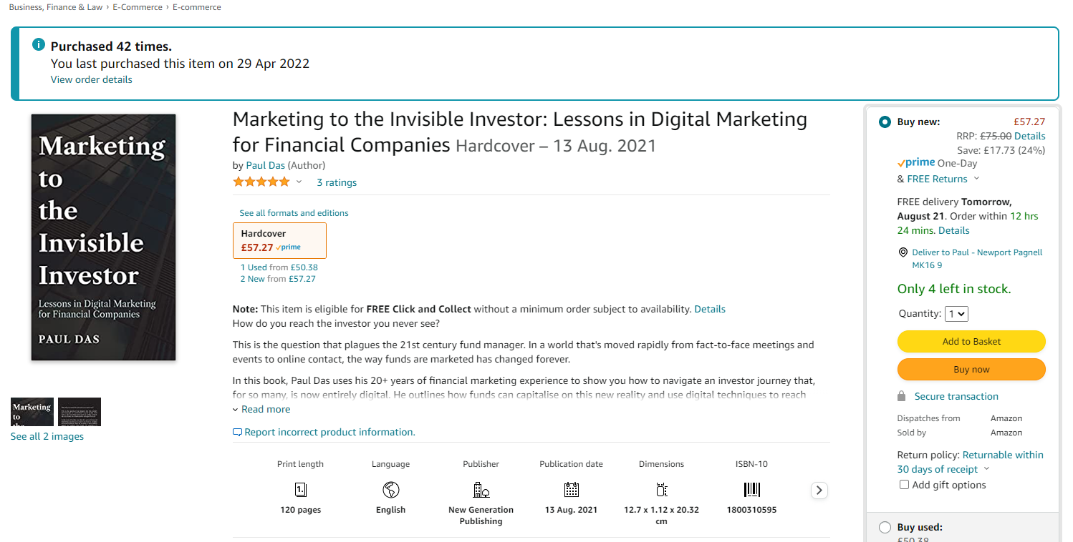
ProFundCom Consultation
Offer to Webinar Attendees
FREE 1 Hour Digital Marketing Audit & Consultation or Just Ask Nicely for the book !

Slide 46
5 Quick Wins for Fund Marketers in 2023


