Slide 1

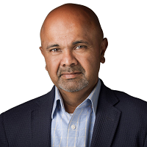
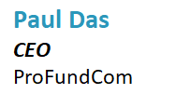
Finding New Investors With Digital Marketing


Slide 2
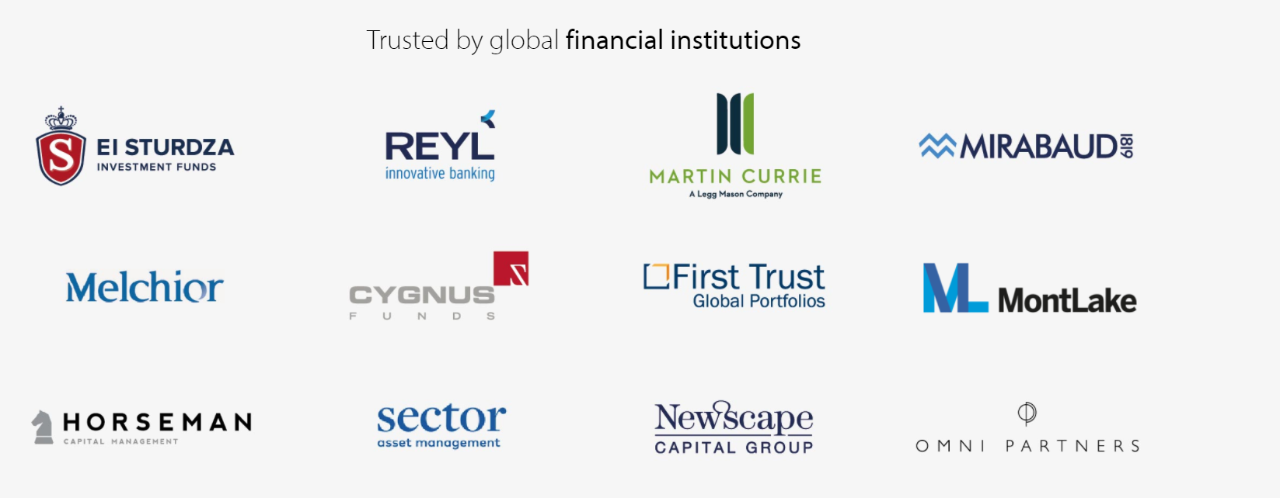

We Are ProFundCom
Using Digital Marketing to Raise AuM
For the last 20 years we have helped fund managers identify new investment opportunities as well as be alerted to redemption risks using digital marketing
Our Clients

Slide 3
The Investor Journey is Totally Digital
Everything Is Data
Thought
Leadership
Investment
Advice
Retention
Review
Inbound
Queries
Market Event
Comms
Due
Diligence
Website
Outbound
Marketing
Asset
Allocation
Client Advisory
Board
AWARENESS
CONSIDERATION
DECISION
SERVICE
LOYALTY
Sales
Pitch
Downgrade
Warnings
Events
Press
Asset
Transfer
Performance
Warnings
Manager
Change
Social
Media
Onboarding
Mandate
Change
Response to
Issues and Errors

Slide 4
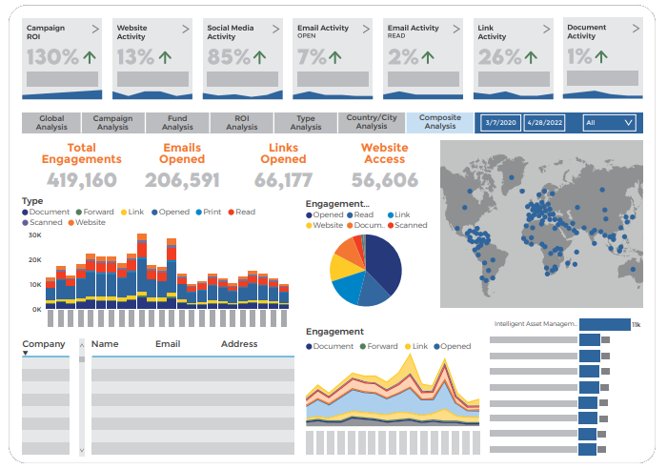
What is the End Game
Show the impact marketing is having on AuM

Slide 5
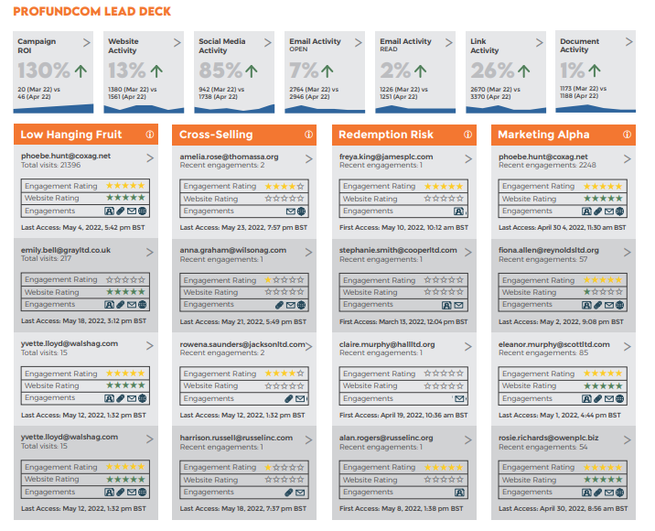
What is the End Game
Show the impact marketing is having on AuM

Slide 6
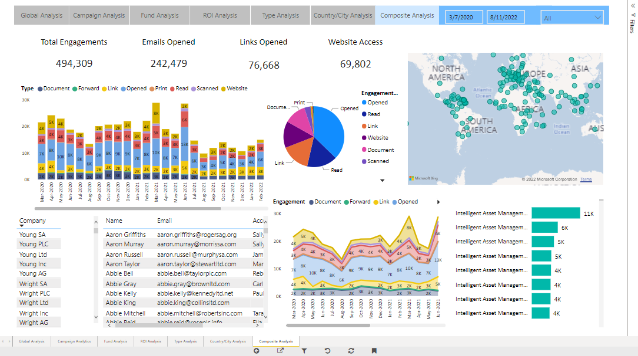
What is the End Game
Show the impact marketing is having on AuM

Slide 7
5 Ways To Find New Investors
Do or Don’t – There Is No Try
1
01
Company narrative
2
Website
02
3
Thought-leadership
03
4
LinkedIn
04
5
Online events and calls
05

Slide 8

GTM – Go To Market
The REAL Plan – IF YOU ONLY DO ONE THING
01
Fund Narrative
02
Ideal Investor Profile
03
Top 100 Investors

Slide 9
GTM – Go To Market
The REAL Plan – IF YOU ONLY DO ONE THING
INVESTMENT
1
2
3
4
5
NARRATIVE
BRAND
DEMAND
ENAGEMENT
ANALYTICS
The what you do and the why you do it
Creating content about the narrative for your Ideal Investor
Creating channels for the Ideal Investor to Engage with your Narrative and Brand
(Outbound)
Creating a demand for your Ideal Investors and they Engage with you
(Inbound)
Track engagement and target the right Ideal Investor at the right time
START

Slide 10
5 Ways To Find New Investors
Do or Don’t – There Is No Try
1
01
Company narrative/brand strategy
2
Website
02
3
Thought-leadership
03
4
LinkedIn
04
5
Online events and calls
05

Slide 11
At What Point Are People Visiting
Everything Is Data
Thought
Leadership
Investment
Advice
Retention
Review
Inbound
Queries
Market Event
Comms
Due
Diligence
Website
Outbound
Marketing
Asset
Allocation
Client Advisory
Board
AWARENESS
CONSIDERATION
DECISION
SERVICE
LOYALTY
Sales
Pitch
Downgrade
Warnings
Events
Press
Asset
Transfer
Performance
Warnings
Manager
Change
Social
Media
Onboarding
Mandate
Change
Response to
Issues and Errors

Slide 12
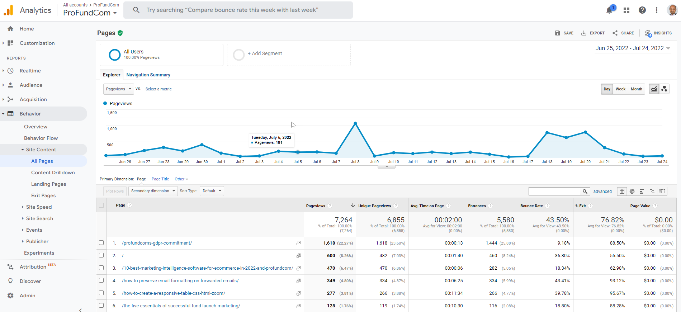
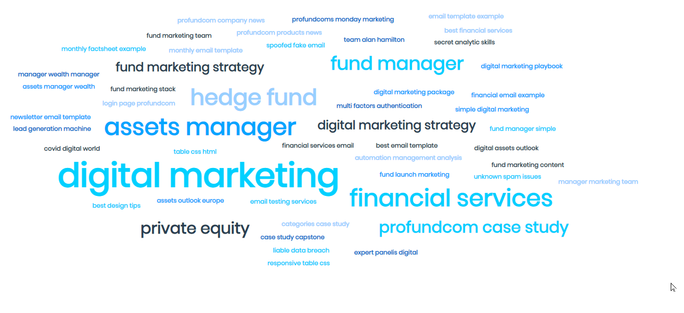
Google Analytics + Studio + Thematic Analysis
We all know about dashboards

Slide 13

Content Distribution
The Plan
Email Campaigns
01
02
Social Media
WEBSITE
Updates
Webinars
04
03

Slide 14
Content Distribution
The Plan
CRM
01
02
Reporting
WEBSITE
Automations
Lead Scoring
04
03

Slide 15
Website Engagement
Earning to right for people to give you their data
$
Newsletter Signup
$$
Gated Content
$$$
Investor Portal
$$$$
Fund Center

Slide 16
5 Ways To Find New Investors
Do or Don’t – There Is No Try
1
01
Company narrative/brand strategy
2
Website
02
3
Thought-leadership
03
4
LinkedIn
04
5
Online events and calls
05

Slide 17

Content Marketing
Content Philosophy
Content Philosophy
1
01
Educate
AGENDA SLIDE
2
02
Entertain
3
03
Enlighten

Slide 18

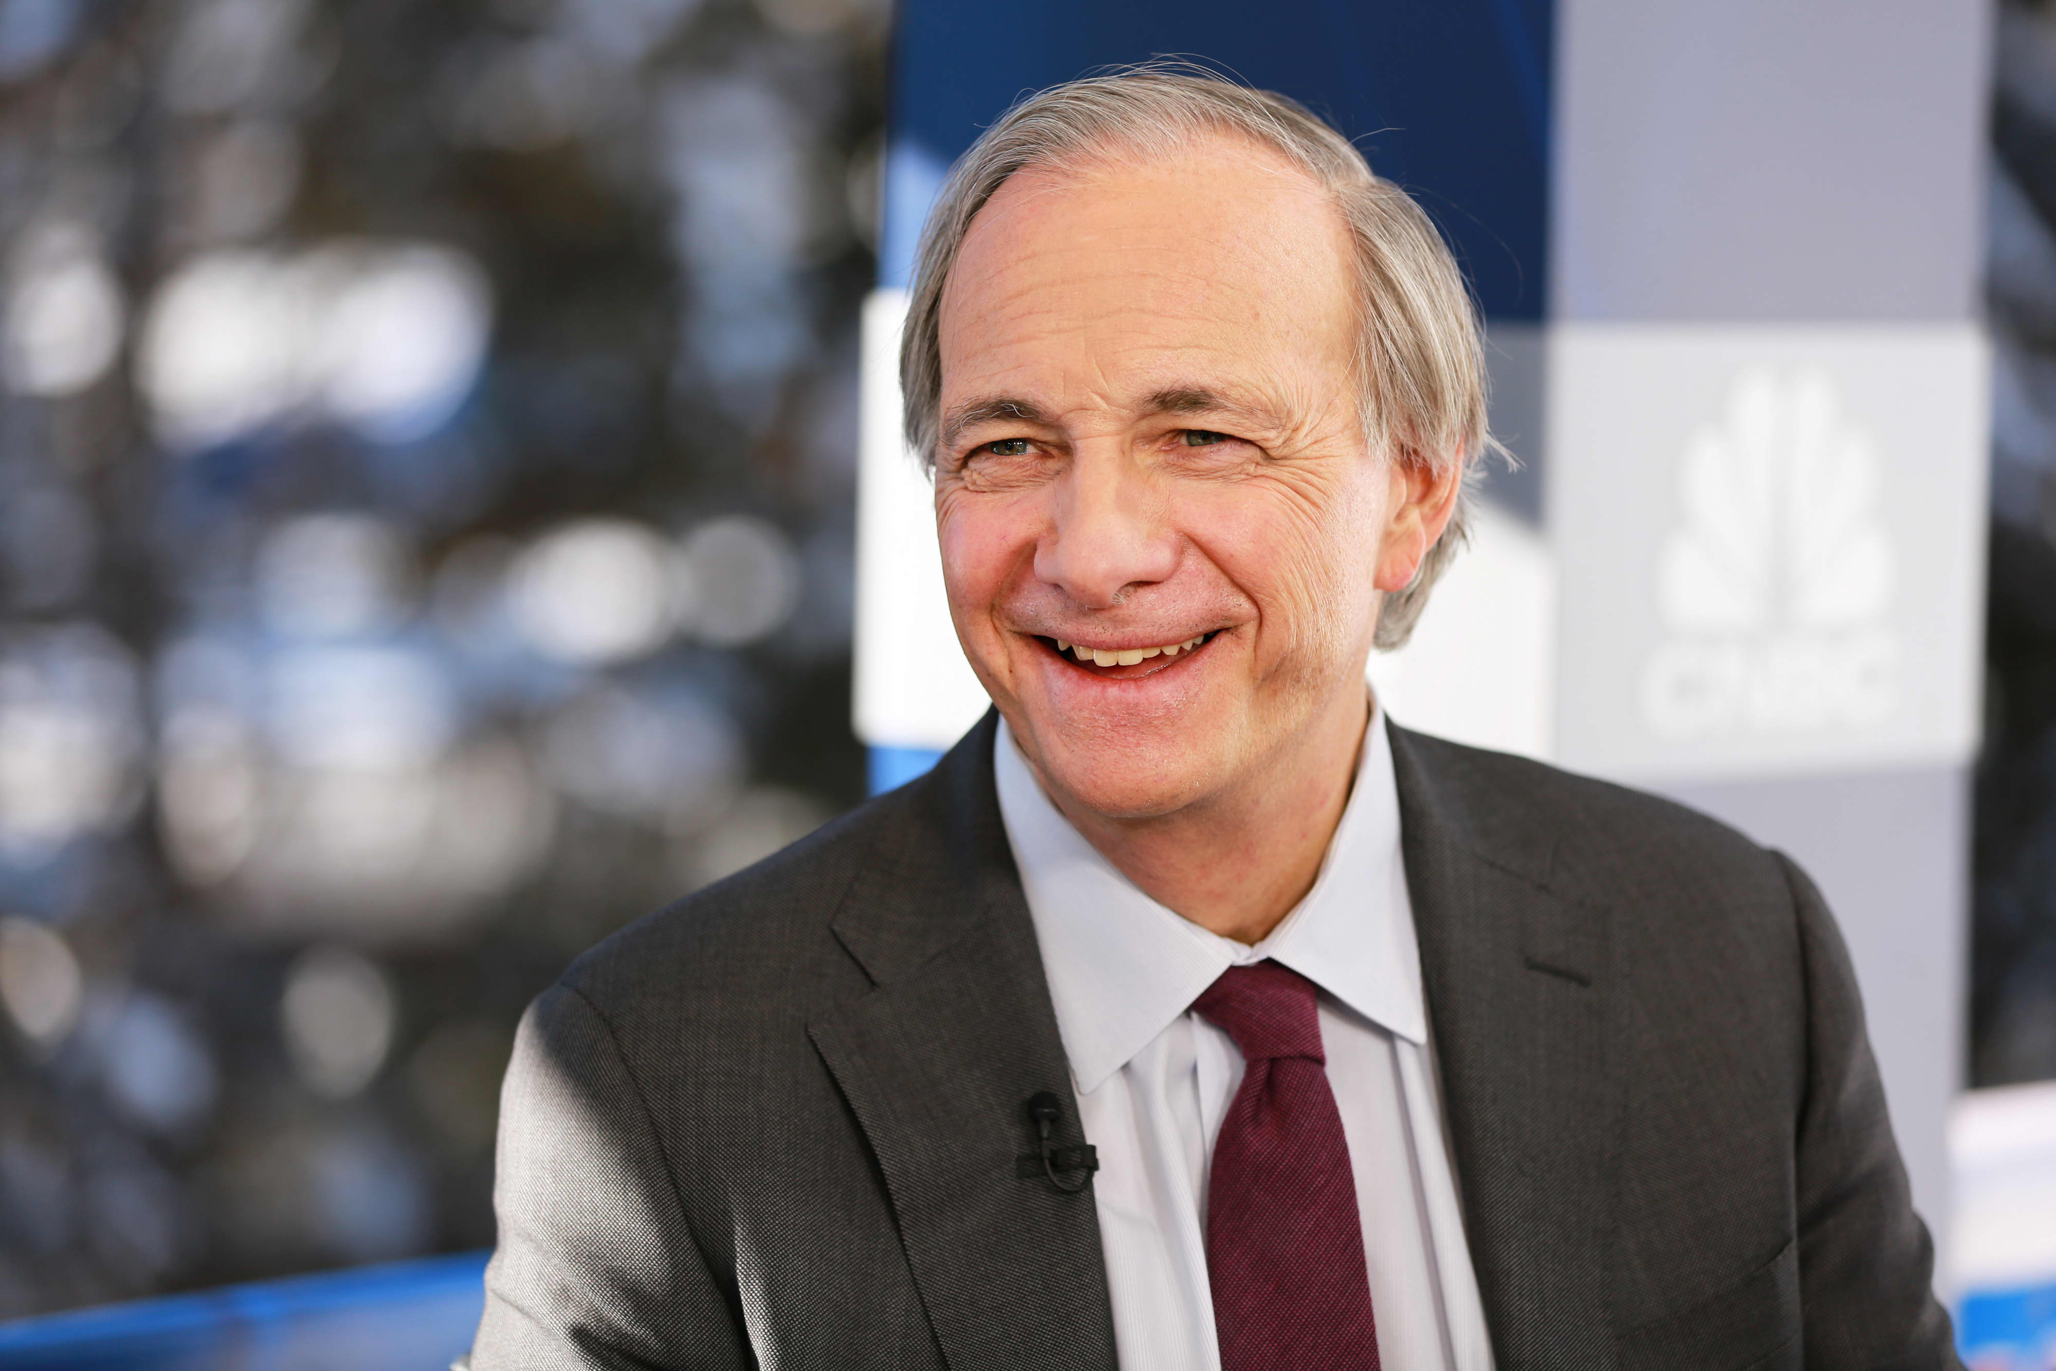
Content Marketing
Content Philosophy
The Power of Words
1
01
Investment Strategy
AGENDA SLIDE
2
02
Attitude to Risk
3
03
Performance

Slide 19

Repurposing Content
Write Once – Use Many
Webinar
Whitepaper
Article
LinkedIn
Tweet

Slide 20
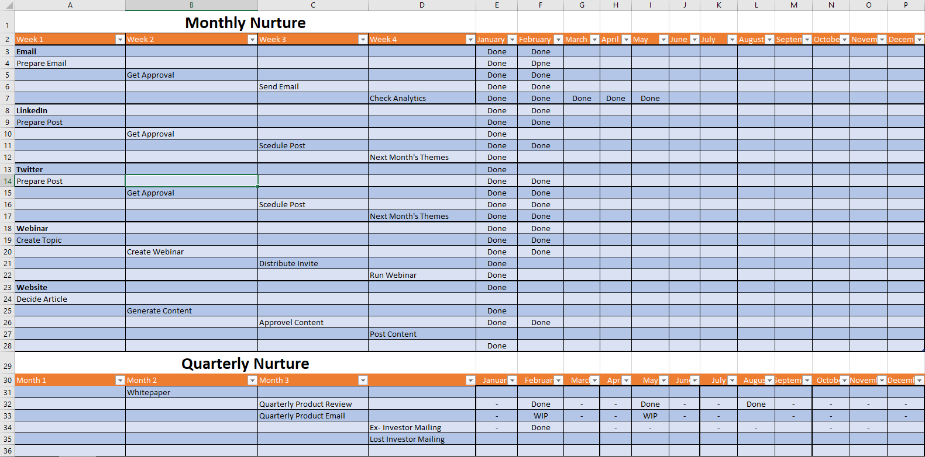
Content + Timing
The Plan

Slide 21
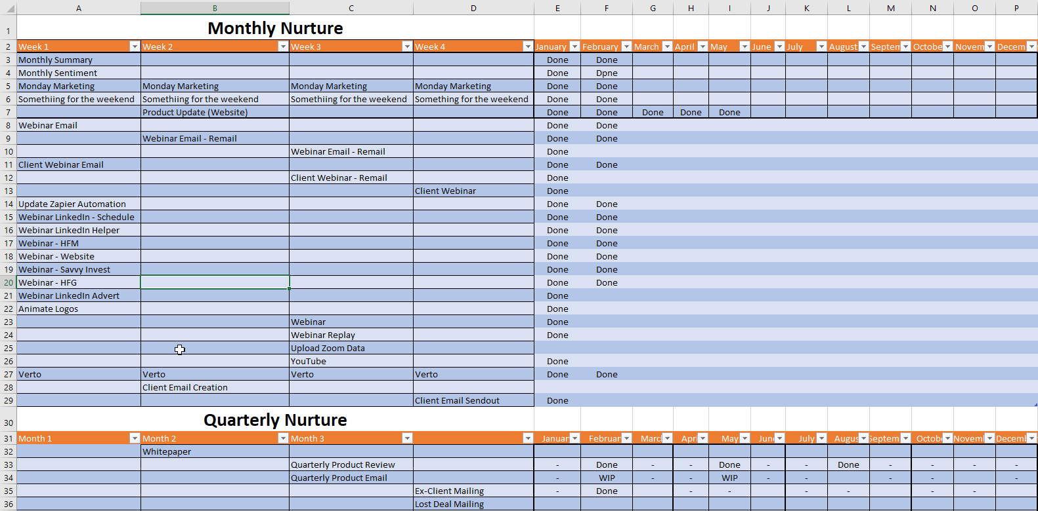
Content + Timing
The Plan

Slide 22

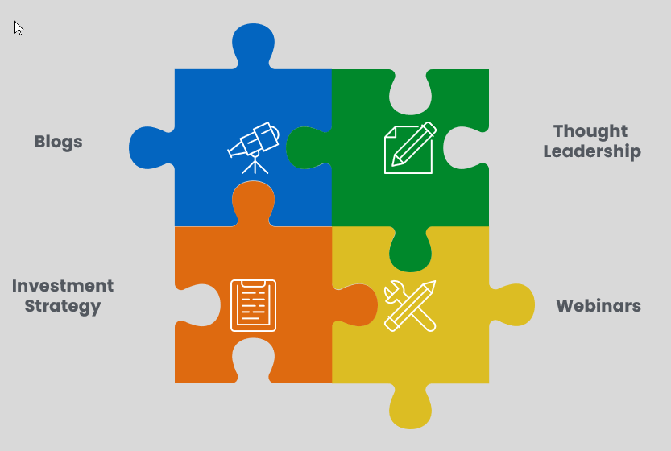
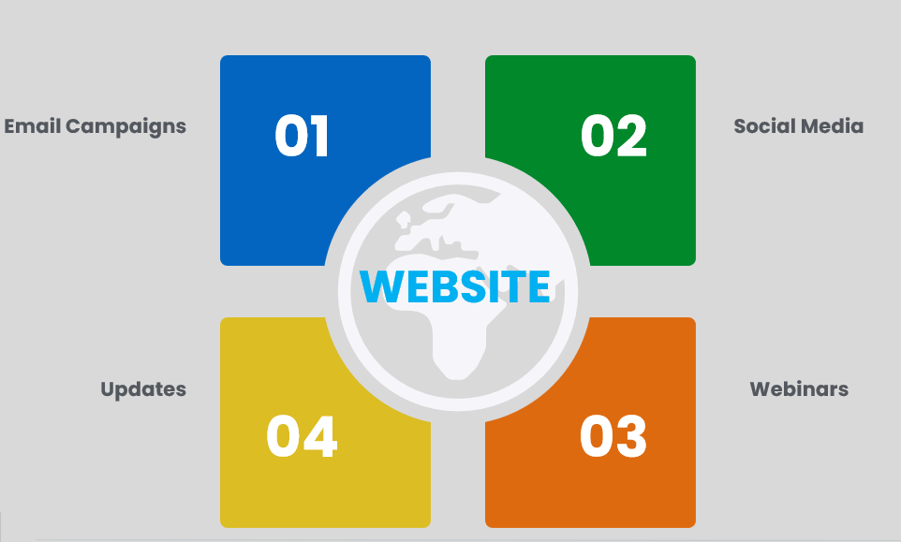
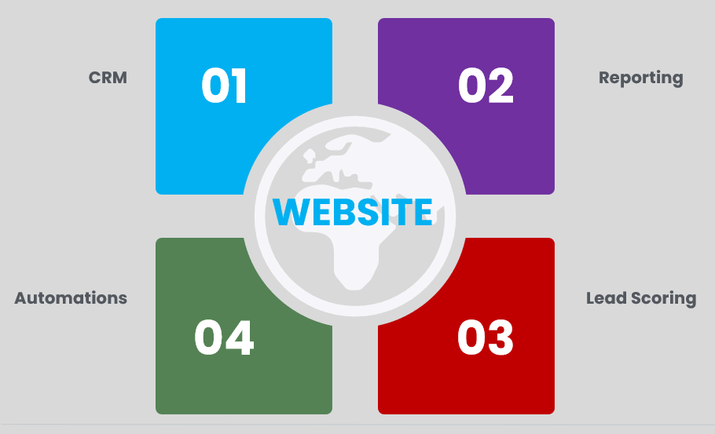



Multiformat
Not just VHS and BetaMax

Slide 23
5 Ways To Find New Investors
Do or Don’t – There Is No Try
1
01
Company narrative/brand strategy
2
Website
02
3
Thought-leadership
03
4
LinkedIn
04
5
Online events and calls
05

Slide 24

Inbound Marketing
Do not under-estimate
SEO
Slow
Email
Platforms
Networking
Social Posts
Existing
Investors
Social DMs
Ads
Quick
Easy
Hard

Slide 25
5 Ways To Find New Investors
Do or Don’t – There Is No Try
1
01
Company narrative/brand strategy
2
Website
02
3
Thought-leadership
03
4
LinkedIn
04
5
Online events and calls
05

Slide 26
Increasing attendance at events and calls
What Outcomes Benefit the Business
Re-mail
Did not Open
Opened Link to Invite
Did not Register
Re-mail
Send Invite
Opened Invited
Did not open Link to Invite
Re-mail

Slide 27
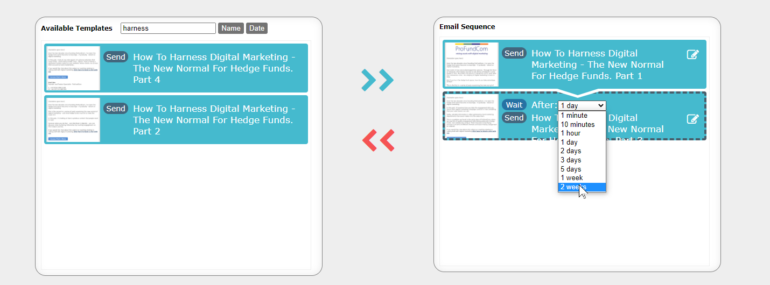
Nurture Campaigns
On a Trigger the Email Sends STOP

Slide 28
5 Ways To Find New Investors
Do or Don’t – There Is No Try
1
01
Company narrative/brand strategy
2
Website
02
3
Thought-leadership
03
4
LinkedIn
04
5
Online events and calls
05

Slide 29

What is the End Game
Show the impact marketing is having on AuM

Slide 30
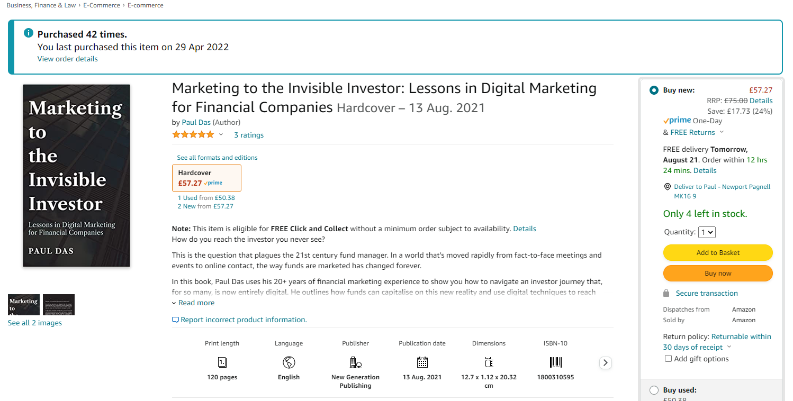
ProFundCom Consultation
Offer to Webinar Attendees
FREE 1 Hour Digital Marketing Audit & Consultation or Just Ask Nicely for the book !

Slide 31
Finding New Investors With Digital Marketing


