Slide 1


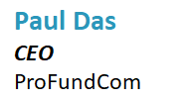
The Secret Analytical Skills for Fund Marketing Teams


Slide 2
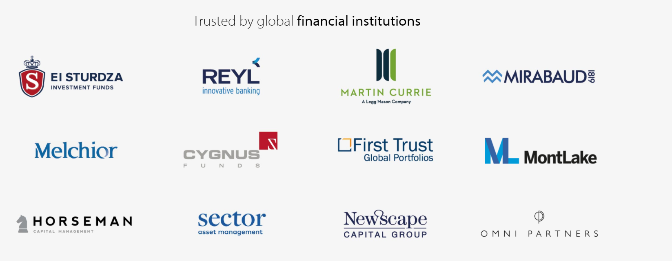

We Are ProFundCom
Using Digital Marketing to Raise AuM
200+ Users
30+ Apps
18th Year
For the last 20 years we have helped fund managers identify new investment opportunities as well as be alerted to redemption risks using digital marketing
Our Clients

Slide 3
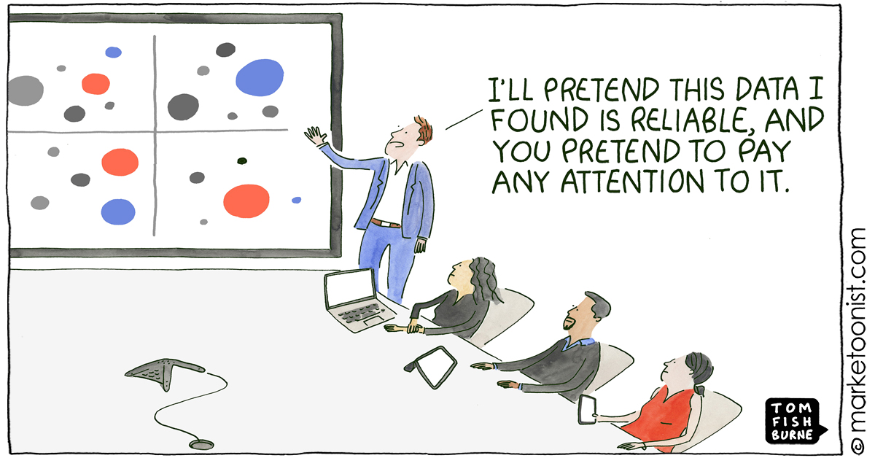
Data – Big Data – Bigger Data
Blah – Big Blah – Bigger Blah

Slide 4
Data Points
The Investor Journey Is Totally Digital
Thought
Leadership
Investment
Advice
Retention
Review
Inbound
Queries
Market Event
Comms
Due
Diligence
Website
Outbound
Marketing
Asset
Allocation
Client Advisory
Board
AWARENESS
CONSIDERATION
DECISION
SERVICE
LOYALTY
Sales
Pitch
Downgrade
Warnings
Events
Press
Asset
Transfer
Performance
Warnings
Manager
Change
Social
Media
Onboarding
Mandate
Change
Response to
Issues and Errors

Slide 5
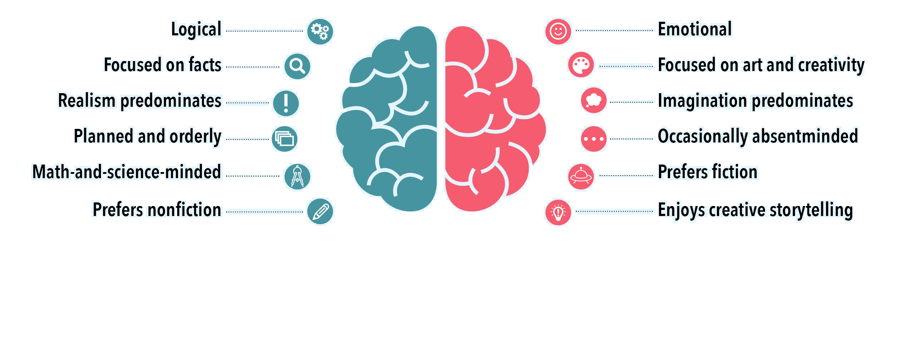
The Reason To Know About Data
Left Brain – Right Brain
Analytic Brain
Marketing Brain

Slide 6
The Reason To Know About Data
The 2 things that even mater
1. Is Marketing Raising AuM
2. Is Marketing Preserving AuM

Slide 7
4 Analytic Skills For Fund Marketers
It’s not Rocket Science
1
01
What tools do you need?
2
How to successfully integrate analytics
02
3
How to analyse analytics effectively
03
4
How to leverage data into actionable business data
04

Slide 8
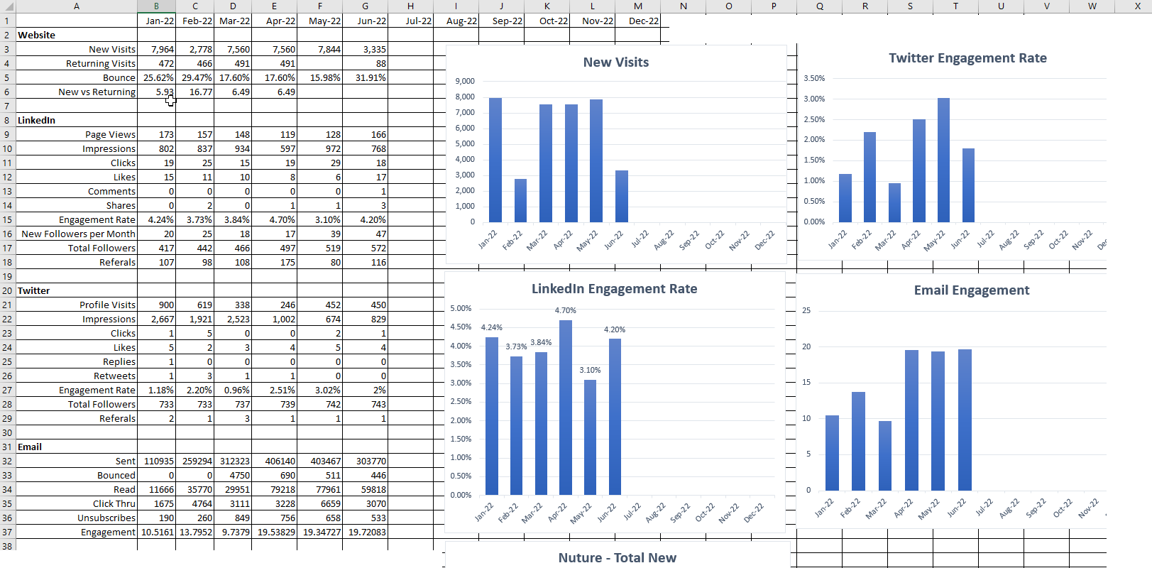
Excel
Mean – Median – Mode - Charting

Slide 9
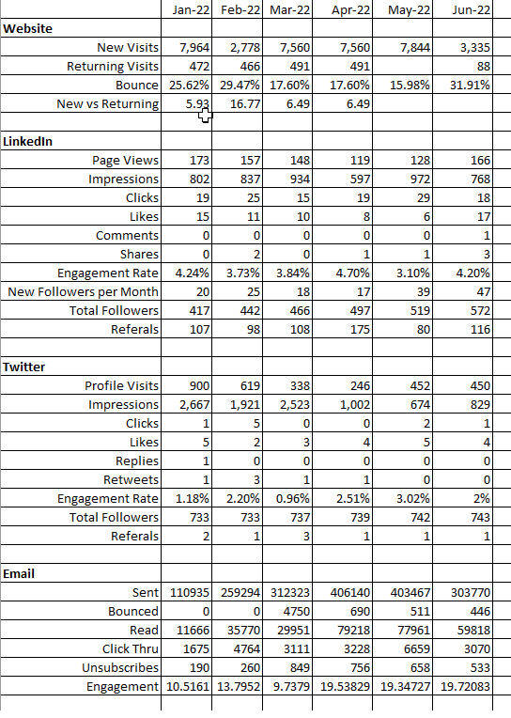
Excel
Mean – Median – Mode - Charting

Slide 10
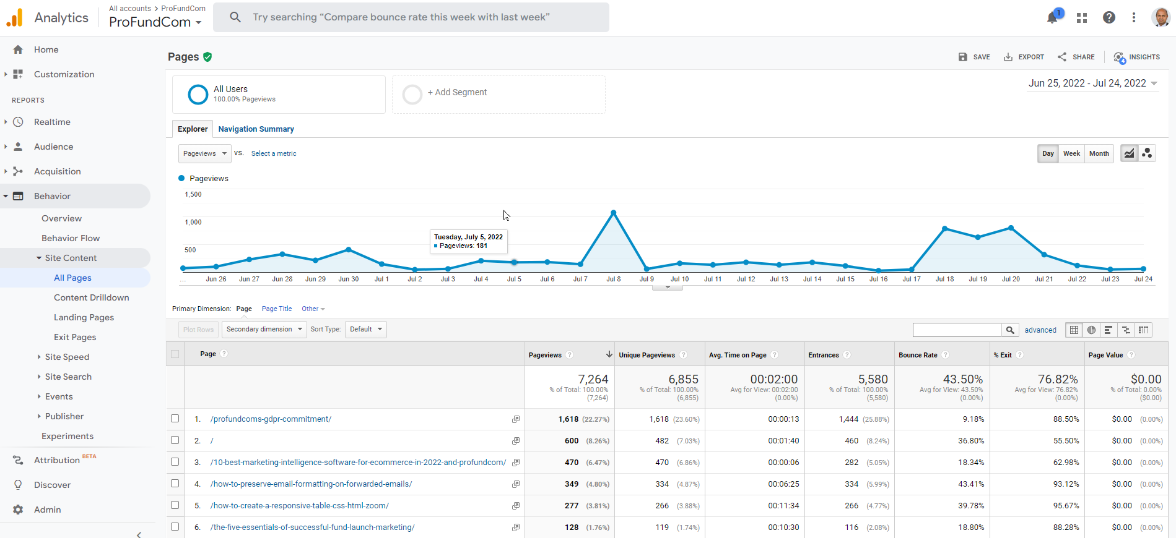
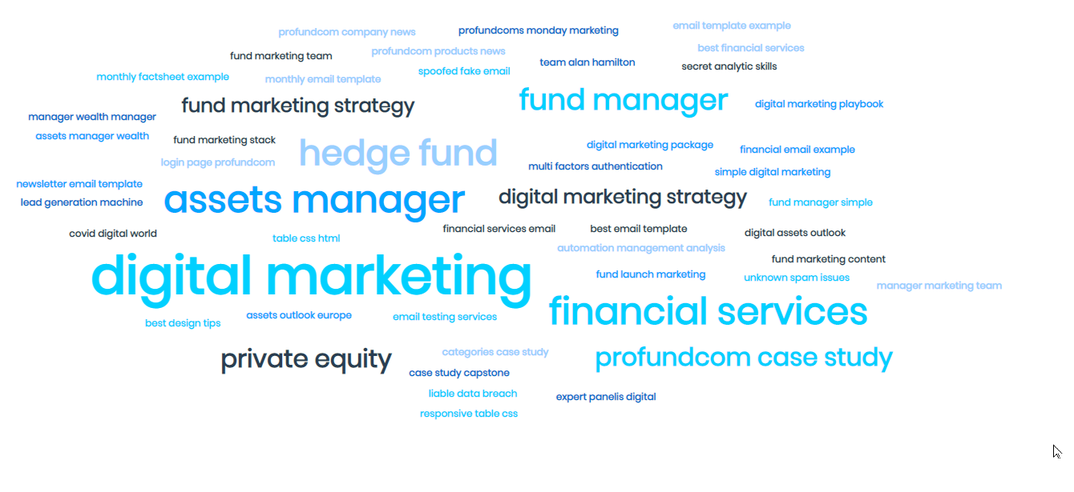
Google Analytics + Studio + Thematic Analysis
We all know about dashboards

Slide 11
Google Analytics + Studio + Thematic Analysis
We all know about dashboards

Slide 12
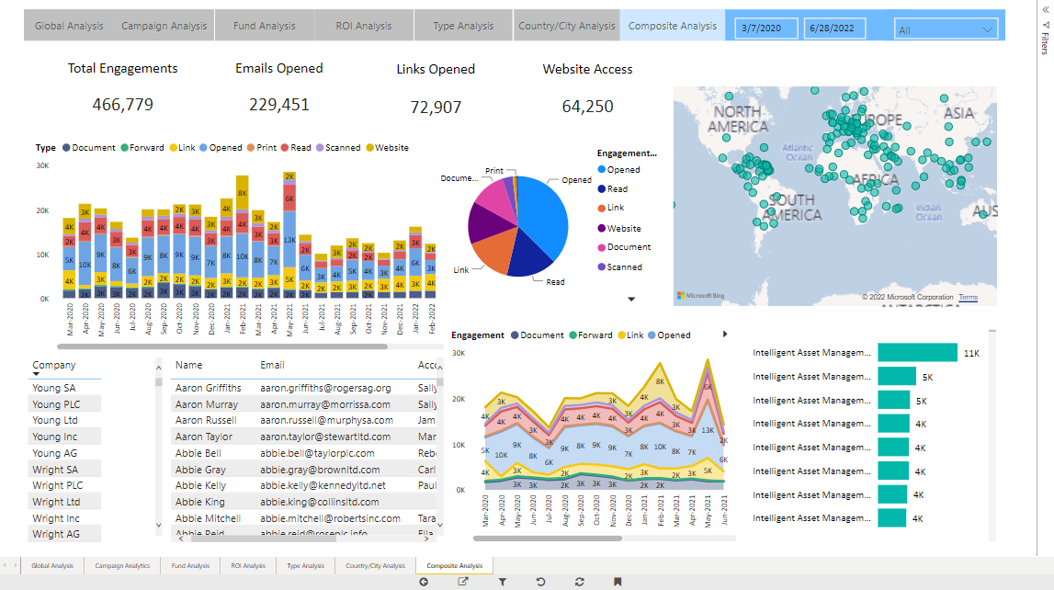
PowerBI + Tableau
We all know about dashboards

Slide 13
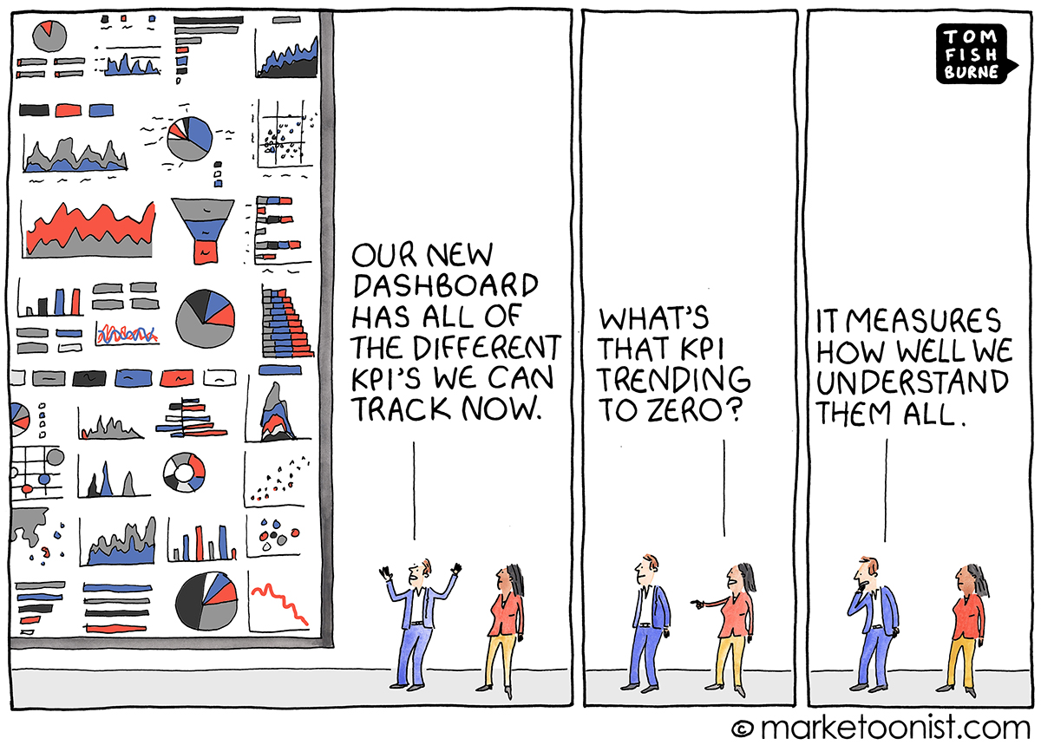
The Dashboard Trap
If my dashboard was so great, why did you download the data into Excel?

Slide 14
4 Analytic Skills For Fund Marketers
It’s not Rocket Science
1
01
What tools do you need?
2
How to successfully integrate analytics
02
3
How to analyse analytics effectively
03
4
How to leverage data into actionable business data
04

Slide 15
Single View
We All Want A Single View – What We Really Want Is Actionable Insights

Slide 16
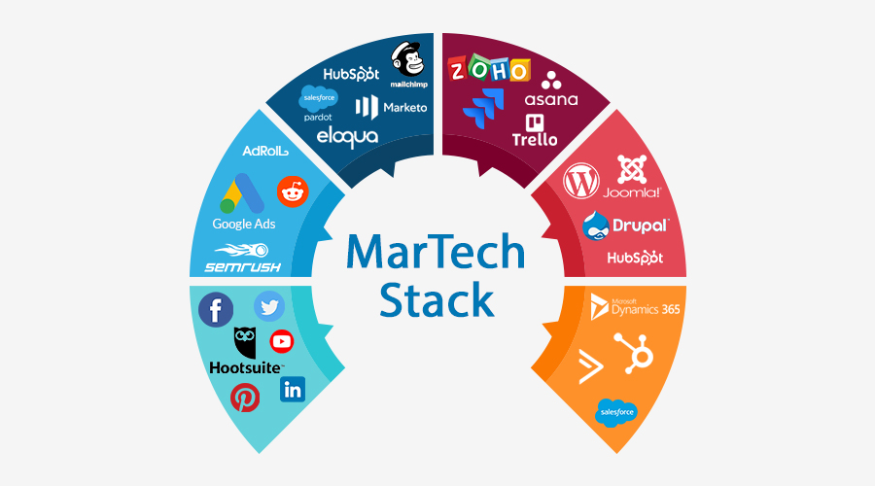
Lots Of Moving Parts – Marketing Is Hard
What Do We Need To Get Right?

Slide 17
Lots Of Moving Parts – Marketing Is Hard
What Do We Need To Get Right?
CRM
DELIVERY
SEO
CONTENT
Social
ANALYTICS

Slide 18
















Lots Of Moving Parts
What Do We Need To Get Right?
DELIVERY
CHECKS
ANALYTICS
CONTENT

Slide 19
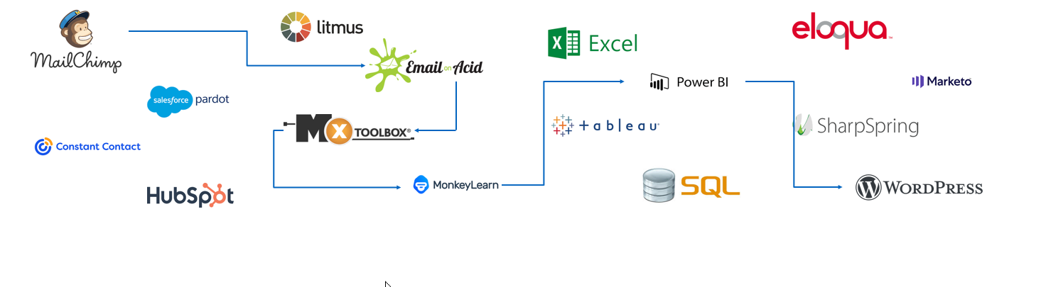
Lots Of Moving Parts
Lots To Go Wrong
DELIVERY
CHECKS
ANALYTICS
CONTENT

Slide 20
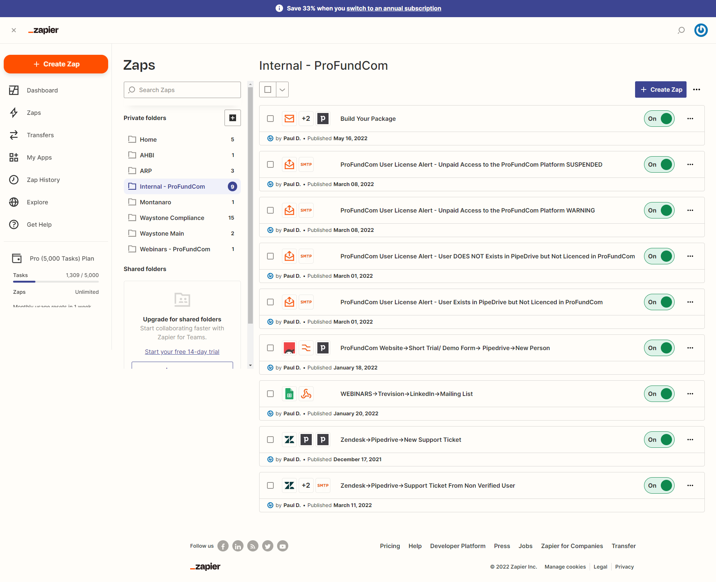
No-Code Platforms
You still end up being a coder
Zapier
Integrately
MuleSoft
Celigo
Workato
Boomi
Tray.io
Cloud Elements

Slide 21
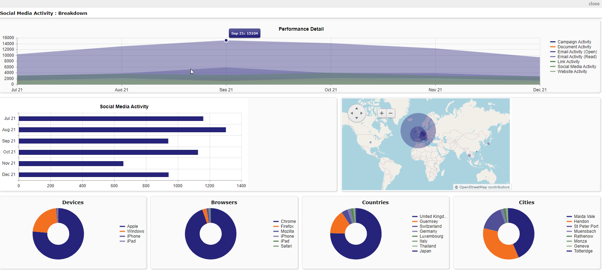
Out-of-the-box Analytics
Every Channel Adds 15% Inefficiency

Slide 22
4 Analytic Skills For Fund Marketers
It’s not Rocket Science
1
01
What tools do you need?
2
How to successfully integrate analytics
02
3
How to analyse analytics effectively
03
4
How to leverage data into actionable business data
04

Slide 23
Out-of-the-box Analytics
Every Channel Adds 15% Inefficiency

Slide 24
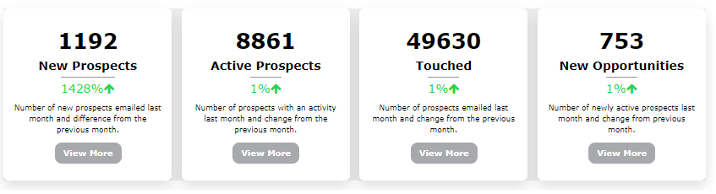
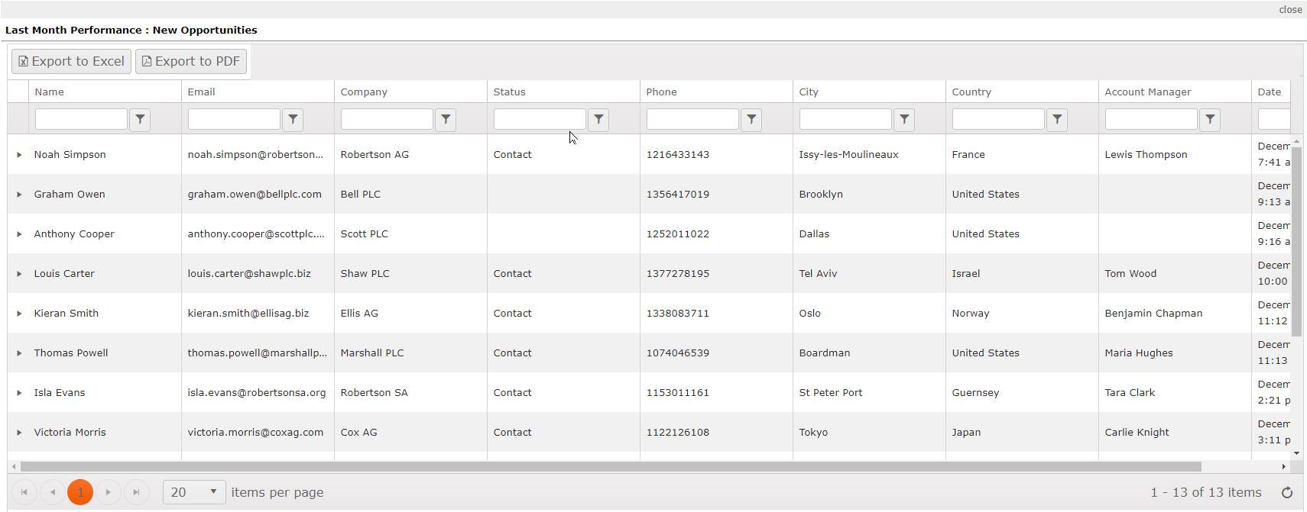
What Is the Cross-Channel ROI?
Every Channel Adds 15% Inefficiency

Slide 25
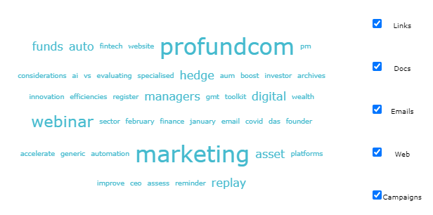
What Is Working Across All Channels?
Every Channel Adds 15% Inefficiency

Slide 26
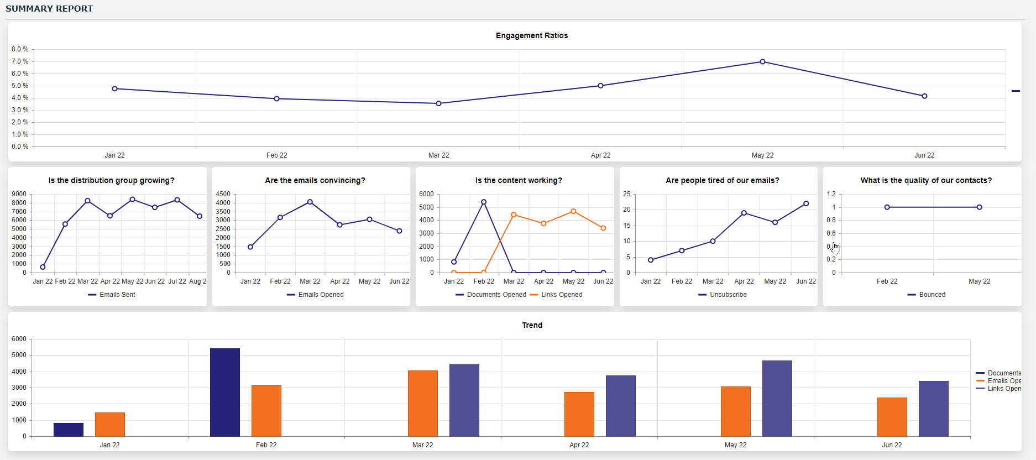
Is Our Audience Even Interested
Every Channel Adds 15% Inefficiency

Slide 27
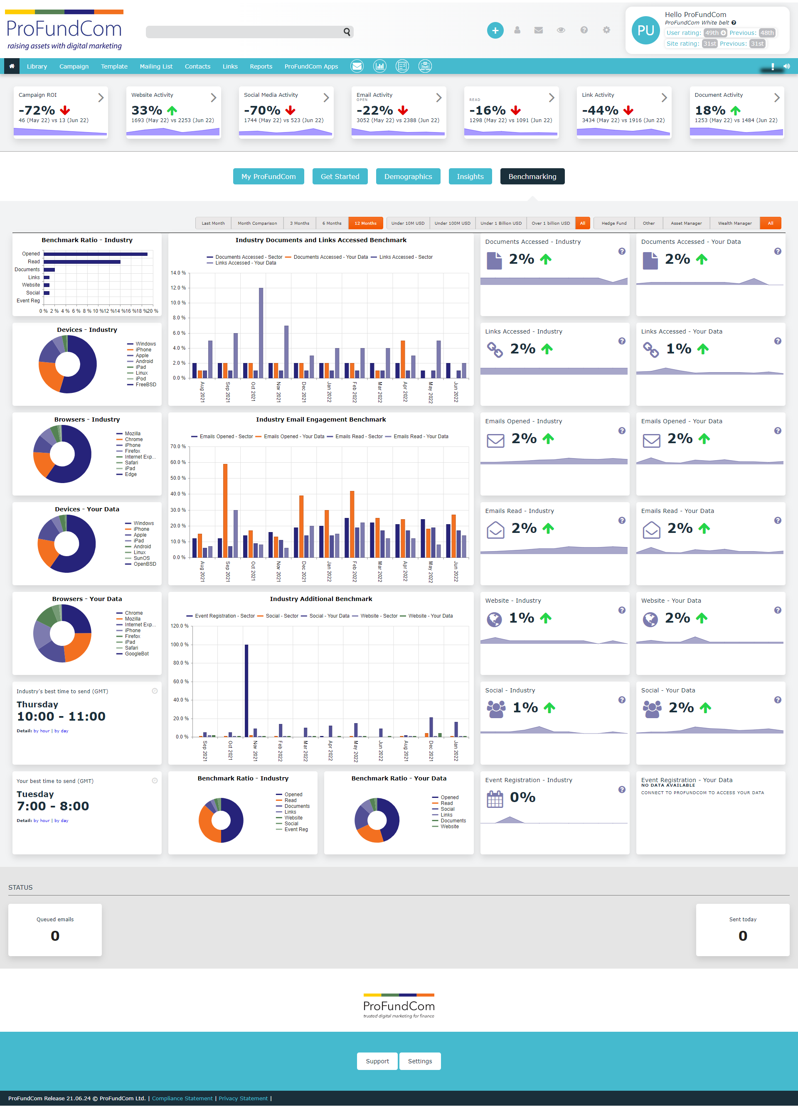
How Do We Compare
Every Channel Adds 15% Inefficiency

Slide 28
4 Analytic Skills For Fund Marketers
It’s not Rocket Science
1
01
What tools do you need?
2
How to successfully integrate analytics
02
3
How to analyse analytics effectively
03
4
How to leverage data into actionable business data
04

Slide 29
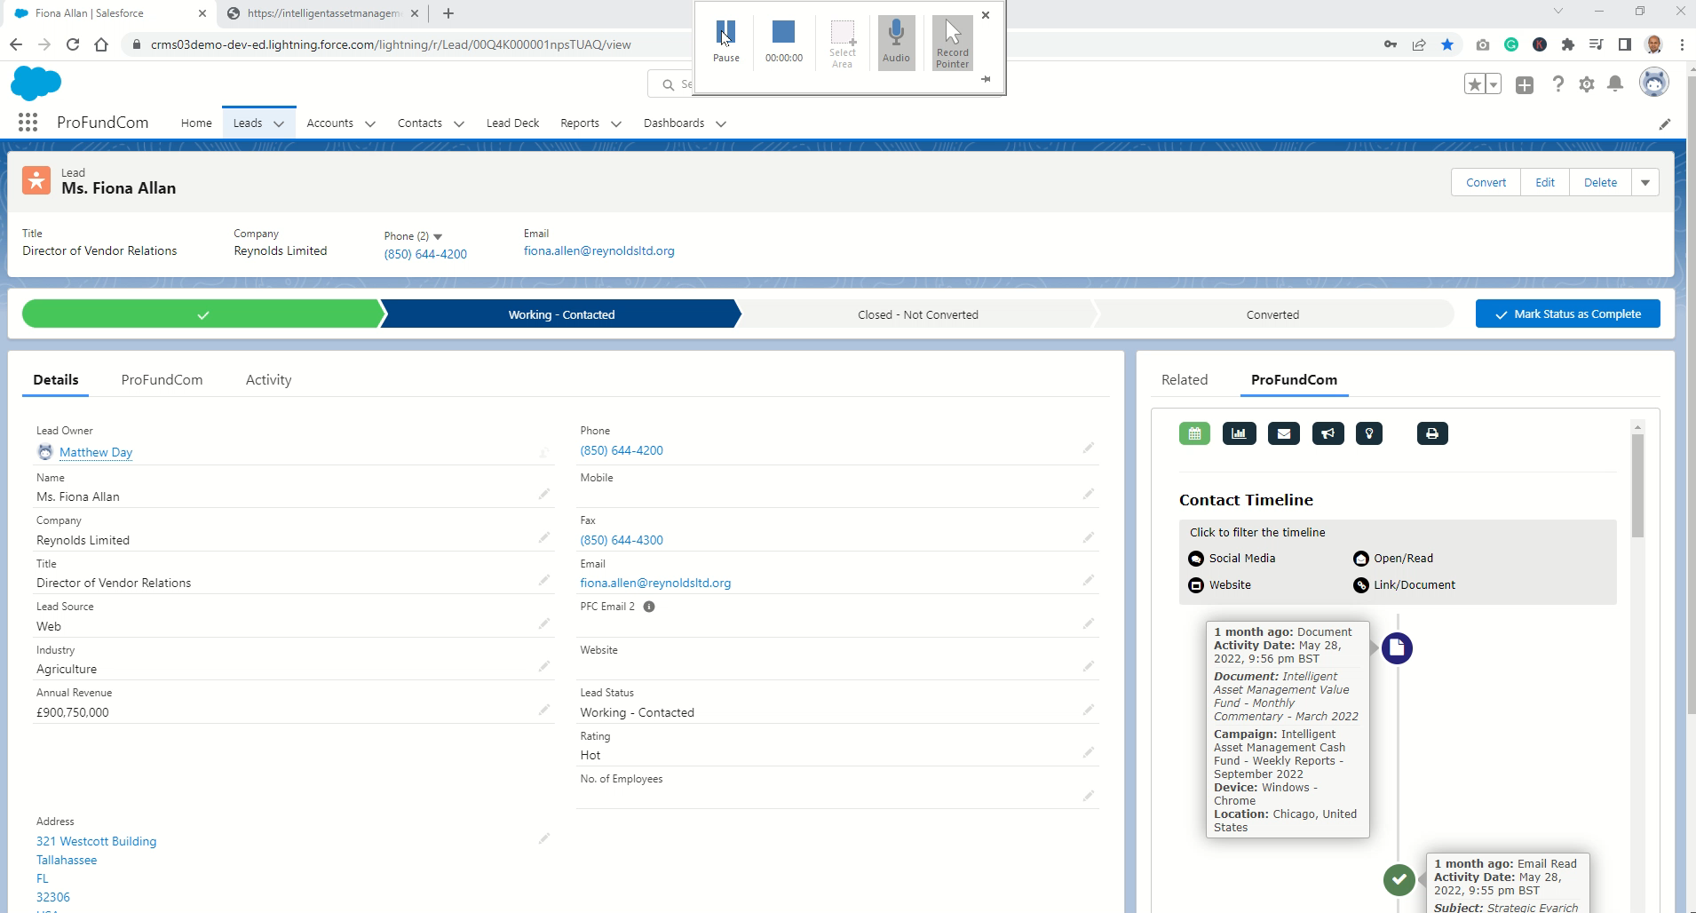
Actionable Actions For Sales
Single View Of All Contact Activity

Slide 30
4 Analytic Skills For Fund Marketers
It’s not Rocket Science
1
01
What tools do you need?
2
How to successfully integrate analytics
02
3
How to analyse analytics effectively
03
4
How to leverage data into actionable business data
04

Slide 31

ProFundCom Consultation
Offer To Webinar Attendees
FREE 1 Hour Digital Marketing Audit & Consultation or Just Ask Nicely for the book !

Slide 32
The Secret Analytical Skills for Fund Marketing Teams


