Slide 1

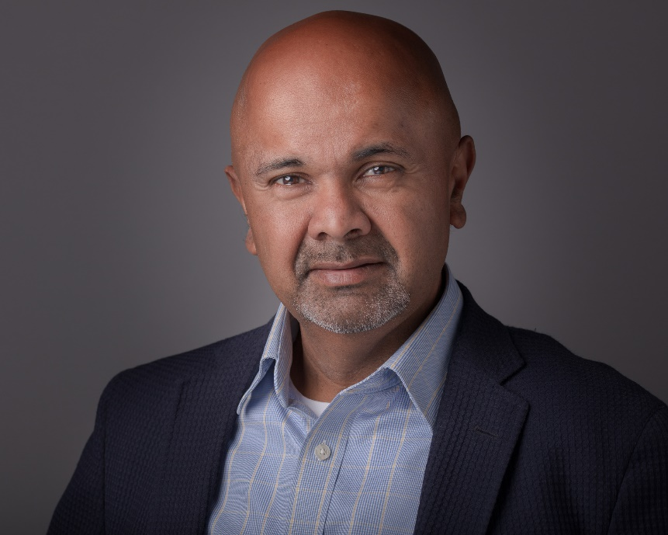
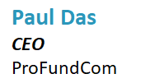
4 Key Considerations When Evaluating Your Fund Marketing Stack


Slide 2
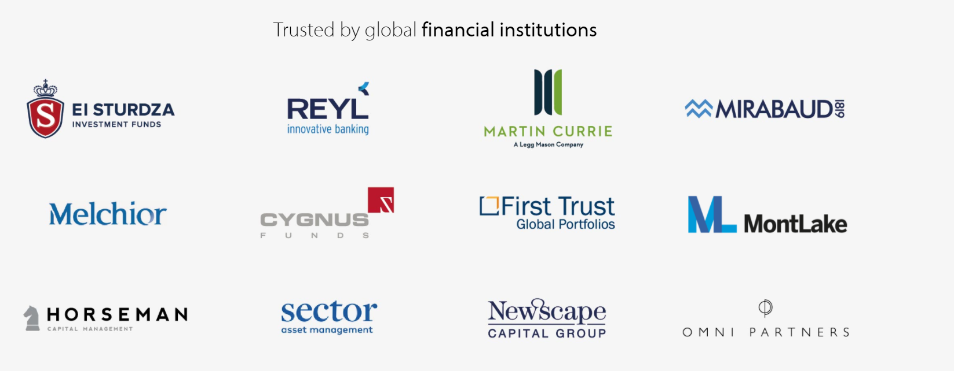

We Are ProFundCom
Using Digital Marketing to Raise AuM
200+ Users
30+ Apps
18th Year
For the last 20 years we have helped fund managers identify new investment opportunities as well as be alerted to redemption risks using digital marketing
Our Clients

Slide 3
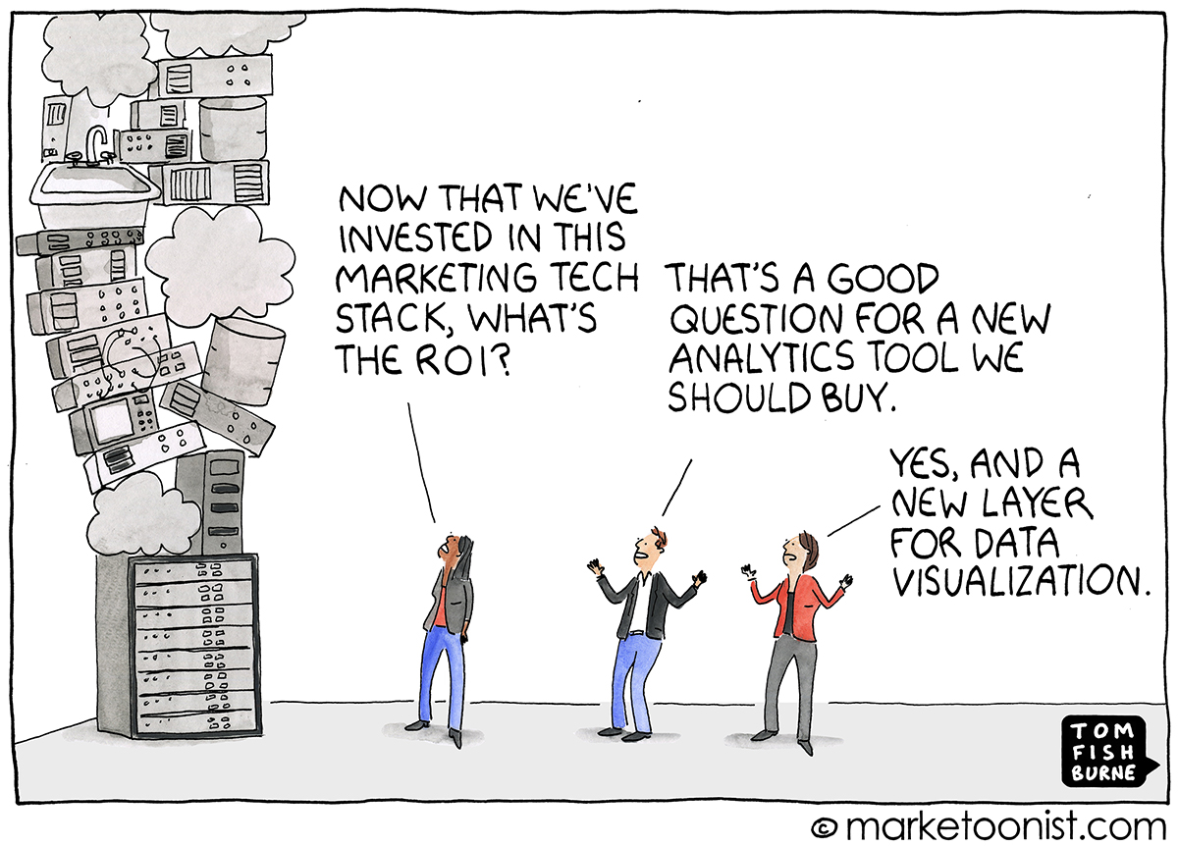
Why Does Your Stack Matter
Because You Are Not The Experts – You Are Marketers

Slide 4
Why Do You Need A Marketing Stack?
The Investor Journey Is Totally Digital
Thought
Leadership
Investment
Advice
Retention
Review
Inbound
Queries
Market Event
Comms
Due
Diligence
Website
Outbound
Marketing
Asset
Allocation
Client Advisory
Board
AWARENESS
CONSIDERATION
DECISION
SERVICE
LOYALTY
Sales
Pitch
Downgrade
Warnings
Events
Press
Asset
Transfer
Performance
Warnings
Manager
Change
Social
Media
Onboarding
Mandate
Change
Response to
Issues and Errors

Slide 5
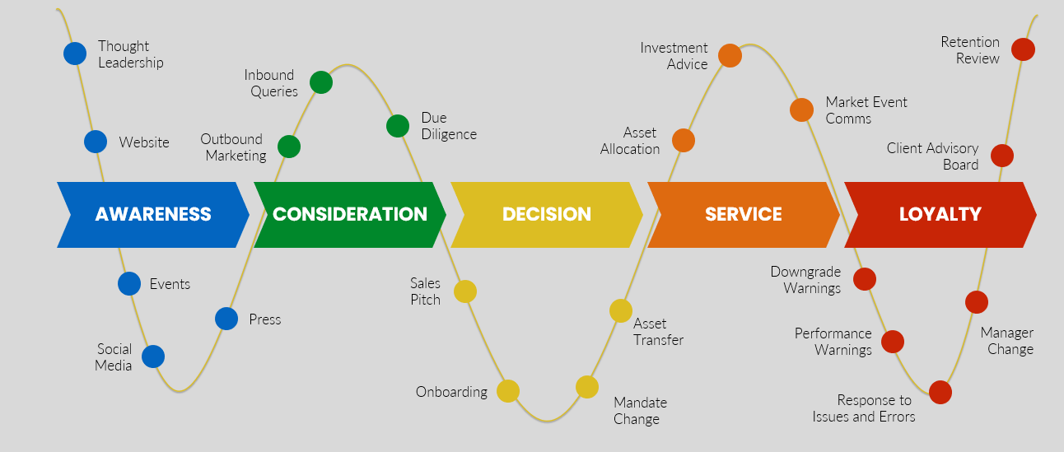
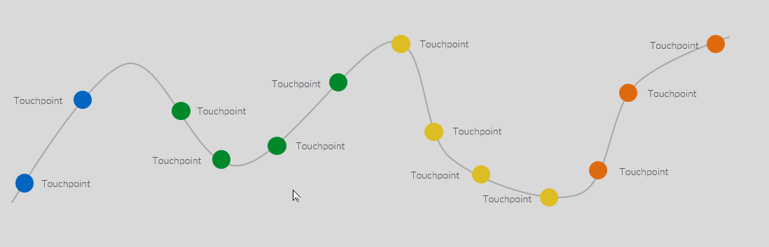
Why Do You Need A Marketing Stack?
Lies, Lies, Lies
What They Told Me
How It Is Going

Slide 6
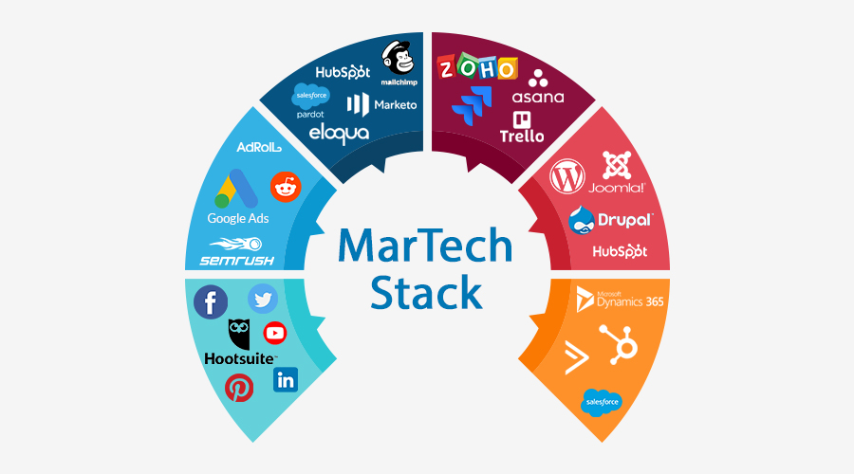
Lots Of Moving Parts – Marketing Is Hard
What Do We Need To Get Right?

Slide 7
The Marketing Stack Selection Problem
Different Agendas
Raise AuM
Preserve AuM
Demonstrate RoI
Get more budget
Get a pay rise
Sell Licences
Sell Consulting
Sell Support
7 Year
Cycle
Your Agenda
Their Agenda

Slide 8
4 Things For Fund Managers
The More Data Points The Better
1
Workflows - how to join the dots
01
2
CRM - how compatible with other systems?
02
3
Email marketing platforms - does it matter?
03
4
Analytics & integration - never operate in siloes
04

Slide 9
Lots Of Moving Parts – Marketing Is Hard
What Do We Need To Get Right?
CRM
DELIVERY
SEO
CONTENT
Social
ANALYTICS

Slide 10






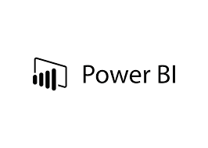


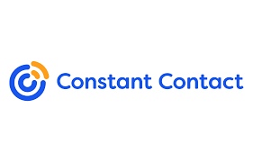






Lots Of Moving Parts
What Do We Need To Get Right?
DELIVERY
CHECKS
ANALYTICS
CONTENT

Slide 11
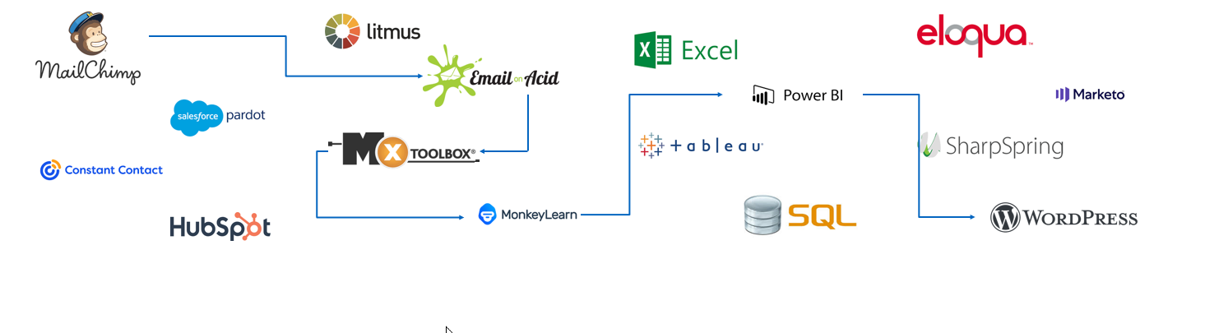
Lots Of Moving Parts
Lots To Go Wrong
DELIVERY
CHECKS
ANALYTICS
CONTENT

Slide 12


Lots Of Moving Parts
Lots To Go Wrong
Less is More
Please No

Slide 13
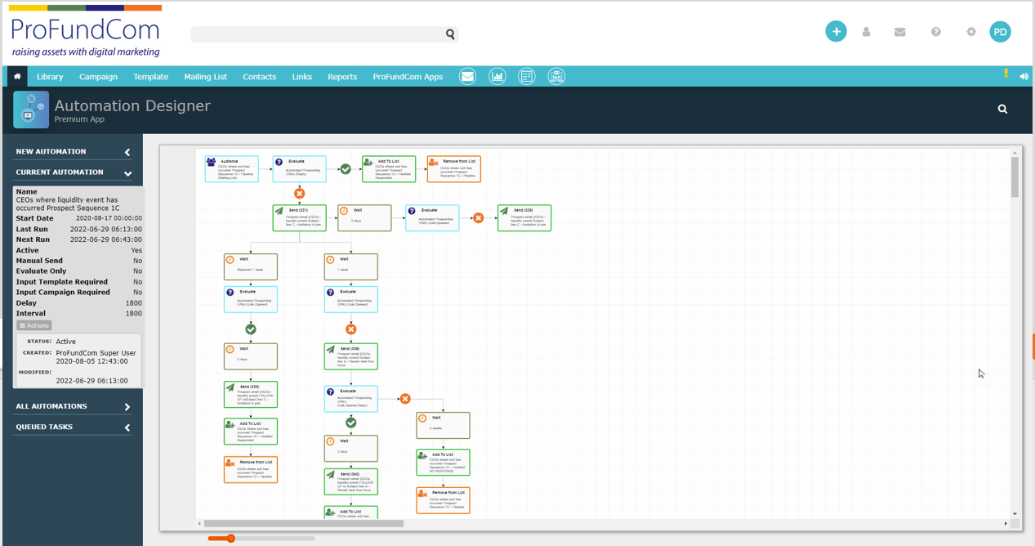
What Options Are Available
What Do We Need To Get Right?

Slide 14
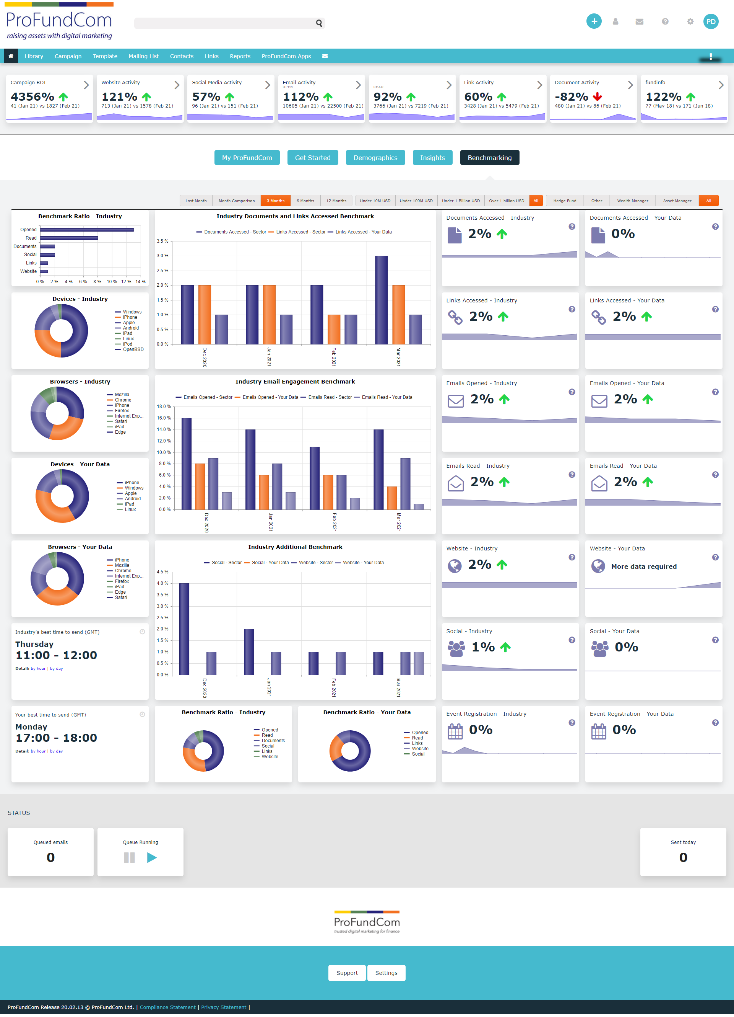
What Options Are Available
What Do We Need To Get Right?

Slide 15
4 Things For Fund Managers
The More Data Points The Better
1
Workflows - how to join the dots
01
2
CRM - how compatible with other systems?
02
3
Email marketing platforms - does it matter?
03
4
Analytics & integration - never operate in siloes
04

Slide 16

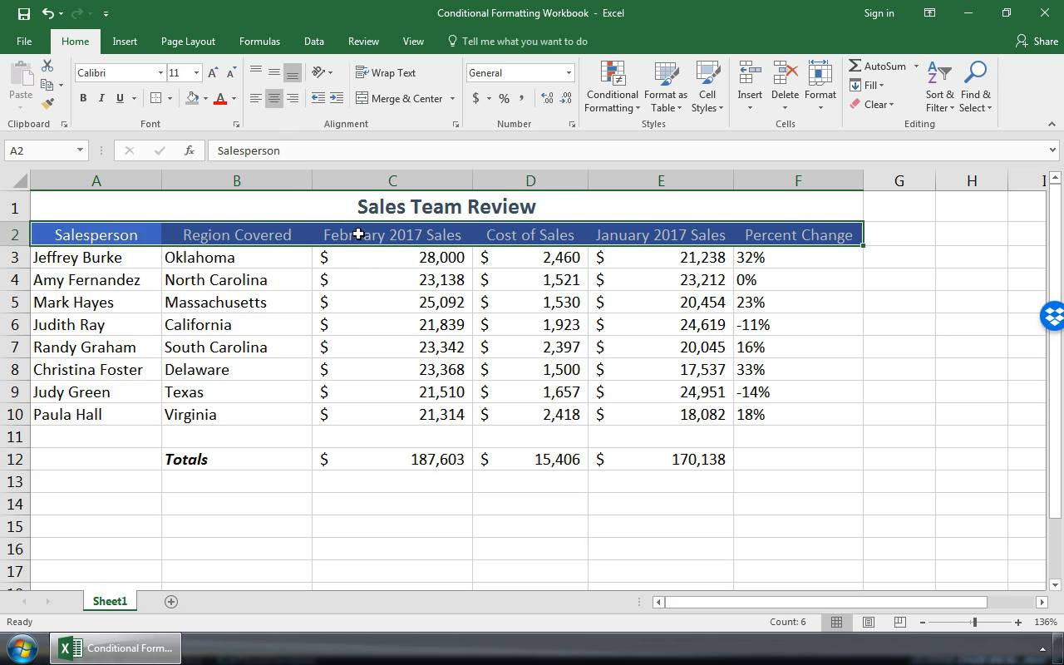
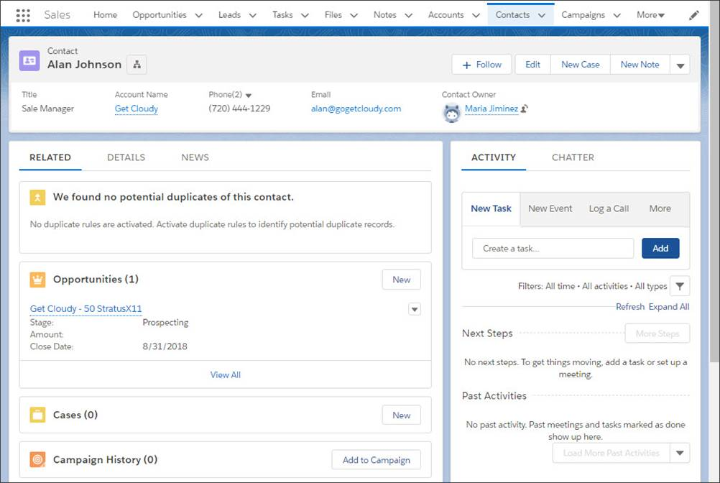

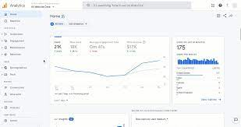



Connect Sales and Marketing
Single View Of All Contact Activity

Slide 17
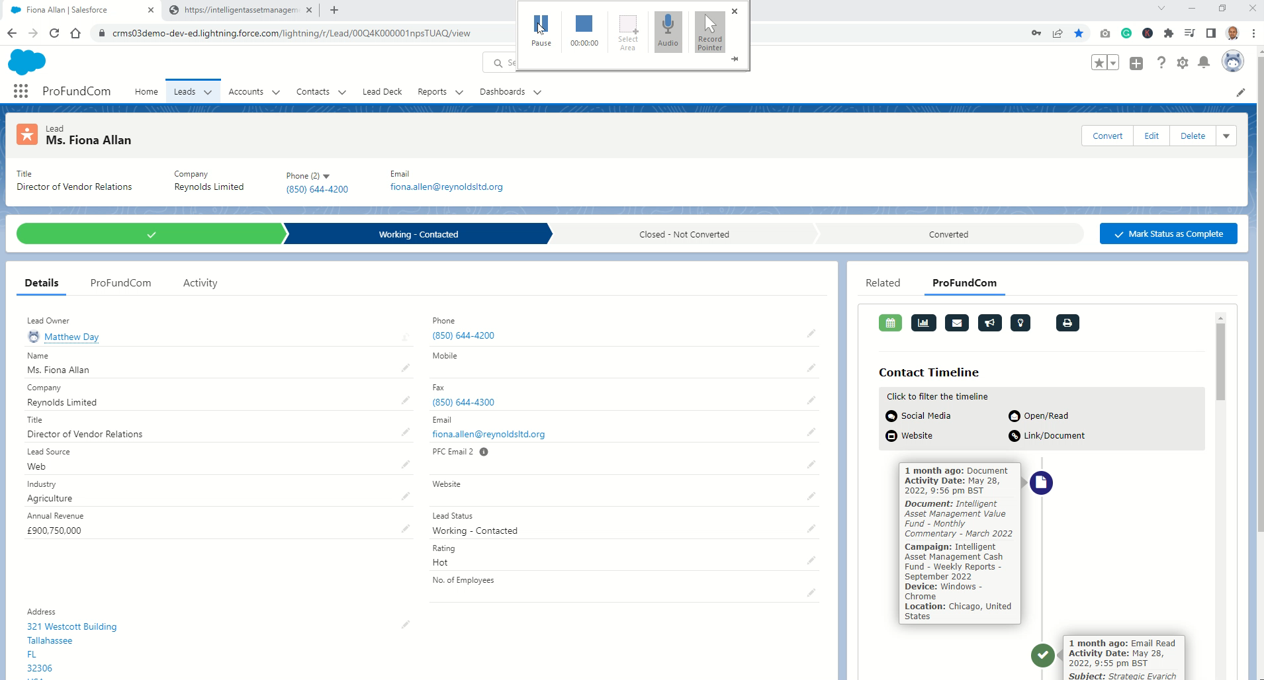
Connect Sales and Marketing
Single View Of All Contact Activity

Slide 18
4 Things For Fund Managers
The more data points the better
1
Workflows - how to join the dots
01
2
CRM - how compatible with other systems?
02
3
Email marketing platforms - does it matter?
03
4
Analytics & integration - never operate in siloes
04

Slide 19
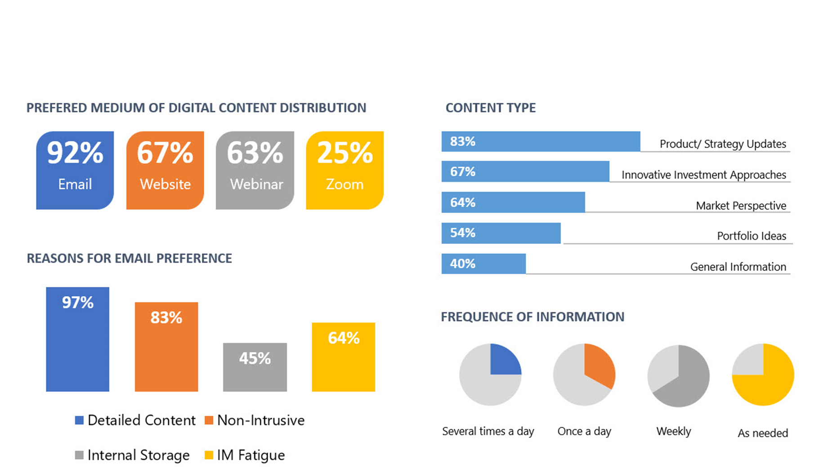
The Reason Why Email Is Relevant
Going Back To Email

Slide 20
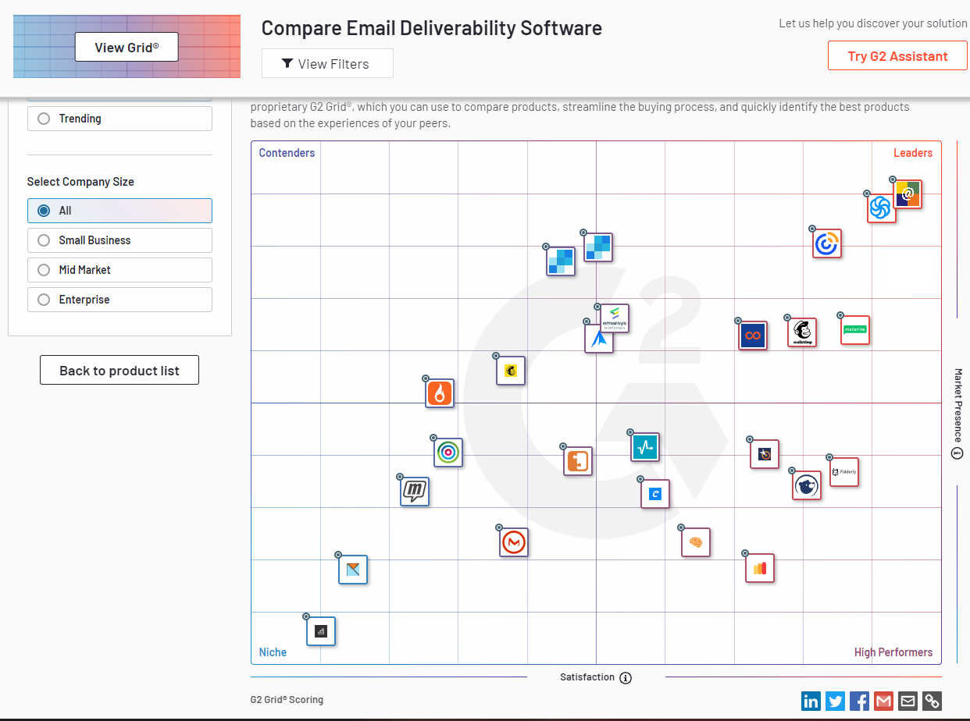
It Is The Deliverability, Stupid
Going Back To Email

Slide 21
Email Delivery – Avoiding Checkmate
Not All Platforms Care About Delivery
SPF/ DKIM
IP Reputation
Image Density
Anti-Spoofing
Bulk Email Detection

Slide 22
Email Delivery – Avoiding Checkmate
Not All Platforms Care About Delivery
Content Triggers
Body and Subject
Mixing of HTTP
And HTTPS content
Non-Existent
Sender
Text Equivalents
SPAM Reports

Slide 23
Email Delivery – Avoiding Checkmate
Not All Platforms Care About Delivery
Bounce
Management
Identical
Content
Images Not
Embedded
Too Many BCC’d
Too Many CC’s

Slide 24
Email Delivery – Avoiding Checkmate
Not All Platforms Care About Delivery

Slide 25
4 Things For Fund Managers
The More Data Points The Better
1
Workflows - how to join the dots
01
2
CRM - how compatible with other systems?
02
3
Email marketing platforms - does it matter?
03
4
Analytics & integration - never operate in siloes
04

Slide 26
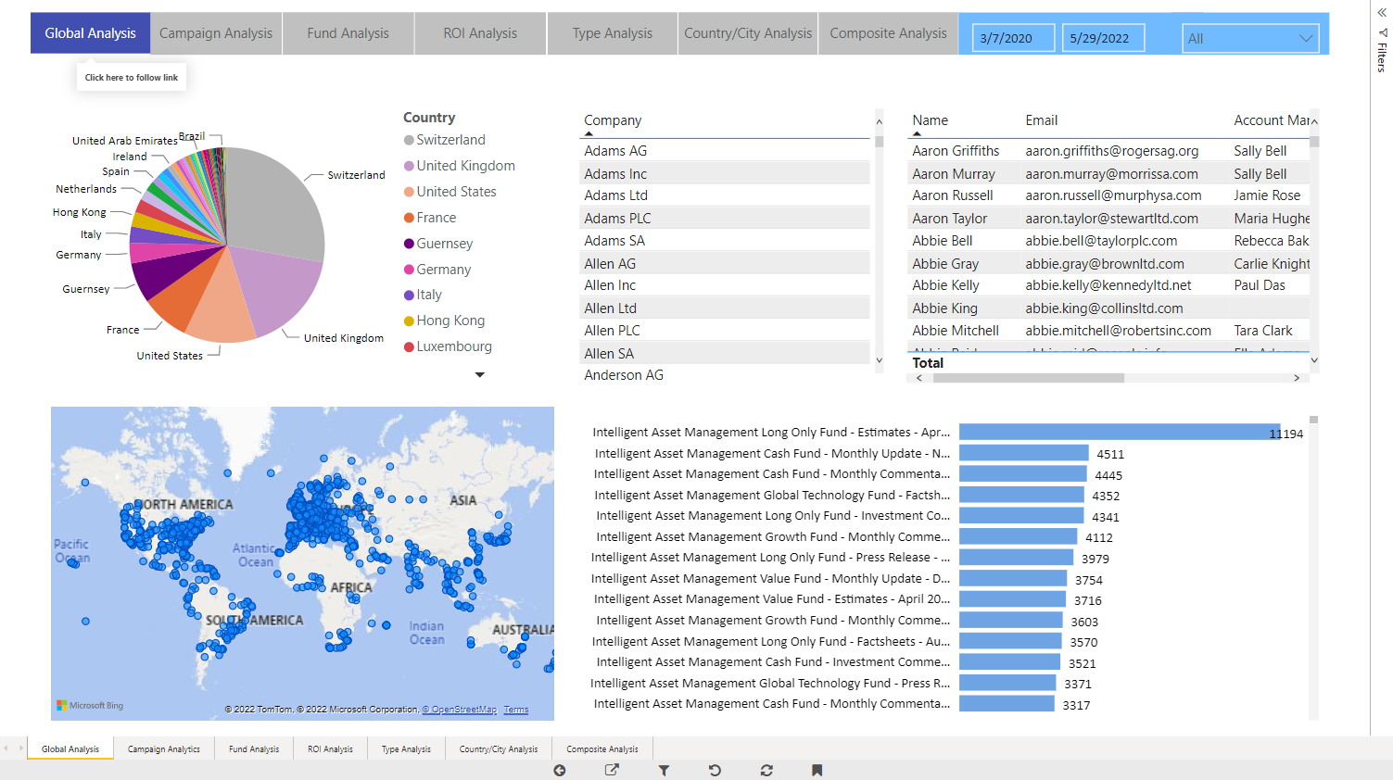
What Is Working Across All Channels?
Every Channel Adds 15% Inefficiency

Slide 27
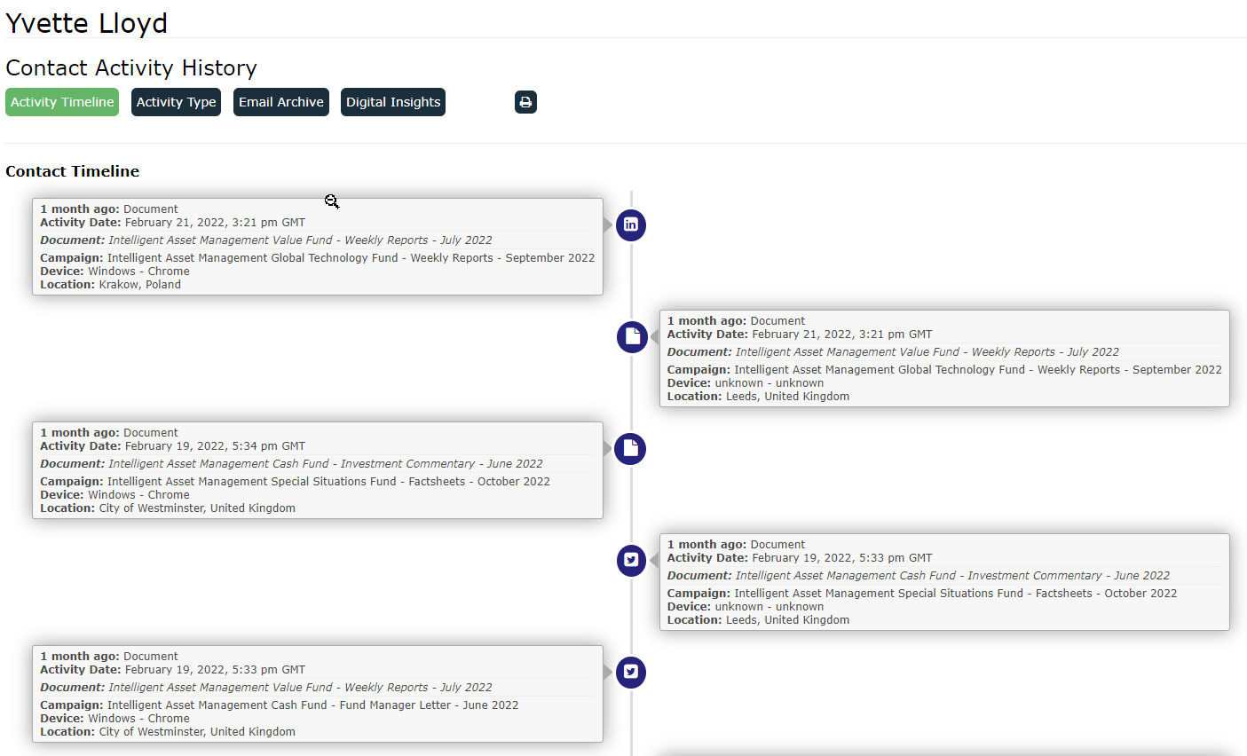
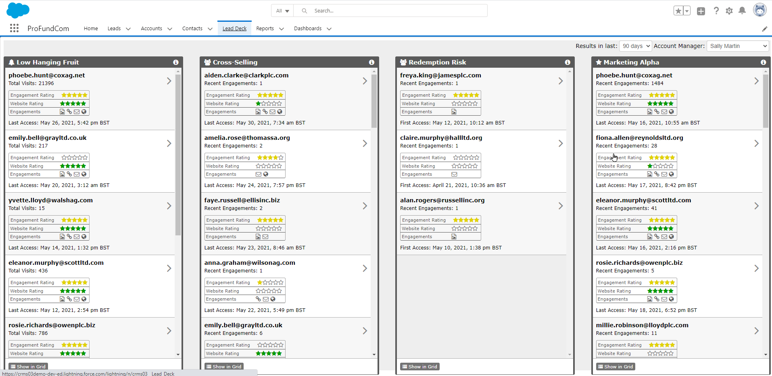
Who Are We Attracting Across All Channels
Every Channel Adds 15% Inefficiency

Slide 28
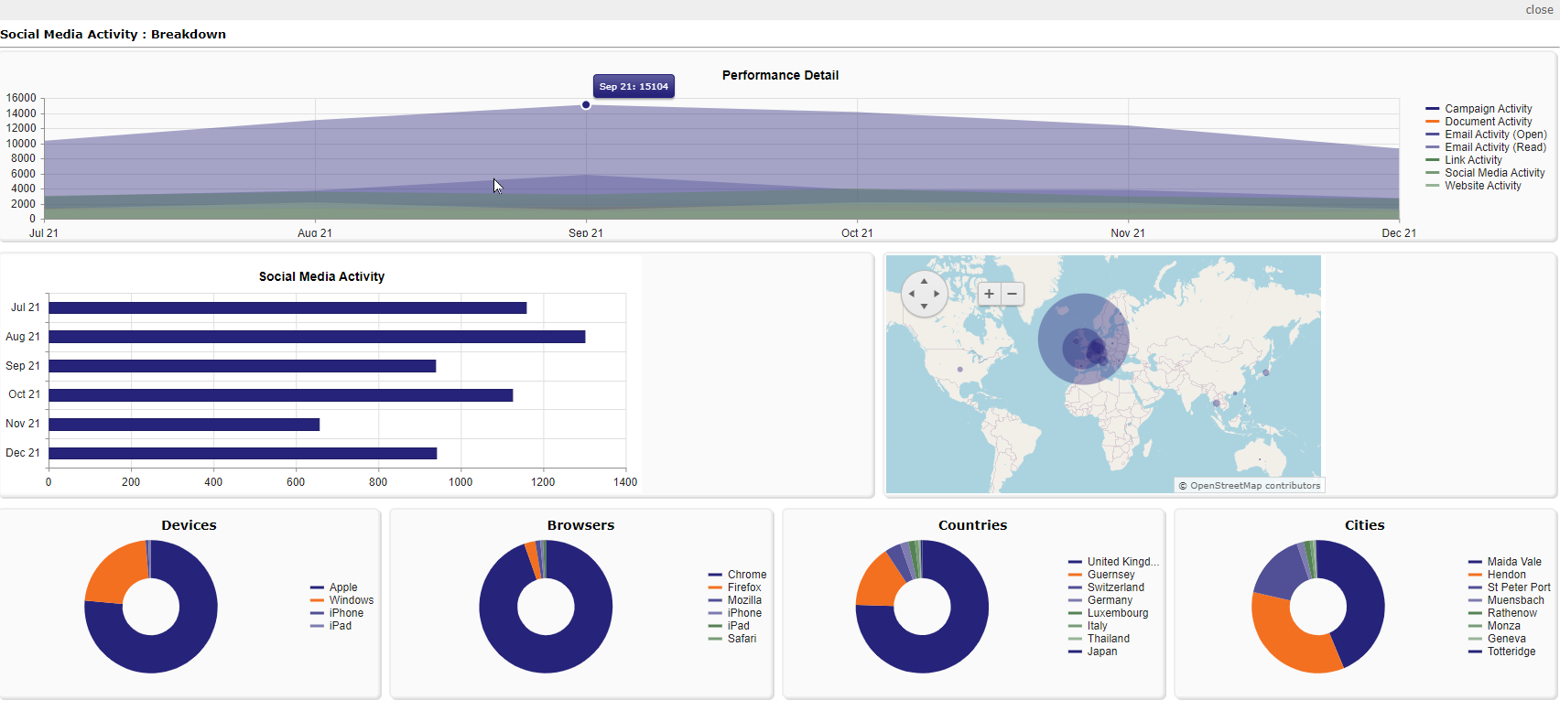
How Are All Channels Performing?
Every Channel Adds 15% Inefficiency

Slide 29
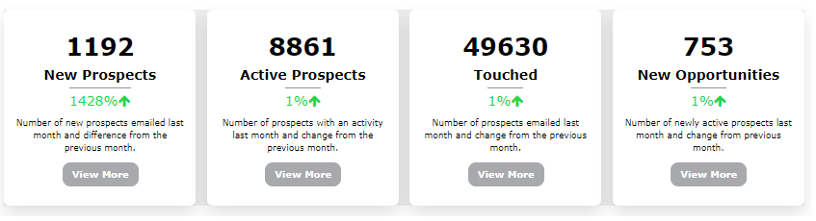
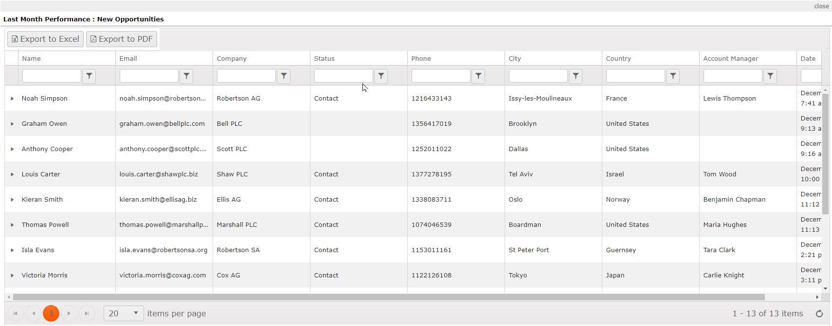
What Is the Cross-Channel ROI?
Every Channel Adds 15% Inefficiency

Slide 30
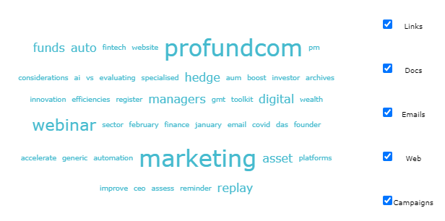
What Is Working Across All Channels?
Every Channel Adds 15% Inefficiency

Slide 31
4 Things For Fund Managers
The More Data Points The Better
1
Workflows - how to join the dots
01
2
CRM - how compatible with other systems?
02
3
Email marketing platforms - does it matter?
03
4
Analytics & integration - never operate in siloes
04

Slide 32

ProFundCom Consultation
Offer To Webinar Attendees
FREE 1 Hour Digital Marketing Audit & Consultation or Just Ask Nicely for the book !

Slide 33
4 Key Considerations When Evaluating Your Fund Marketing Stack


