Slide 1

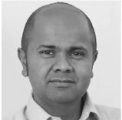
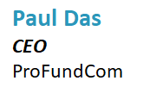
5-Step Guide to Creating & Distributing Great Fund Marketing Content


Slide 2
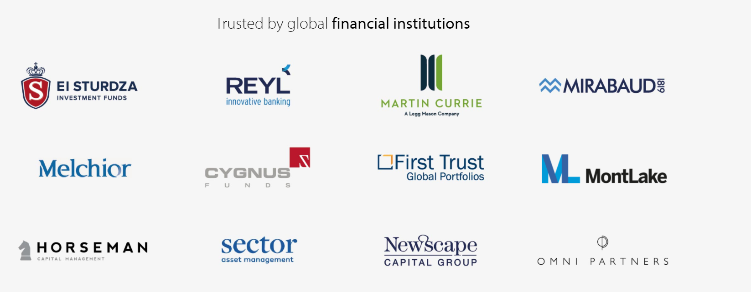

We Are ProFundCom
Using Digital Marketing to Raise AuM
For the last 20 years we have helped fund managers identify new investment opportunities as well as be alerted to redemption risks using digital marketing
Our Clients

Slide 3
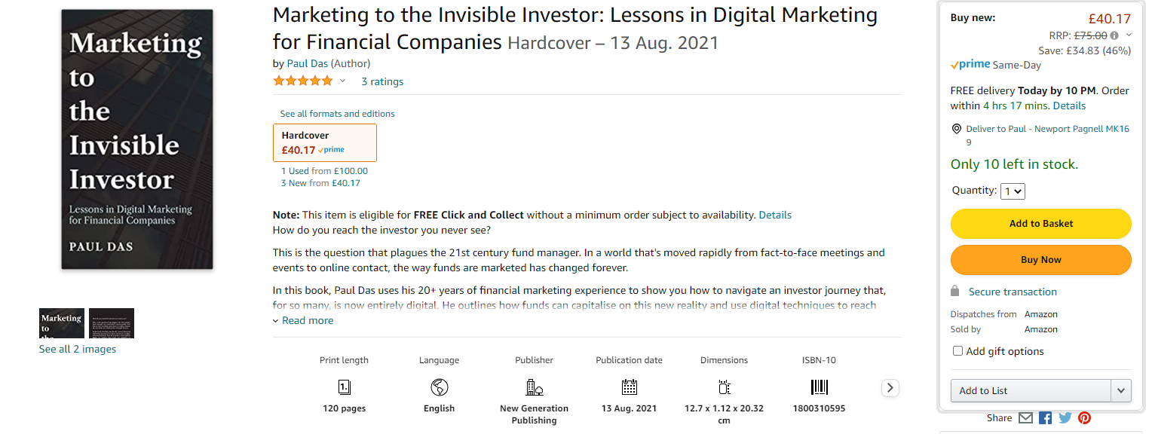
What Did You Do Over Covid?
Well, I Can Play Imagine

Slide 4
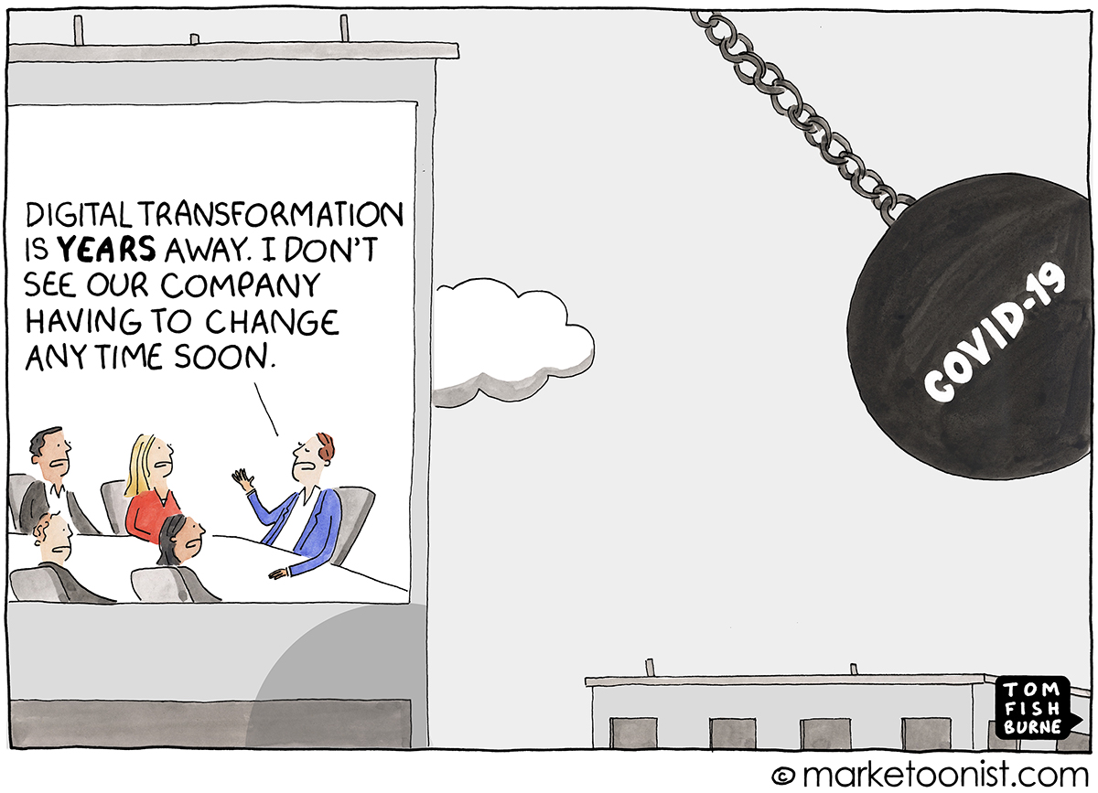
What Changed In 2021?
Some Changed

Slide 5
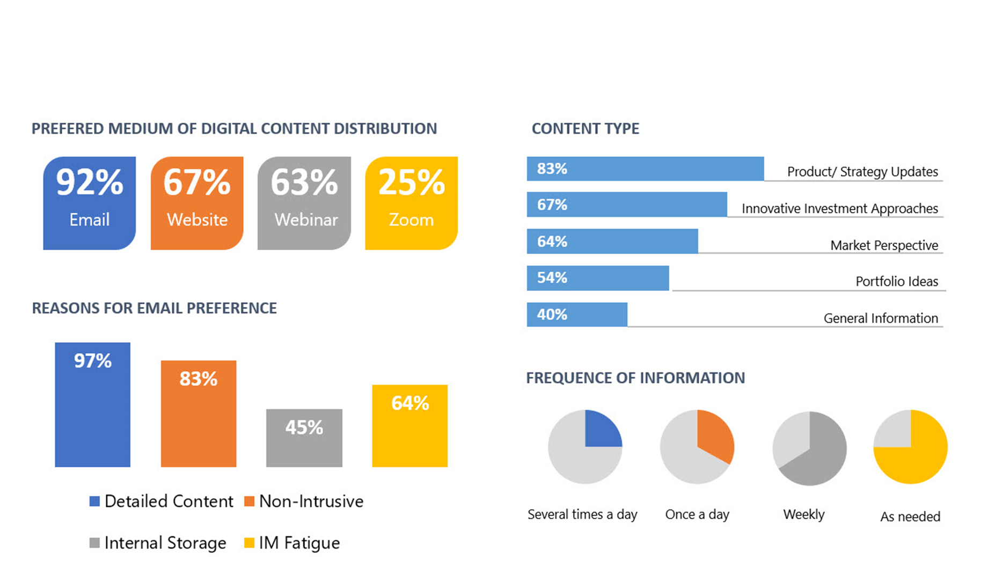
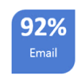
What Changed In 2021?
Going Back to Email

Slide 6
The Investor Journey is Totally Digital
Everything Is Data
Thought
Leadership
Investment
Advice
Retention
Review
Inbound
Queries
Market Event
Comms
Due
Diligence
Website
Outbound
Marketing
Asset
Allocation
Client Advisory
Board
AWARENESS
CONSIDERATION
DECISION
SERVICE
LOYALTY
Sales
Pitch
Downgrade
Warnings
Events
Press
Asset
Transfer
Performance
Warnings
Manager
Change
Social
Media
Onboarding
Mandate
Change
Response to
Issues and Errors

Slide 7
5 Things For Fund Managers
Do or Don’t – There Is No Try
1
01
Content Plan
2
Blogs, Whitepaper et al
02
3
Hacks
03
4
Sharing
04
5
Measure
05

Slide 8
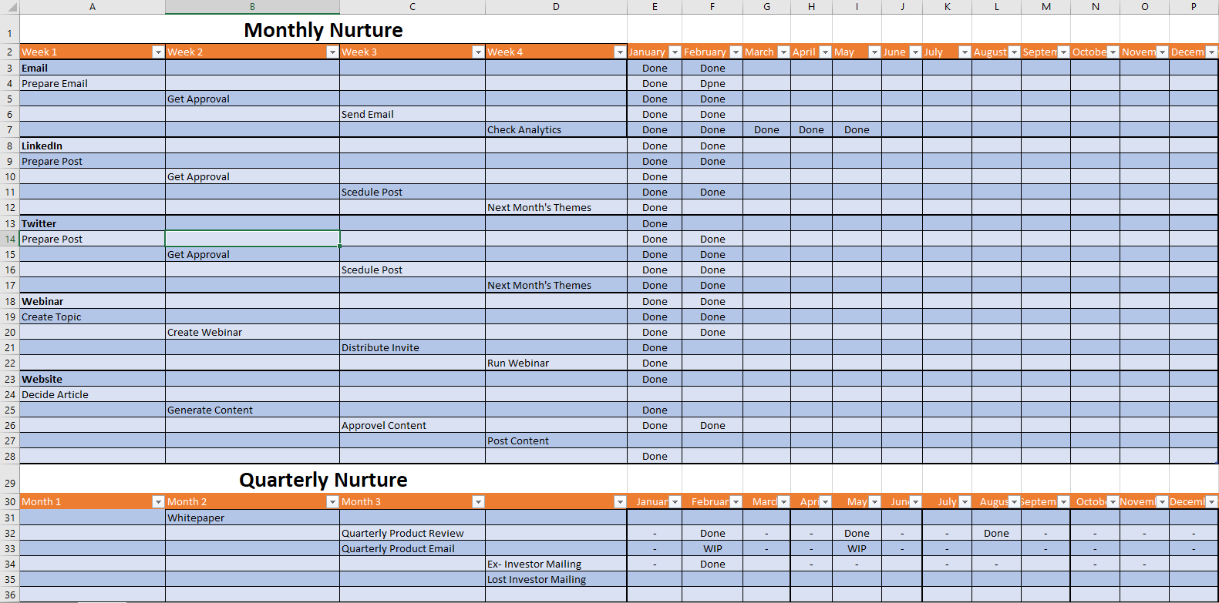
Content + Timing
The Plan

Slide 9
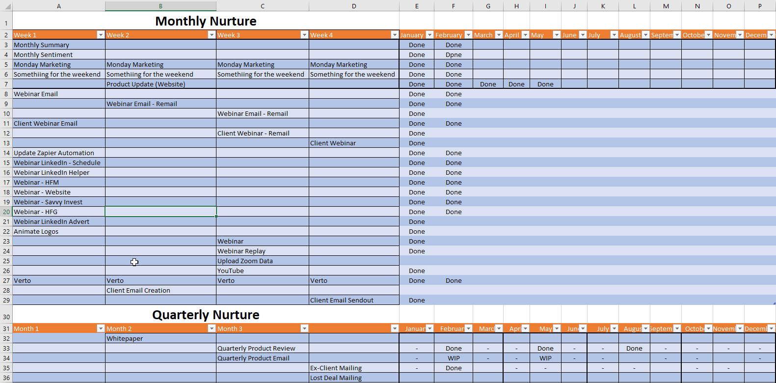
Content + Timing
The Plan

Slide 10
Content Distribution
Going Back to Email

Slide 11

Content Distribution
The Plan
Email Campaigns
01
02
Social Media
WEBSITE
Updates
Webinars
04
03

Slide 12
Content Distribution
The Plan
Email Campaigns
01
02
Social Media
WEBSITE
Updates
Webinars
04
03

Slide 13
Content Distribution
The Plan
CRM
01
02
Reporting
WEBSITE
Automations
Lead Scoring
04
03

Slide 14
Investor Centricity
A simpler, smarter investor experience based on understanding the investor’s perspective
Target individual interests in products across all digital and social media platforms.
INTERESTS
Provide a simpler, smarter investor experience but at the same time remain totally compliant.
Access to AI, Machine Learning and Big Data analysis to get metrics on what individuals are finding useful and what they are not.
ANALYSIS
SUCCESS

Slide 15
5 Things For Fund Managers
Do or Don’t – There Is No Try
1
01
Content Plan
2
Blogs, Whitepaper et al
02
3
Hacks
03
4
Sharing
04
5
Measure
05

Slide 16
Content Generation
Is Failure an Option?
Blogs
Thought
Leadership
Investment
Strategy
Webinars

Slide 17

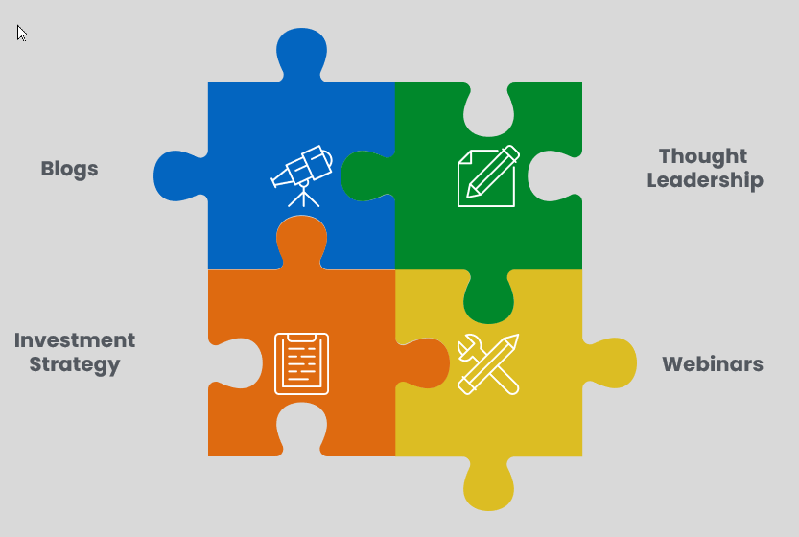
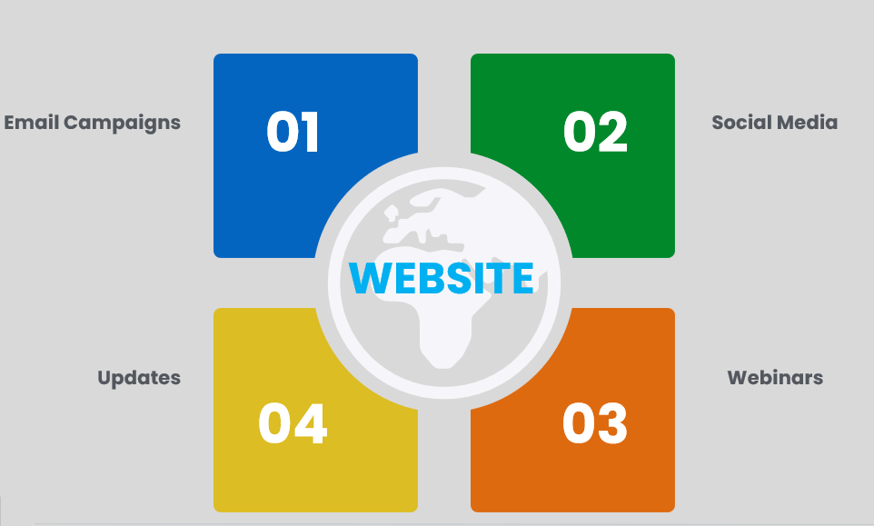
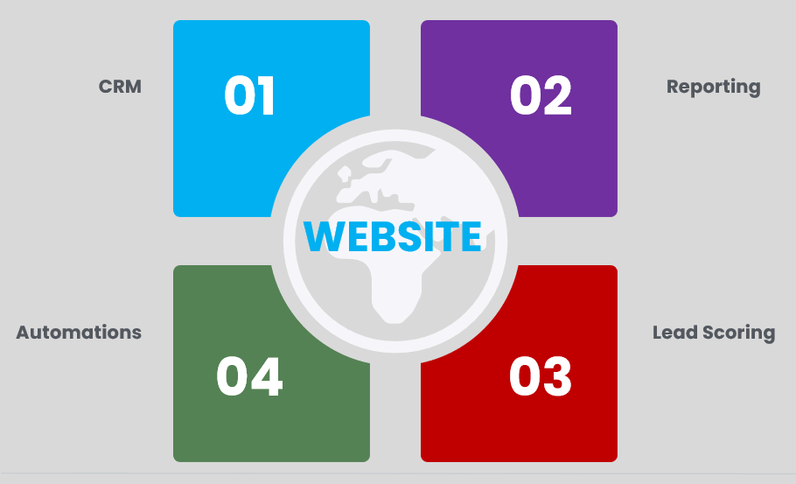



Multiformat
Not just VHS and BetaMax

Slide 18
Multiformat
Not just VHS and BetaMax
Email
LinkedIn
Twitter
Press
Podcasts
Video

Slide 19

Content Marketing
Content Philosophy
Content Philosophy
1
01
Educate
AGENDA SLIDE
2
02
Entertain
3
03
Enlighten

Slide 20

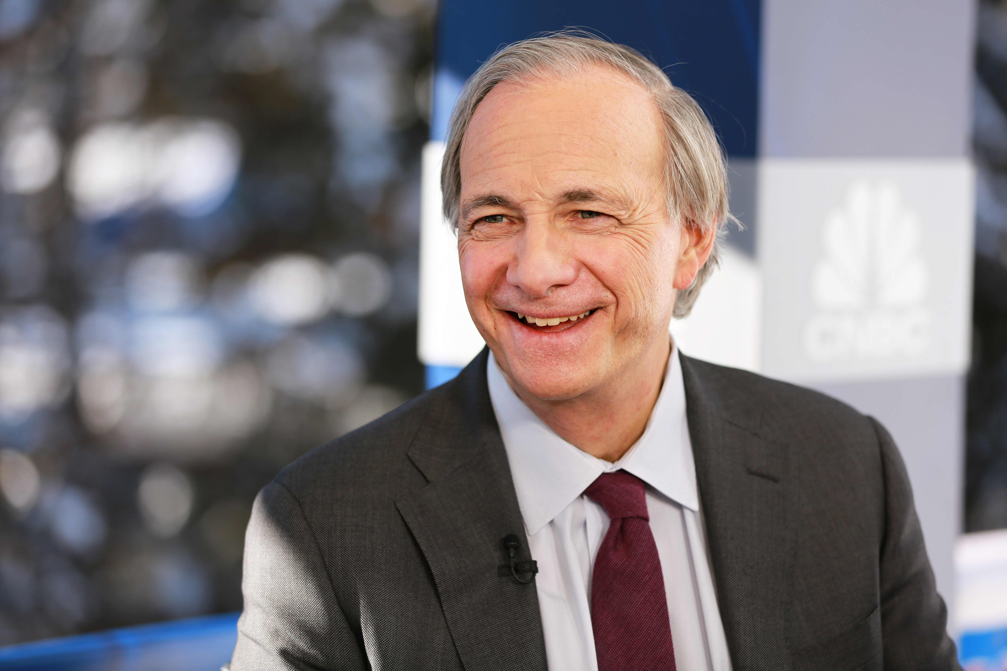
Content Marketing
Content Philosophy
The Power of Words
1
01
Investment Strategy
AGENDA SLIDE
2
02
Attitude to Risk
3
03
Performance

Slide 21
5 Things For Fund Managers
Do or Don’t – There Is No Try
1
01
Content Plan
2
Blogs, Whitepaper et al
02
3
Hacks
03
4
Sharing
04
5
Measure
05

Slide 22
Inbound Marketing
Do not under-estimate
SEO
Slow
Email
Platforms
Networking
Social
Posts
Existing
Investors
Ads
Social
DMs
Quick
Easy
Hard

Slide 23

Repurposing Content
Write Once – Use Many
Webinar
Whitepaper
Article
LinkedIn
Tweet

Slide 24
5 Things For Fund Managers
Do or Don’t – There Is No Try
1
01
Content Plan
2
Blogs, Whitepaper et al
02
3
Hacks
03
4
Sharing
04
5
Measure
05

Slide 25
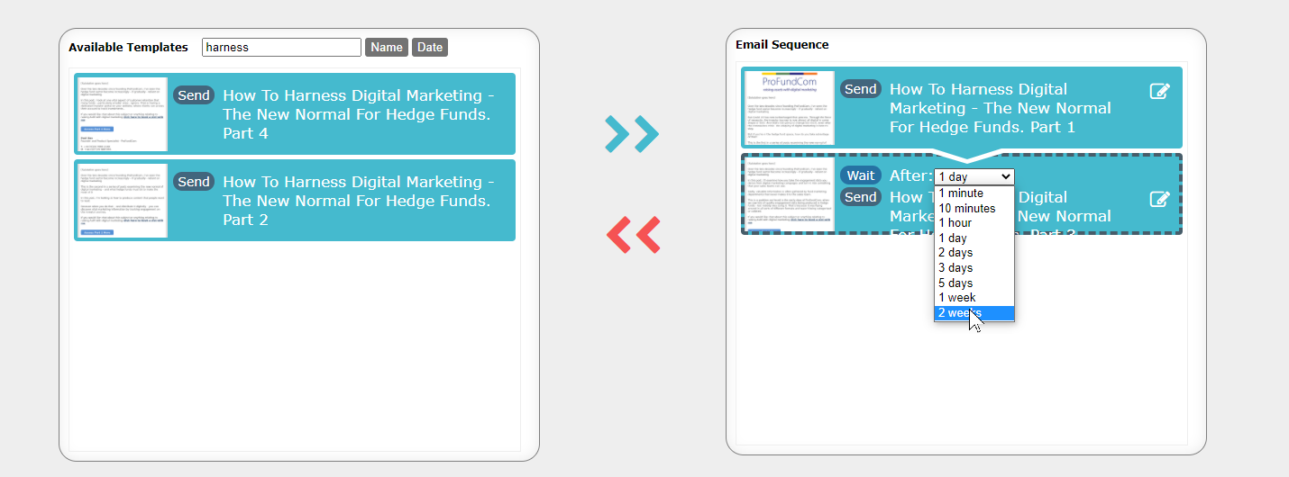
Nurture Campaigns
On a Trigger the Email Sends STOP

Slide 26
Increasing attendance at events and calls
What Outcomes Benefit the Business
Re-mail
Did not Open
Opened Link to Invite
Did not Register
Re-mail
Send Invite
Opened Invited
Did not open Link to Invite
Re-mail

Slide 27
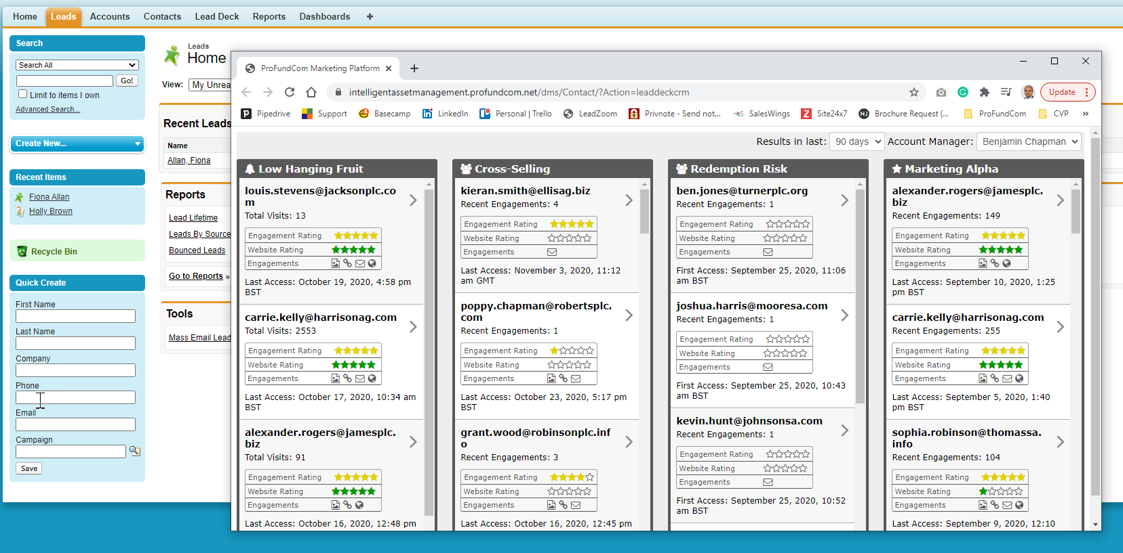
Lead Scoring
Taking the Noise Out of Marketing

Slide 28
5 Things For Fund Managers
Do or Don’t – There Is No Try
1
01
Content Plan
2
Blogs, Whitepaper et al
02
3
Insights
03
4
Sharing
04
5
Measure
05

Slide 29
Content Distribution
Going Back to Email

Slide 30
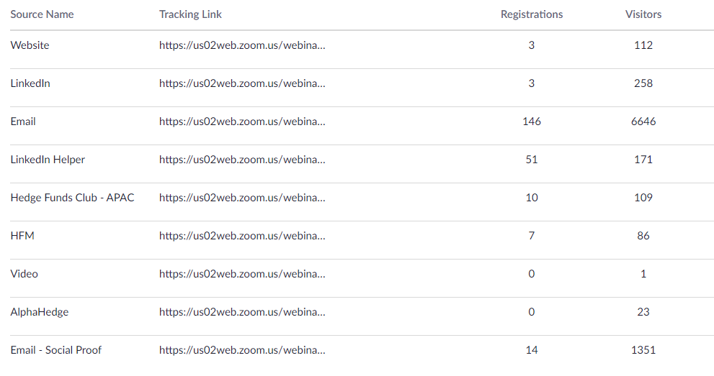
Content Distribution
Going Back to Email

Slide 31
5 Things For Fund Managers
Do or Don’t – There Is No Try
1
01
Content Plan
2
Blogs, Whitepaper et al
02
3
Hacks
03
4
Sharing
04
5
Measure
05

Slide 32
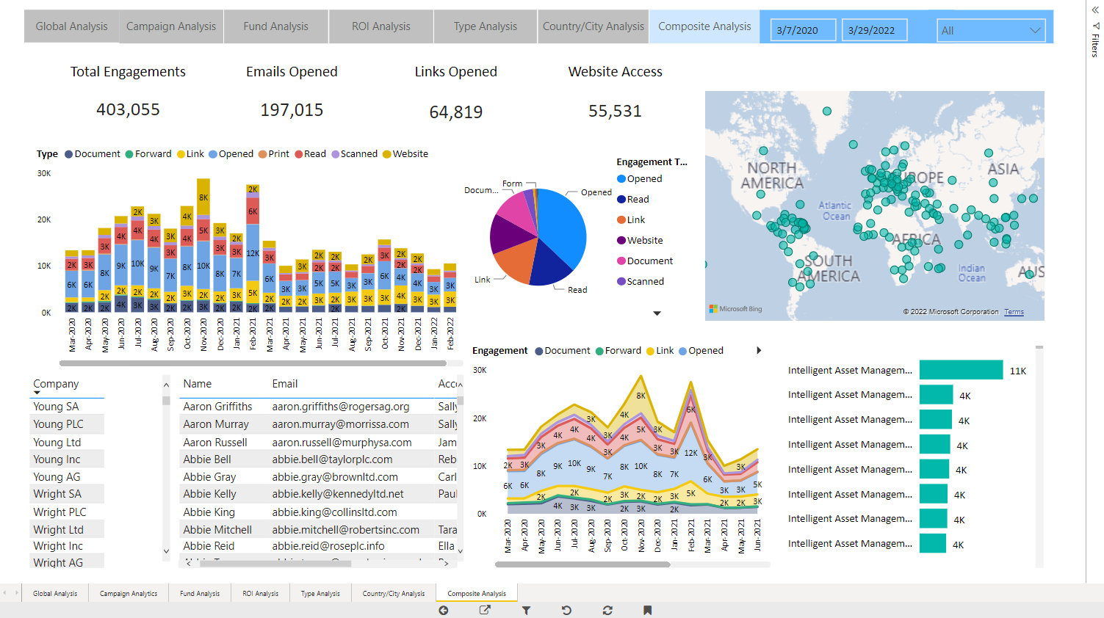
What Is Working Across All Channels?
Every Channel adds 15% inefficiency

Slide 33
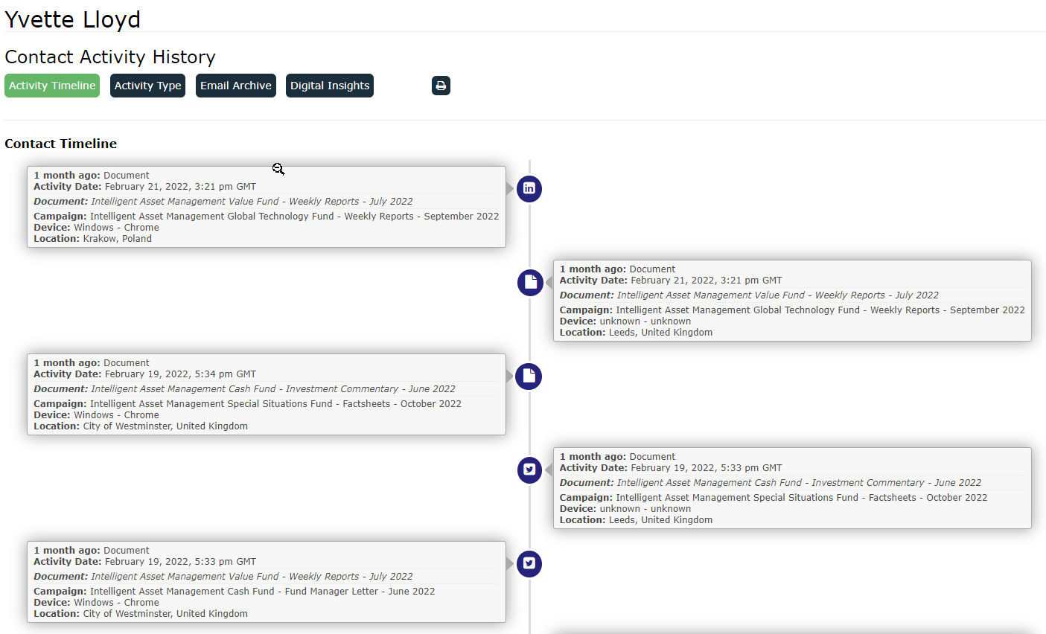
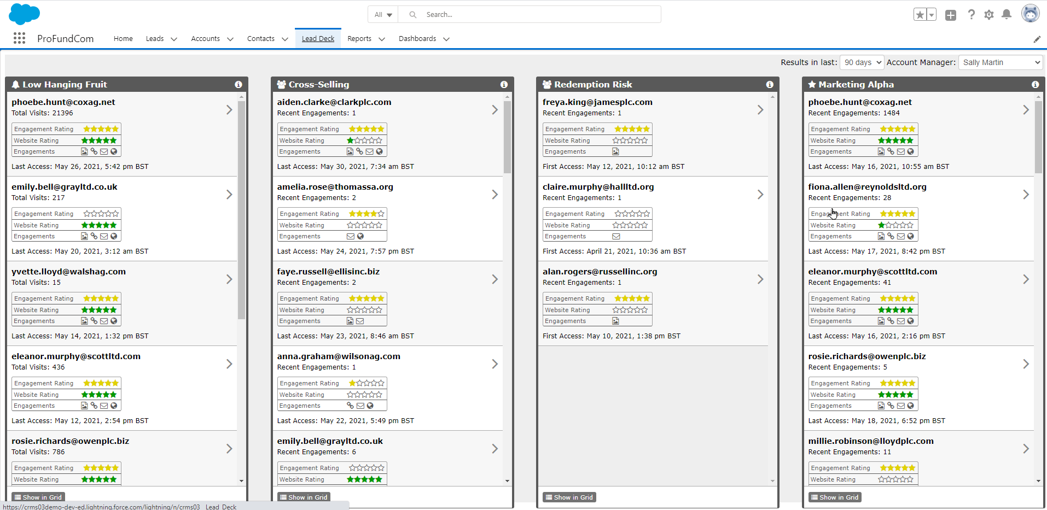
Who Are We Attracting Across All Channels
Every Channel Adds 15% Inefficiency

Slide 34
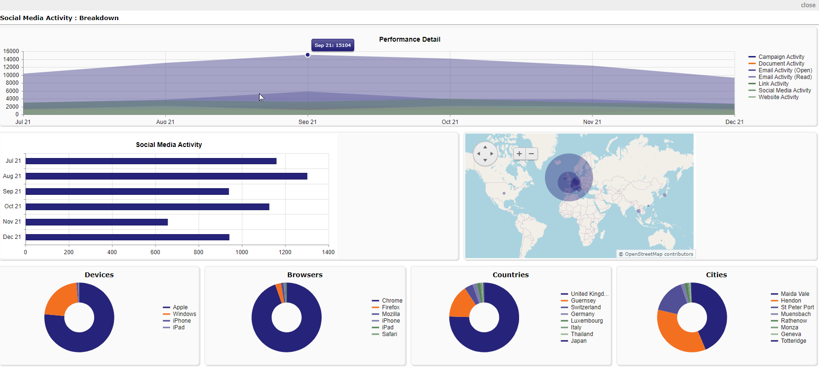
How Are All Channels Performing?
Every Channel adds 15% inefficiency

Slide 35
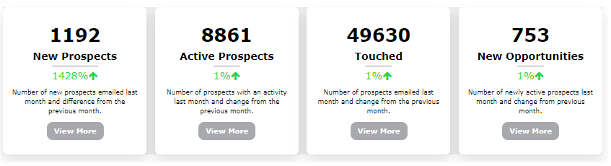
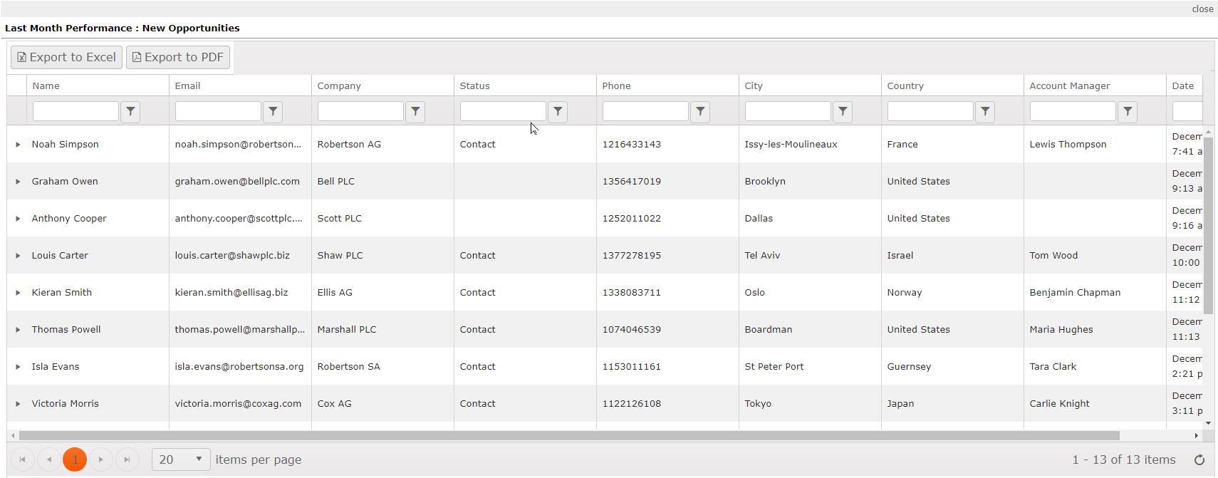
What Is the Cross-Channel ROI?
Every Channel adds 15% inefficiency

Slide 36
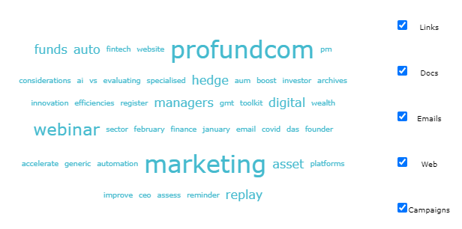
What Is Working Across All Channels?
Every Channel adds 15% inefficiency

Slide 37
Nurture Campaigns
On a Trigger the Email Sends STOP

Slide 38
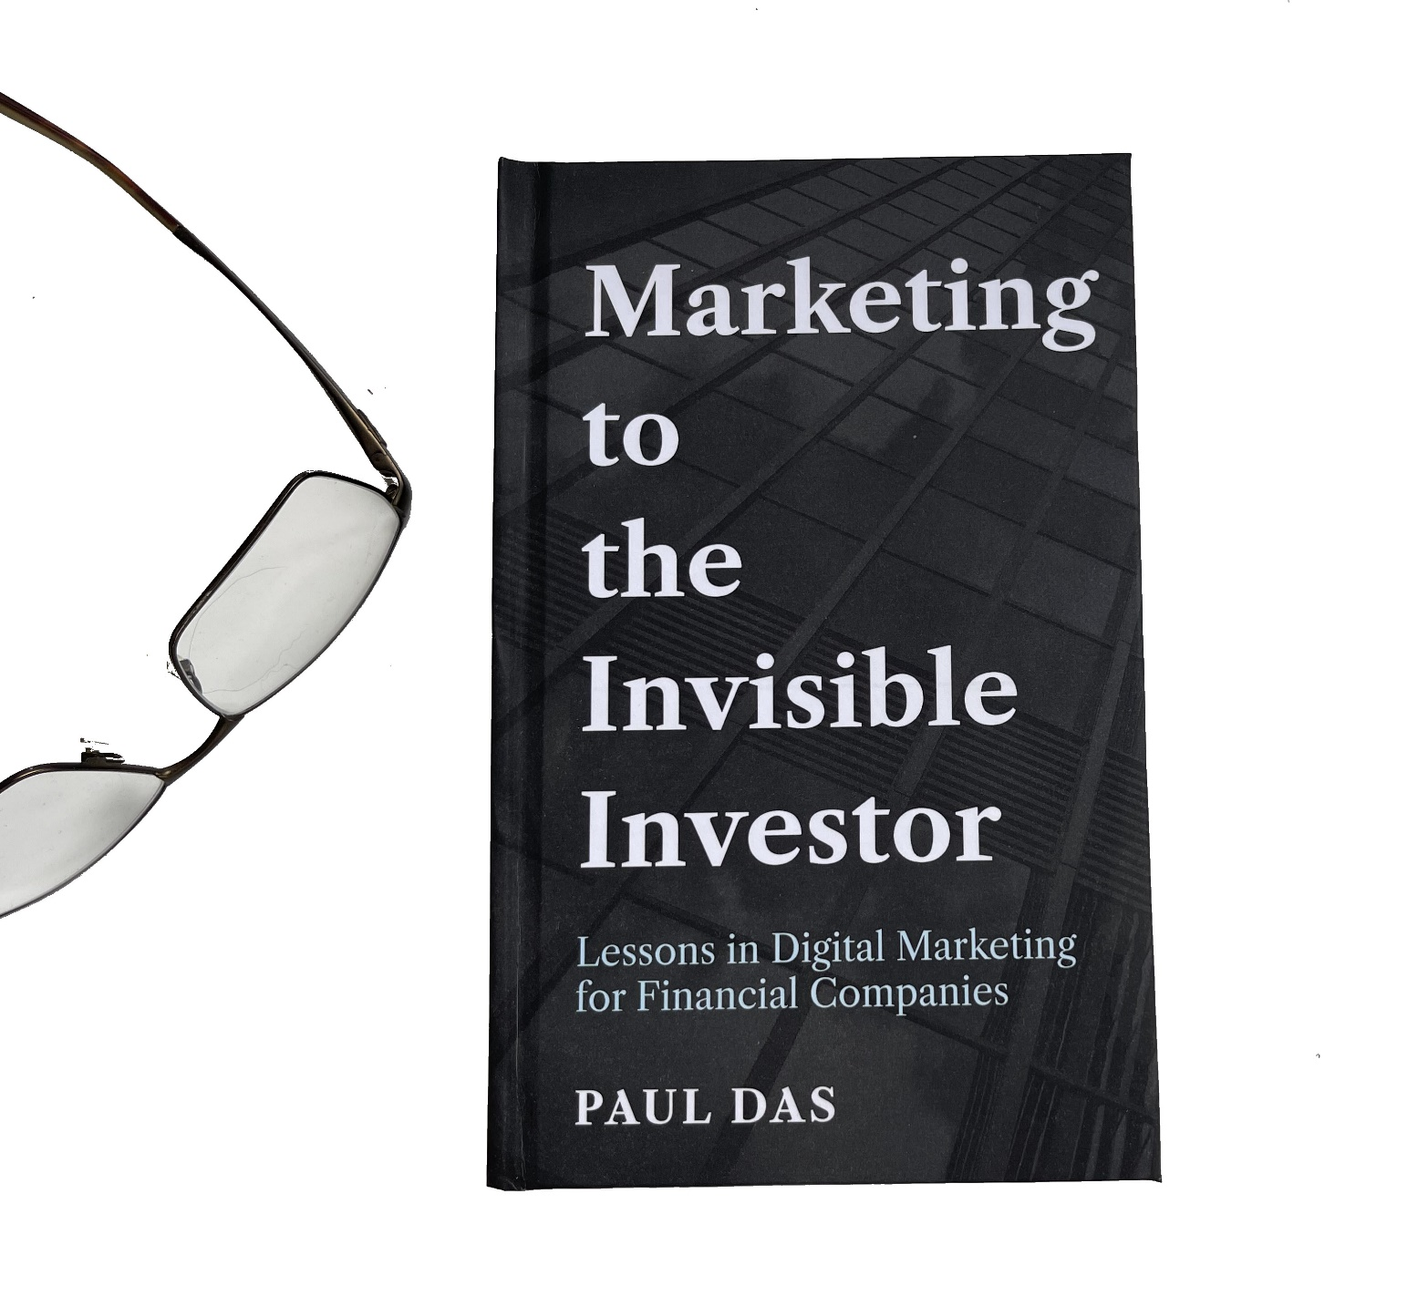
ProFundCom Consultation
Offer to Webinar Attendees
FREE 1 Hour Digital Marketing Audit & Consultation or Just Ask Nicely for the book !

Slide 39
5-Step Guide to Creating & Distributing Great Fund Marketing Content


